Slide 1
3. Mathematical Versions of
Simple Growth Models
Functional Forms
Examples of Choosing Functional Forms
Basic Theory of Econ Models
The Error Term
Notes:
6

Slide 2
3. Functional Forms
To explain and predict the relationship between variables, it is ESSENTIAL to know the correct graph or functional form.
The wrong functional form can lead to the wrong conclusion:
Notes:
6

Slide 3
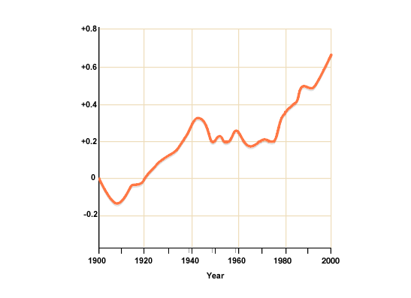
3. Global Warming and Functional Form
When viewing historical data on temperature, most people assume a positive linear relationship (overlaid in blue)
Source: BBC, http://www.bbc.co.uk/bitesize/higher/geography/physical/atmosphere/revision/2/
Notes:
6

Slide 4
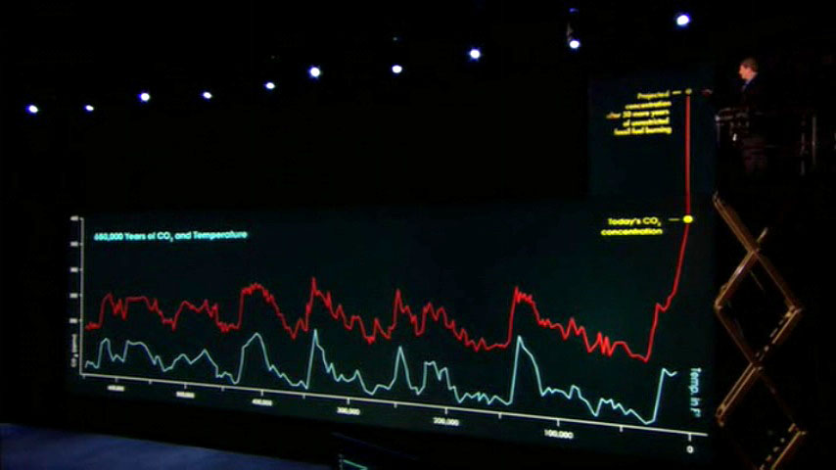
3. Global Warming and Functional Form
In his 2006 film, “An Inconvenient Truth”, Al Gore advocated a more exponential relationship:
Source: An Inconvenient Truth (2016) screen shot. Blue trend line added
Notes:
6

Slide 5
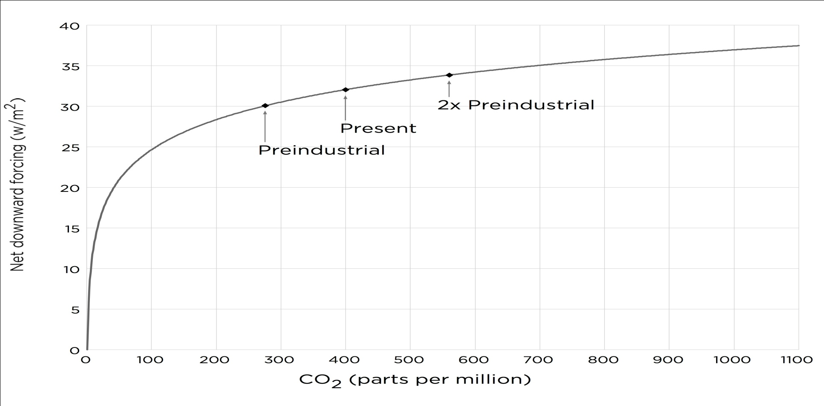
3. Global Warming and Functional Form
In laboratory settings, the pure greenhouse effect is seen to have a logarithmic relationship:
Source: Myhre et al (1988). Copied from http://www.moralcaseforfossilfuels.com/data/
Notes:
6

Slide 6
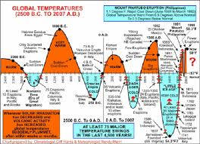
3. Global Warming and Functional Form
Other parties point out the historical cyclical nature of global temperatures:
Source: http://toadvancefreedom.com/climate-change-global-catastrophe-or-false-alarm/
Notes:
6

Slide 7
3. Global Warming and Functional Form
Different relationships between variables (different functional forms) can lead to different conclusions.
THE FUNCTIONAL FORM MATTERS!
Notes:
6

Slide 8
3.1.2.1 – Linear Functional Form
Linear:
Y_{t}= β₁ + β₂X_{t}
Constant slope: β₂
-straight line relationship
-same increase every period (β₂>0)
-same decrease every period (β₂<0)
Notes:
6

Slide 9
3.1.2.1 – Positive Linear Growth
Linear Time Trend (β₂ >0):
Notes:
6

Slide 10
3.1.2.1 – Negative Linear Growth
Linear Time Trend (β₂ <0):
Notes:
6

Slide 11
3.1.2.1 – Linear Growth Examples
Positive Slope Examples:
-Simple saving ($500/year, put into a matress)
-Age: Starting age +1 every 365.25 days
Negative Slope Example:
-40 Day Christmas countdown
Notes:
6

Slide 12
3.1.2.2 –Quadratic Functional Form
Quadratic :
Y_{t}= β₁ + β₂ X_{t} + β₃ X_{t}²
Slope: Changing (see graphs)
-U-shaped (β₃ >0) or inverted U (β₃ <0)
-negative growth, then no growth, then positive OR
-positive growth, then no growth, then negative
Notes:
6

Slide 13
3.1.2.2 U-shaped Quadratic Model
Quadratic Valley (β₃ >0):
Notes:
6

Slide 14
3.1.2.2 Inverse U Quadratic Model
Quadratic Hill (β₃ <0):
Notes:
6

Slide 15
3.1.2.2 –Quadratic Model
U-shaped Examples:
-Introvert meeting someone new: less comfortable then more comfortable
-Health care costs: highest after you are born and before you die
Inverted U-shaped Examples:
-Working out: increases health before decreasing it from overwork
-Studying late at night: Improves mark before decreasing it
Notes:
6

Slide 16
3.1.2.2 Lin-Log Functional Form
Lin-Log:
Y_{t}= β₁ + β₂ *ln(X_{t})
Slope: Changing, positive or negative according to β₂
-if β₂ is positive, increases at a decreasing rate
-if β₂ is negative, decreases at a decreasing rate
Notes:
6

Slide 17
3.1.2.2 Increasing Lin-Log Model
Lin-Log Trend (β₂ >0):
Notes:
6

Slide 18
3.1.2.2 Decreasing Lin-Log Model
Lin-Log Trend (β₂ <0):
Notes:
6

Slide 19
3.1.2.2 Reciprocal Functional Form
Reciprocal:
Y_{t}= β₁ + β₂(1/X_{t})
Slope: Changing and tricky:
-if β₂ is negative, increases at a decreasing rate
-if β₂ is positive, decreasing at a decreasing rate
-(sharper jumps than lin-log)
Notes:
6

Slide 20
3.1.2.2 Reciprocal Model
Reciprocal (β₂<0):
Notes:
6

Slide 21
3.1.2.2 Reciprocal Model
Reciprocal (β₂>0):
Notes:
6

Slide 22
3.1.2.2 Log-log Functional Form
Log-log:
ln(Y_{t})= β₁ + β₂ ln(X_{t})
Slope: Changing, positive or negative according to β₂
-shape depends on β₂ (< or >1)
-more gradual/smooth than lin-log or reciprocal
Notes:
6

Slide 23
3.1.2.2 Increasing Log-log Model
Log-log (β₂ >0):
Notes:
6

Slide 24
3.1.2.2 Slightly Increasing Log-log Model
Log-log (0< β₂ <1):
Notes:
6

Slide 25
3.1.2.2 Slightly Decreasing Log-log Model
Log-log (-1< β₂ <0):
Notes:
6

Slide 26
3.1.2.2 Decreasing Log-log Model
Log-log (β₂ <-1):
Notes:
6

Slide 27
3.1.2.2 Positive Slope Model
Examples:
-Studying: each hour yields less as you approach perfect (diminishing marginal returns)
-Pizza: Your enjoyment decreases after each piece (if enjoyment can become negative, u-shaped curve is appropriate)
-Race Dilemma: Keep running ½ of remaining distance to finishing line, never actually reaching it
Notes:
6

Slide 28
3.1.2.2 Negative Slope Models
Examples:
-Drugs: fries a lot of brain cells to start, then when your whole brain is fried, few left to fry
-Subsides: Large when you are poor, and small when you are rich
-Earthquake: Each aftershock is less than the previous
Notes:
6

Slide 29
3.1.2.2 Logistic Functional Form
Logistic:
-if all β’s are positive and β₂ > β₁, slanted-S shape
-you can create or find a functional form to model any relationship
Notes:
6

Slide 30
3.1.2.2 Logistic Model
Logistic:
Examples:
Investing in undervalued stock. Little return, then huge increase (stock realized), then little return.
Notes:
6

Slide 31
3.1.2.2 Cyclical Functional Form
Cyclical:
Y= β₁ + β₂ sin(2πX/p)
+ β₃ cos(2πX/p)
-alternating negative and positive growth
Notes:
6

Slide 32
3.1.2.2 Cyclical Model
Cyclical
Notes:
6

Slide 33
3.1.2.2 Cyclical Model
Examples:
Housing markets
Tech markets
Oil markets
Yearly seasonal markets (fruit, ice cream, etc.)
Notes:
6

Slide 34
3.2.1 Mathematical Models of Economic Relationships #1
Example 1 – Consumption Function
-consumption is based on income
-even with zero income, some consumption (autonomous consumption) occurs
-as income rises, consumption rises
-out of every new dollar earned, a fraction, the marginal propensity to consume (mpc) is spent on consumption – remainder is saved
-the mpc determines the slope of the graph
Notes:
6

Slide 35
3.2.1 Mathematical Models of Economic Relationships #1
constant slope/mpc – is this realistic?
Notes:
6

Slide 36
3.2.1 Mathematical Models of Economic Relationships #1
decreasing slope/mpc –is this realistic?
Notes:
6

Slide 37
3.2.1 Mathematical Models of Economic Relationships #1
Consumption Function – slope = mpc
Linear:
Consumption = 100+0.5income
mpc = slope = 0.5 (constant)
Non-Linear
Consumption = 100+0.95income-0.001income²
mpc = slope = (decreasing)
Are any other functional forms viable for consumption?
Notes:
6

Slide 38
3.2.2 Mathematical Models of Economic Relationships #2
Example 2 – Short-run Phillips Curve
-if no excess demand in the economy, the economy will be at the natural rate of unemployment
-if unemployment falls, wages and prices will tend upwards (hard to find workers)
-if unemployment rises, wages and prices will fall (easier to find workers)
-these changes are asymmetric (excess labour demand has a bigger effect than excess labour supply)
Notes:
6

Slide 39
3.2.2 Mathematical Models of Economic Relationships #2
Short-run Phillips Curve – lin-log function
Notes:
6

Slide 40
3.2.2 Mathematical Models of Economic Relationships #2
Example 2 – Short-run Phillips Curve
Slope = short-run response of inflation to a change in unemployment
Inflation = 5 –ln(unemployment)
Slope:
-as unemployment increases, the slope moves from very negative to slightly negative
-there is a greater effect of low unemployment than high unemployment
Notes:
6

Slide 41
3.2.3 Mathematical Models of Economic Relationships #3
Example 3 – Demand for Xbox Gamma’s
-price of new game systems is often a hot topic
-Xbox’s sell for LESS than the Playstation
-lose MORE money on system in order to make more money on more games
-all else held equal, as price decreases, quantity demand increases
-Xbox sacrificing gain on each system to sell more systems (and later sell more games)
-downward sloping demand curve
Notes:
6

Slide 42
3.2.2 Mathematical Models of Economic Relationships #3
Example 3 – Linear demand for Xbox Gamma’s
Notes:
6

Slide 43
3.2.3 Xbox Math
Note that while demand functions are generally of the form:
Since price is on the y-axis, to graph this function we need to solve for price:
But does a linear graph make the most sense? Will no one buy an expensive Xbox?
Will someone say no to a free Xbox?
Notes:
6

Slide 44
3.2.3 Mathematical Models of Economic Relationships
Example 3 – Lin-Log demand for Xbox Gamma’s
Notes:
6

Slide 45
3.2.5 Interpreting A Linear Function
Y_{t}= β₁ + β₂X
Intercept = β₁: The value of Y when X is zero
Slope = β₂: The change in Y when X increases by 1
Fun_{t}= 80 + 2Board Games_{t}
Intercept =80. When there are no board games, fun is 80.
Slope =2: When board games increase by 1, fun increases by 2.
Notes:
6

Slide 46
3.2.5 Interpreting Any Equation
Economists need to EXPLAIN MATHEMATICAL RELATIONSHIPS by explaining:
Intercepts
Slopes (first derivative)
Long-Run Effects (second derivative)
Notes:
6

Slide 47
3.2.5 Simple Example
Mark = 60 + 4 study
Mark = percentage mark on midterm
Study = hours of study (up to 10 – it’s the night before)
Parameter Explanation:
1) 60 = intercept – without studying, you’d get a 60% on the exam - you genius you!
2) 4 = coefficient of study (first derivative)– every extra hour spent studying increases your mark by 4%
Notes:
6

Slide 48
3.2.5 Simple Example
Mark = 60 + 4 study
3) D²mark/dstudy²=0, this function is a straight line; each hour of studying is equally beneficial
Notes:
6

Slide 49
3.2.5 Another Demand Example
Let q=100-p/2
Parameter Explanation:
1) The intercept (100) expresses the quantity demanded when the good is free (p=0)
2) The slope (-1/2) indicates how much q changes as p increases by 1.
3) The second derivative is zero, we have another straight line
Notes:
6

Slide 50
3.3 The error term
Although economists try to model real behavior, their attempts are not always 100% accurate, for a variety of valid reasons:
Excluded variables
Random events (shocks)
Error in data collection
Notes:
6

Slide 51

3.3 The ERROR term
To account for this, models always include an error term:
Y= β₁ + β₂ X + β₃ Z + β₄ W + Ɛ
The error term, Ɛ, accounts for all of these discrepancies. We now have an econometric model!
Notes:
6

Slide 52
3.3 The ERROR term
For a simple two variable model:
Y_{i}= β₁+ β₂X_{i}+e_{i}
Y_{i}: value of the OBSERVABLE explanatory variable for observation i
X_{i}: value of the OBSERVABLE explanatory variable for observation I
β₁ and β₂: UNOBSERVABLE parameters or coefficients of the model
e_{i:} or ε_{i} is the UNOBSERVABLE random error
Notes:
6

Slide 53
3.3 Erroneous Example 1
Iphone 7 Demand
ln(Q_{i}) = β₁ + β₂ln(P_{i}) + e_{i}
Q_{i} = Iphone 7’s sold in state/province i
P_{i} = Price of Iphone 7 in state/province i
(cross sectional data)
Error: price of Androids, price/availability of itune Aps, price of phone and data plans, shipping constraints, shift in tastes (Huge Anti-Apple Surge)
Notes:
6

Slide 54
3.3 Erroneous Example 2
Weight
Weight_{i} = β₁ + β₂ln(diet_{i}) + e_{i}
Weight_{i} = a given person’s weight
Diet = a given person’s diet
(a cross sectional study)
Error: differences in metabolism, exercise, height, liposuction
Notes:
6

Slide 55
3.3 Erroneous Example 3
Depression
Depression_{i} = β₁ + β₂Econmark_{i} + e_{i}
Depression_{i} = level of depression at any point in the course
Econmark_{i} = current econ mark
(a time series study)
Error: quality of last Walking Dead episode, social life, sport team standings, weather, success of Economics pick-up lines
Notes:
6

