Slide 1
Chapter 2: Demand and Supply
2.1 Demand
2.2 Supply
2.3 Equilibrium
2.4 Elasticity

Slide 2
2.1 Demand & Supply in Perfect Competition
Assumptions:
  a large number of buyers and sellers of a good
  everyone has full information
  no one buyer or seller has any market power; individuals are “price-takers”
Demand and Supply are simplest in a PC (perfect competition) market
Different supply and demand curves exists for every good in every location at one time

Slide 3
Demand: Definition
A schedule showing amounts that will be purchased at different prices during some specified time period, everything else held constant (ceteris paribus)
This could refer to goods and services (goods market)
This could also refer to labour and capital (factor market)

Slide 4
Demand: Origins
Demand for a good or service comes from two areas:
1) Derived Demand –desired to make something else
(ie: iron is desired to make cars)
2) Direct Demand –desired to be used/consumed itself
(ie: Pepsi Vanilla is desired to be drank)

Slide 5
The Law of Demand
There is an inverse relationship between the quantity of anything that people will want to purchase and the price they must pay to obtain it:
    ceteris paribus (all else held equal)
This causes demand curves to be downward sloping
When prices increase, people buy less
When prices decrease, people buy more

Slide 6
The Individual’s Demand Schedule
A
5
B
4
C
3
Price of Downloads ($)
D
2
Change in Price =
Movement along
the Demand
E
1
0
10
20
30
40
50
Number of Downloads per Year

Slide 7
Math Note:
We always graph P on vertical axis and Q on horizontal axis, but we write demand as Q as a function of P… If P is written as function of Q, it is called the inverse demand:
Normal Form: Q^{d}=100-2P
    Inverse form: P =50 - Q^{d}/2

Slide 8
Change A: Changes in Quantity Demanded
A change in a good’s price
  Causes
  a change in quantity demanded
  (the same thing as a movement along the same demand curve)

Slide 9
A Change in Quantity Demanded
Originally, song downloads
cost $2
5
4
Due to a tax, song downloads
increase to $3
3
Price of Downloads ($)
2
1
D₁
D₃
0
20
30
40
50
60
70
80
Quantity of Downloads Demanded

Slide 10
Change B: Shifts in Demand
A change in non-price determinants of demand (income, tastes, etc)
Causes
  a shift in demand*
*The whole demand schedule

Slide 11
A Shift in the Demand Curve
Suppose universities
outlaw the use of
Smartphones
Decrease
in Demand
Suppose the
government gives
every student an
free Smartphone
5
4
3
Price of Songs ($)
Increase
in Demand
2
1
D₁
D₂
D₃
0
20
30
40
50
60
70
80
Quantity of Songs Demanded

Slide 12
Non-Price determinants of Demand
    4) Expectations
      Future prices
      Income
      Product availability
    5) Population
    (market size)
    1) Income, wealth
    2) Tastes and preferences
    3) The price of related goods
      Complements
      Substitutes
What movement would these factors cause?

Slide 13
Shift vrs. Movement
A policy to discourage
smoking (no smoking in
public buildings) shifts
the demand curve left
A tax raises the price of
cigarettes, resulting in a
movement along the
demand curve
Price of Cigarettes, per pack
Price of Cigarettes, per pack
$4
$2
$2
D’
D
D
10
20
10
20
Number of Cigarettes
smoked per day
Number of Cigarettes
smoked per day

Slide 14
Normal vs. Inferior Goods
For normal goods,
Demand decreases
With income
For inferior goods,
Demand increases
When income decreases
Price of Kraft Dinner
Price of Chicken
$2
$2
D’
D’
D
D
10
20
10
20
30
Chicken eaten in a month
Kraft Dinner eaten
in a month

Slide 15
2.2 Supply
The amount a producer supplies depends on PROFITS, which depend on COSTS
Costs depend on
    the kinds of inputs (factors of production) used
    the amount of each input used
    prices of inputs used
    technology

Slide 16
Supply: Definition
A schedule that shows how much will be supplied at different prices for a given time period, ceteris paribus.
This could refer to goods and services (goods market)
This could also refer to labour and capital (factor market)

Slide 17
The Law of Supply
The price of a product or service and the quantity supplied are directly related, ceteris paribus
This creates an upward sloping supply curve
The higher the price of a good, the more sellers will make available
The lower the price of a good, the fewer sellers will make available

Slide 18
Change A: Change in Quantity Supplied
  A change in a good’s price
  Causes
    A change in quantity supplied.
    (This is also called a movement along the supply curve.)

Slide 19
The Individual Producer’s Supply Schedule
Downloads
Price /
Download
F
5
G
4
H
F $5 550
G 4 400
H 3 350
I 2 250
J 1 200
3
Price of Download ($)
I
2
Change in Price
Movement along
The Supply
J
1
0
100
200
300
400
500
600
Quantity of Downloads Supplied
(millions)

Slide 20
Change B: Shifts in Supply
A change in
non-price determinants
of supply
Causes
  A shift in supply

Slide 21
A Shift in the Supply Curve
When supply decreases the quantity supplied
will be less at each price:
ie: Developers form a union and successfully negotiate higher wages
5
S₂
S₁
S₂
b
a
4
When supply increases
the quantity supplied
will be greater at each
price:
ie: Producers develop a cheaper way to provide downloads.
d
c
b
3
Price of Downloads ($)
d
2
1
0
20
40
60
80
100
120
140
Quantity of Downloads

Slide 22
Non-Price Determinants of Supply
Cost of Inputs
Technology and Productivity
Taxes and Subsidies
Price Expectations (in the input market)
Number of firms in the industry
How will these shift supply?

Slide 23
2.3 Market Equilibrium
In the Market, buyers and sellers interact, resulting in a
  Single Equilibrium of
    One Equilibrium Price
    One Equilibrium Quantity

Slide 24
Putting Demand and Supply Together: Finding Market Equilibrium
(1) (2) (3) (4) (5)
Difference
Price per Quantity Supplied Quantity Demanded (2) - (3)
Download Condition
$5 100 million 20 million 80 million
4 80 million 40 million 40 million
3 60 million 60 million 0
2 40 million 80 million -40 million
1 20 million 100 million -80 million
Excess quantity
supplied (surplus)
Excess quantity
supplied (surplus)
Excess quantity
demanded (shortage)
Excess quantity
demanded (shortage)

Slide 25
Market Equilibrium: Definition
Excess quantity supplied at price $5
The condition in a market when quantity supplied equals quantity demanded at a particular price; a point from where there tends to be no movement
S
5
4
Market clearing, or
equilibrium, price
E
Q_{D}= Q_{S}
3
Price pef Downlaod ($)
2
A
B
1
D
Excess quantity demanded at price $1
0
20
40
60
80
100
Quantity of Download
(millions)

Slide 26
The Law of Supply & Demand
The price of any good will adjust until the price is such that the quantity demanded is equal to the quantity supplied
A high price will result in excess supply, pushing price down, and a low price will result in excess demand, pushing price up
    the market clears resulting in a single market clearing or equilibrium price.

Slide 27
Example: The Market for Cranberries
Q^{d} = 500 – 4p
Q^{S} = -100 + 2p
p = price of cranberries (dollars per barrel)
Q = demand or supply in millions of
barrels per year

Slide 28
    a. The equilibrium price of cranberries is calculated by equating demand to supply:
    Use equilibrium price with either demand or supply to get equilibrium quantity:

Slide 29
Example: The Market For Cranberries
Price
125
Market Supply: P = 50 + Q^{S}/2
•
P*=100
50
Market Demand: P = 125 - Q^{d}/4
Q* = 100
Quantity

Slide 30
Factor Market Example: Coffee Shop Jobs
L^{d} = 18 – W
L^{S} = -10 + W
W = Wage (the PRICE of labour)
L = Labour (full time workers, the QUANTITY of labour)

Slide 31
    a. The equilibrium wage (price) of workers is calculated by equating demand to supply:
    Use equilibrium wage (price) with either demand or supply to get equilibrium labour (quantity):

Slide 32
Example: Coffee Shop Jobs
Wage (Price of Labour)
125
Market Supply: W = 10 + L^{S}
•
W*=14
50
Market Demand: W = 18 - L^{d}
Q* = 4
L (Quantity of Labour)

Slide 33
Comparative Statics:
Shifts in Demand &/or Supply
How do you analyze a change in an exogenous variable?
1) Decide whether Demand &/or Supply is affected.
2) Decide in which direction the affected
    Demand &/or Supply will move.
3) Use a Demand and Supply diagram to determine the new equilibrium.
4) Calculate the new equilibrium.
(if possible)

Slide 34
Comparative Statics: Gas Prices
Summer 2022: Gas prices at equilibrium are $1.67 per liter
Winter arrives and people drive less (downward shift in demand)
  The new market equilibrium is $1.37 per liter
Cold Weather causes a decrease in gas prices

Slide 35
Winter Gas Prices
S
E₂
$1.67
E₁
$1.37
D₂
D₁
Q₁
Q₂

Slide 36
Simultaneous Shifts
Example of a double shift.
  2 events
    1. ↑ supply
    2. ↑ demand
only ↑ supply ↓P, ↑Q.
only ↑ demand ↑P, ↑Q.
  ↑Q is guaranteed

Slide 37
Increased Price Example
S₁
S₂
E₂
P₂
E₁
P₁
D₂
D₁
Q₁
Q₂

Slide 38
Decreased Price Example
S₁
S₂
P₁
E₁
P₂
E₂
D₁
D₂
Q₁
Q₂

Slide 39
Simultaneous Shifts
Example of a double shift.
Second possibility:
  2 events
    1. ↑ supply
    2. ↓ demand
only ↑ supply ↓P, ↑Q.
only ↓ demand ↓P, ↓Q
    ↓P is guaranteed

Slide 40
Increased Quantity Example
S₁
S₂
E₁
P₁
E₂
P₂
D₁
D₂
Q₁
Q₂

Slide 41
Decreased Quantity Example
S₁
S₂
E₁
P₁
E₂
P2
D₁
D₂
Q₁
Q₂

Slide 42
Example: The Market for Cranberries
p = price of cranberries (dollars per barrel)
Q = demand or supply in millions of
barrels per year
Assume that a plague reduced cranberry supply by 100 and fear of inflection likewise reduced cranberry demand by 100 so that:

Slide 43
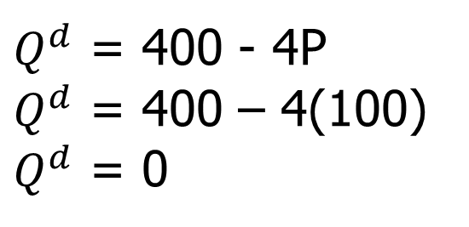
    a. The new equilibrium price of cranberries is calculated by equating demand to supply:
    Use equilibrium price with either demand or supply to get equilibrium quantity:
$Q^{d}$ = 400 - 4P
$Q^{d}$ = 400 – 4(100)
$Q^{d}$ = 0

Slide 44
Example: The Market For Cranberries
New Market Supply: P = 100 + Q^{S}/2
Price
125
Old Market Supply: P = 50 + Q^{S}/2
•
P_{OLD}=P_{New}
50
Old Market Demand: P = 125 - Q^{d}/4
Q_{New}
Q_{OLD}
Quantity
New Market Demand: P = 100 - Q^{d}/4

Slide 45
2.4 Elasticity: Percentage Change
Which makes more sense?
  GDP increases by 1.4% OR GDP increases by $2.1 Billion
  Inflation is 3.2% OR “Prices have gone up between 5 cents and $350,000”
Percentage changes are often easier to understand than the amount of change
  Economists often use elasticities to examine percentage change or responsiveness
Notes:
6

Slide 46
Price Elasticity of Demand
Price Elasticity of Demand (Є _{Q,p})
  The percent change in quantity demanded when its price increases by 1%
  Depends on:
    A) slope of demand curve
    B) location on demand curve
Notes:
6

Slide 47
Solution: Price Elasticity of Demand
Price Elasticity of Demand
Percentage change in quantity demanded
Є_{Q,P}
=
Percentage change in price
  The ratio of the two percentages is a
  number without units.
Notes:
8

Slide 48
Price Elasticity
Example
  Price of oil increases 10%
  Quantity demanded decreases 1%
When discussing the price elasticity of demand, this negative sign is often implied.
Notes:
10

Slide 49
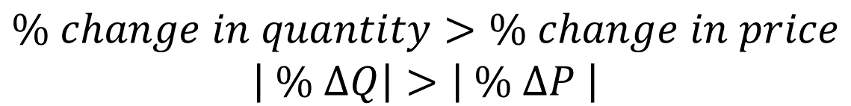
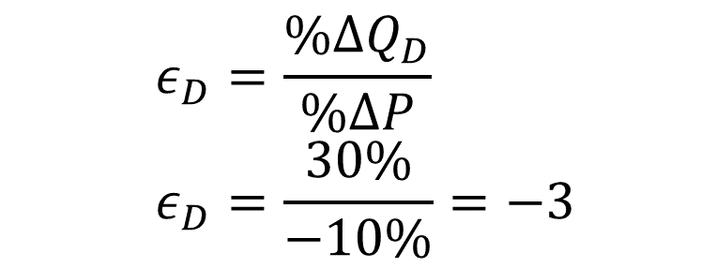
Elastic Demand: ε_{D} < -1
$$\% change in quantity>\% change in price$$
$$\left| \% ∆Q\right|>\left| \% ∆P \right|$$
Bananas:
If a 10% ↓ Price → 30% ↑ Quantity
    $$ε_{D}=\frac{\%∆Q_{D}}{\%∆P}$$
    $$ε_{D}=\frac{30\%}{−10\%}=−3$$
People are SENSITIVE to price changes.
Other examples: Chocolate bars, extra cell phone charger (most cheap items at a checkout)
Notes:
35

Slide 50

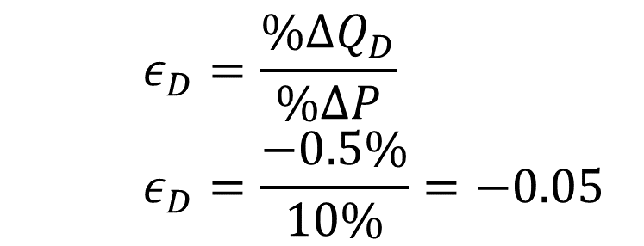
Inelastic Demand: ε_{D} > -1
$$\% change in quantity<\% change in price$$
$$\left| \% ∆Q\right|<\left| \% ∆P \right|$$
Cell phone Service:
If a 10% ↑ Price → 0.5% ↓ Quantity
    $$ε_{D}=\frac{\%∆Q_{D}}{\%∆P}$$
    $$ε_{D}=\frac{−0.5\%}{10\%}=−0.05$$
People are INSENSITIVE to price changes.
Other examples: Utilities, drugs, internet (items people need or think they need)
Notes:
35

Slide 51
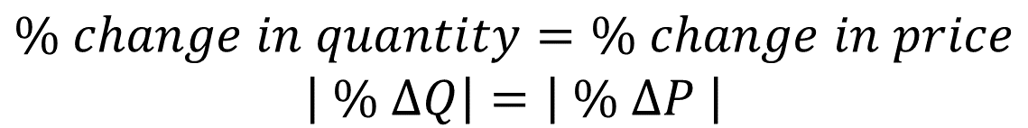
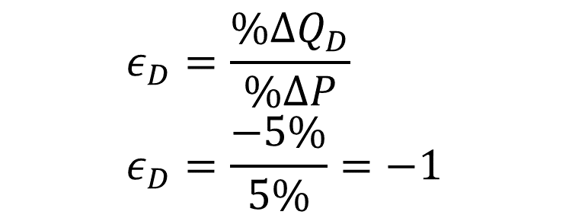
Unitary Elastic Demand: ε_{D} = -1
$$\% change in quantity=\% change in price$$
$$\left| \% ∆Q\right|=\left| \% ∆P \right|$$
Beef:
If a 5% ↑ Price → 5% ↓ Quantity
    $$ε_{D}=\frac{\%∆Q_{D}}{\%∆P}$$
    $$ε_{D}=\frac{−5\%}{5\%}=−1$$
Price elasticity of demand is exactly equal to
-1.
Notes:
35

Slide 52
Price Elasticity Ranges: Extreme Price Elasticities
D
P₁ is
the demand curve
Perfect elasticity, -Quantity drops to zero if the price increases
ε = ∞
Example:
Price of 4 quarters in change.
P₁
Perfect inelasticity,
-Quantity demanded never changes
ε = 0
Example:
Insulin
Price
$1
D
P₀
Price
0
8
0
Quantity Demanded
Quantity Demanded
Notes:
39

Slide 53
Elasticity of Demand
Calculating elasticity
Change in Q
Change in P
Є_{Q,P}
=
Sum of quantities/2
Sum of prices/2
or
Change in
Q
Change in
P
Є_{Q,P}
=
(
Q
+
Q
)/2
(
P
+
P
)/2
1
2
1
2
Always use
the mid-point
formula
Δ
Q
Δ
P
or
Є_{Q,P}
=
Avg.
Q
Avg.
P
Notes:
23

Slide 54
Elasticity: Pizza Example
Perfectly Competitive Pizza Corporation decreases the price of its pizza from $20.50 to $19.50
  As a result, pizza sales increase from 9 an hour to 11 an hour
Calculate elasticity of demand.
How does this elasticity affect revenue?

Slide 55
Calculating the Elasticity of Demand
Price (dollars/pizza)
Original
point
20.50
/Q_{ave}
2/10
Elasticity = = 4
=
/P_{ave}
1/20
ΔP=1
20.00
New
point
19.50
D
9 10 11
Quantity (pizzas/hour)
Q_{ave} =1/2(11+9)=10
P_{ave} =1/2(20.50+19.50)=20
ΔQ=2

Slide 56
Elasticity of Demand (mid-point)
Δ Q = 2
X 100
%Δ Q =20%
Q₁ + Q₂ (9 + 11)
= 10
2
20%
Є_{Q,P} =
= Є_{Q,P} =
=
4
5%
Δ P = $1.00
X 100
%Δ P =5%
P₁ + P₂ ($20.50 + $19.50)
= $20
2
Always use the mid-point formula for calculating elasticity

Slide 57
Total Revenue and Elasticity
Total Revenue
=
Price Per Good
X
# of Goods Sold
TR = P X Q
Assumption : Costs are constant

Slide 58
Elasticity and Total Revenue
1.10
Elastic
demand
.80
Unit
elastic
Price
.55
Inelastic
demand
0
Quantity
55 110
3.00
Maximum
total revenue
(dollars)
When demand
is inelastic,
price cut decreases
total revenue
Total Revenue
When demand is elastic, price cut
increases total revenue
Quantity
0 55 110

Slide 59
Relationship Between Price
Elasticity of Demand and Total Revenues
Price Elasticity Effect of Price Change
of Demand on Total Revenues (TR)
Price Price
Decrease Increase
Inelastic (Є_{Q,P} < 1) TR ↓ TR ↑
Unit-elastic (Є_{Q,P} = 1) No change No change Elastic (Є_{Q,P} > 1) TR ↑ TR ↓
Note: It is possible to classify elasticity by observing the change in revenue from a price change
Notes:
55

Slide 60
Exercise
2 drivers - Tom & Jerry each drive to to a gas station.
Before looking at the price, each places an order.
Tom says, “I’d like 10 litres of gas”.
Jerry says, “I’d like $10 of gas”.
What is each driver’s price elasticity of demand?

Slide 61
Determinants of
Price Elasticity of Demand
Existence of substitutes
  Goods are more price elastic if substitutes exist
Share of budget
  Goods are more price elastic when a consumer’s expenditure on the good is large (in dollar terms or relatively)
Necessity
  Goods are less price elastic when seen as a necessity
Notes:
58

Slide 62
Market and Brand Elasticities
Market and Brand Elasticities may not be equal
  A smoker is inelastic to the price of cigarettes (they need to smoke), but elastic to a brand of cigarettes (happy to buy another brand)
Notes:
58

Slide 63
Special Case: Linear Demand Curve
Q^{d} = a – bp
a,b are positive constants
p is price
    -b is the slope
    a/b is the choke price (price at which nothing is sold)

Slide 64
    the elasticity is
      ε_{Q,P} = (ΔQ/Δp)(p/Q)
      = -b(P/Q)
      Since the slope of the graph is –b.
      Therefore…elasticity falls from 0 to -∞ along the linear demand curve, but slope is constant.
    if Q^{d} = 400 – 10p, and p = 30,
ε_{Q,P} = (-10)(30)/(100)
ε_{Q,P} = -3 "elastic"

Slide 65
Changes in Elasticity Along a Linear Demand
1.10
1.00
Elastic (Є_{Q,P} > 1)
.90
Unit-elastic (Є_{Q,P} = 1)
.80
.70
Inelastic (Є_{Q,P} < 1)
.60
Price per Minute ($)
.50
.40
.30
.20
D
.10
0
1
2
3
4
5
6
7
8
9
10
11
Quantity per Period (billions of minutes)
Notes:
50

Slide 66
The Relationship Between Price Elasticity of Demand and
Total Revenues for Long Distance Phone Service
Quantity Total Elasticity
Price Demanded Revenue Є_{Q,P}
$1.10 0
1.00 1
.90 2
.80 3
.70 4
.60 5
.50 6
.40 7
.30 8
.20 9
.10 10
0
1.0
1.8
2.4
2.8
3.0
3.0
2.8
2.4
1.8
1.0
21.000
6.333
3.400
Elastic
2.143
1.144
1.000
Unit-elastic
.692
.467
Inelastic
.294
.158
Notes:
47

Slide 67
Special Case: Constant Elasticity Curve
Q^{d} = Ap^{ε or} ln(Q^{d})=ln(A)+ εLn(p)
ε = elasticity of demand (must be negative)
p = price
A = constant
    Elasticity is constant, but the slope of demand falls from 0 to -∞.

Slide 68
Example: A Constant Elasticity versus a Linear Demand Curve
Price
•
Observed price and quantity
P
Constant elasticity demand curve
Linear demand curve
0
Q
Quantity

Slide 69
Price Elasticity of Supply
Price Elasticity of Supply (Є _{Qs,P})
  The percent change in quantity supplied when its price increases by 1%
  Depends on:
    A) slope of supply curve
    B) location on supply curve
Notes:
6

Slide 70
Elasticity of Supply
Calculating elasticity
Change in Q
Change in P
=
Є_{Qs,P}
Sum of quantities/2
Sum of prices/2
or
Change in
Q
Change in
P
Є_{Qs,P}
=
(
Q
+
Q
)/2
(
P
+
P
)/2
1
2
1
2
Δ
Q
Δ
P
Always use
the mid-point
formula
or
Є_{Qs,P}
=
Avg.
Q
Avg.
P
Notes:
23

Slide 71
Elasticity of Supply Ranges
Perfectly Elastic Supply: ε_{S} =∞
    Quantity supplied falls to 0 when there is any decrease in price
Elastic Supply: ε_{S} > 1
    Percent change in quantity supplied is greater than percent change in price
Inelastic Supply: ε_{S} < 1
    Percent change in quantity supplied is less than percent change in price
Perfectly Inelastic Supply: ε_{S} = 0
    Quantity supplied is constant no matter what happens to price
Notes:
89

Slide 72
Supply Elasticity Ranges
S
Price
Elasticity of supply = 0
Price
Elasticity of supply =
Quantity supplied is
the same for any
price!
S
Suppliers will offer
ANY quantity at this
price
0
Quantity
0
Quantity

Slide 73
Elasticity of Supply: Depends On:
Resource substitution possibilities, -The more unique the resource, the more inelastic the supply.
Time frame for the supply decision, Momentary supply Long-run supply Short-run supply
  - Typically, the longer producers have to adjust to a price change, the more elastic is supply.

Slide 74
Long-Run Elasticity (Usually)
-For most goods, elasticity of demand is greater in the long run (curves are “flatter”)
  People are more able to adjust to changes over time (slowly switch consumption)
-For most goods, elasticity of supply is greater in the long run (curves are “flatter”)
  Firms are more able to adjust to changes over time (slowly switch production)

Slide 75
Long-Run Elasticity (Exceptions)
-For essential durable goods (ie: Cars), long-run demand elasticity is less (curves are “steeper”)
  People can use their goods longer now, but eventually they have to buy new goods as old ones break
-For reusable goods (ie: Aluminum), long-run supply elasticity is less (curves are “steeper”)
  People resell their supplies when prices go up, but eventually their supplies run out

Slide 76
Supply Elasticity and the Long Run
(most non-durable, non-essential goods)
S1 (SR)
S2
S3 (LR)
P₁
Price per Unit
P_{e}
As time passes, the
supply curve rotates
to S2 and then to S3
and quantity supplied
rises first to Q1 and
then to Q2
Q_{e}
Q1
Q2
Quantity Supplied per Period
Notes:
98

Slide 77
When is the Long Run?
The long run is how long a consumer or firm takes to fully adjust to a price change
  Time required to change ANY variable
  ie) Give up Pepsi Vanilla, Build more cost efficient Pepsi factory, secure a US Pepsi Vanilla supplier
The short run is anything shorter than the long run
  At least one variable cannot be changed

Slide 78
Cross Price Elasticity of Demand
Demand is affected by the price of substitutes and compliments
  An increase in the price of a substitute increases demand
  An increase in the price of a complement decreases demand
This effect can be measured using cross price elasticity
If the cross price elasticity is zero, the good is neither a complement nor a substitute

Slide 79
Cross Price Elasticity of Demand
Percentage change in quantity demanded of X
Є
=
Q_{i},P_{j}
Percentage change in price of Y
  Є _{Qi,Pj} = Change in X
  ---------------
  (X₁ + X₂)/2
  /
  Change in Price of Y
  ----------------------------
  (P_{y1} + P_{y2})/2
  Substitutes – Positive Cross Price Elasticity
  Complements – Negative Cross Price Elasticity
Notes:
8

Slide 80
Cross Price Elasticity of Demand Example
“Recent cat attacks have prompted cat owners to buy guns for self-defense”
Originally, 2 Econ students owned a cat. After the price of guns went from $100 to $200, only 1 Econ student owned a cat.
Calculate the cross-price elasticity of demand

Slide 81
Cross-Price Elasticity
Δ Q = -1
X 100
%Δ Q_{i} =-66%
Q₁ + Q₂ (2 + 1)
= 1.5
2
-66%
Є_{Q,P} =
= Є_{Qi,Pj} =
=
-1
66%
Δ P = $100
X 100
%Δ P_{J} =66%
P₁ + P₂ ($100 + $200)
= $150
2
Are cats and guns substitutes or compliments?

Slide 82
Income Elasticity of Demand
Income Elasticity of demand refers to a HORIZONTAL SHIFT in the demand curve resulting from an income change
Price elasticity of demand refers to a MOVEMENT ALONG THE DEMAND CURVE in response to a price change

Slide 83
Income Elasticity of Demand
Percentage change in quantity demanded
Є
=
Q,I
Percentage change in income
  Є _{Q,I}= Change in Q
  ---------------
  (Q₁ + Q₂)/2
  /
  Change in M
  ----------------------------
  (M₁ + M₂)/2
  Normal Good – Positive Shift/Elasticity
  Inferior Good – Negative Shift/Elasticity
Notes:
8

Slide 84
Income Elasticity of Demand Example
In New Zealand, the average family will own 4 Toyotas in their lifetime.
If average Kiwi family income rose from $140K to $160K a year, the average Kiwi family would own 2 Toyotas over their lifetime
Calculate Income Elasticity of Demand for Toyotas in New Zealand.
Are Toyotas normal or inferior goods in New Zealand?

Slide 85
Income Elasticity of Demand
Δ Q = -2
X 100
%Δ Q =-66%
Q₁ + Q₂ (4 + 2)
= 3
2
-66%
Є_{Q,I} =
= Є_{Qi,Pj} =
=
-5
13.3%
Δ I = $20K
X 100
%Δ I =13.3%
I₁ + I₂ ($140K + $160K)
= $150K
2
In New Zealand, are Toyotas normal or inferior goods?
Guess which brand is the luxury car.

Slide 86
Chapter 2 Key Ideas
Supply and Demand
  Supply and Demand Movements
Equilibrium
Elasticity of Demand
  Total Revenue Maximizing
Elasticity of Supply
Cross Price Elasticity of Demand
Income Elasticity

