Slide 1



Optimizing Hospital and Community-based Maternity Care for newcomer Women in Alberta
Dr Gina Higginbottom, Canada Research Chair in Ethnicity and Health, Associate Professor, Faculty of Nursing (FON), University of Alberta. Email: gina.higginbottom@ualberta.ca
Dr Beverley O’Brien, Professor, FON, University of Alberta

Slide 2
Acknowledgments
Funders of the Emerging Team Grant:
Faculty of Medicine and Dentistry, University of Alberta
Alberta Health Services
The Women and Children’s Health Research Institute
Our Thanks also to:
Multicultural Health Brokers
Tracy Kaczanowski, Alberta Health Services

Slide 3
Our Team Members
Team leader & PI: Dr Gina Higginbottom, Canada Research in Ethnicity and Health, Assoc. Professor, FON
Co-Team leader : Dr Beverley O’Brien, Professor, FON
Co investigators:
Dr Zubia Mumtaz, School of Public Health, U of A
Dr Sophie Yohani, Educational Psychology, U of A
Dr Philomena Okeke-Iherjinka, Gender Studies, U of A
Patricia Paton, Knowledge Management Consultant, AHS,
Yvonne Chiu, Multi-Cultural Health Brokers, Edmonton
Dr Elaheh Ahmadi, Family Medicine, U of A
Dr Rebecca Malhi, Post-Doctoral Researcher, U of A
Shireen Bell, RN, Researcher, U of A
Jennifer Pillay, Research Coordinator

Slide 4
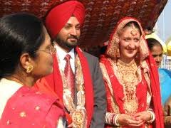

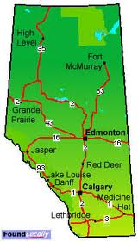


Background
Alberta is a popular destination for immigrants/refugees (i.e., newcomers) including childbearing women and their families¹
Source: Kathleen Cohen (Worldart.sjsu.edu)
Source: www.microsoft.com
Source: Kathleen Cohen (Worldart.sjsu.edu)
1. Statistics Canada [community profile- Populations]: The Canadian Statistic . [Cited 2006 Feb 25] available from: http://www12.statcan/English/profile01/details/Priont.cfm?Lang=E7&Geo1=CMA&.
Source: Kathleen Cohen (Worldart.sjsu.edu)

Slide 5
Number and share of foreign born people in Canada 1906-2006
Source: Statistics Canada: censuses of population 1906-2006

Slide 6
Region of birth of recent immigrants to Canada 1971-2006
Source: Statistics Canada: censuses of population 1906-2006

Slide 7
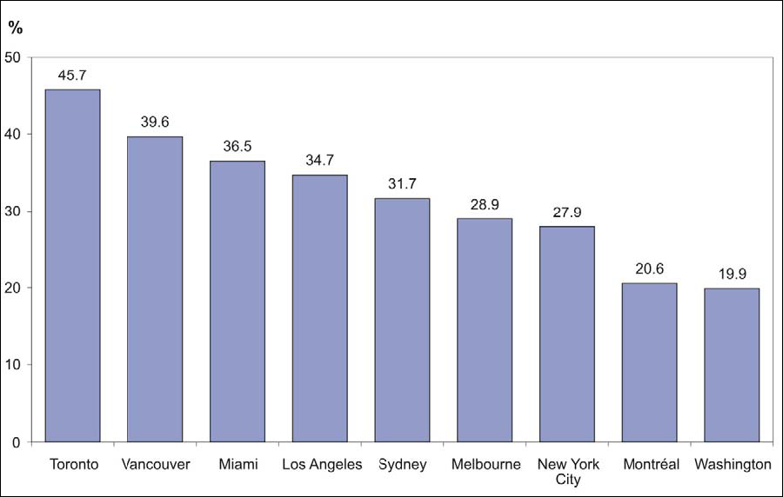
Foreign born as a percentage of the total population 2006
Sources: Statistics Canada, 2006 Census; Australian Bureau of Statistics, 2006 Census; U.S. Census Bureau,2005 American Community Survey.

Slide 8



Background
Immigrant women may have difficulty finding and using the right kind of health services, including maternity services¹
Source: www.microsoft.com
Source: www.microsoft.com
Source: Kathleen Cohen (Worldart.sjsu.edu)
1 Higginbottom GMA, Morgan M, Kenney C, Dassanayake J, Tremblay P, Chiu Y, Gabriel E, Forgeron J (2010) Immigrant and Aboriginal women’s experiences of maternity care services in Canada: A narrative synthesis. International Journal of Qualitative Methodology 9(4):472-473.

Slide 9
Background
There is evidence that newcomers have difficulty accessing and receiving culturally relevant and safe maternity care²
Potential barriers to receiving effective health care may include cultural misunderstandings, communication problems and racism ^{3, 4}
2. Desmeules, M., Gold, J., & McDermott, S. et al. (2005). Disparities in mortality among Canadian immigrants and refugees, 1980-98: results of a national cohort study. Journal of Immigrant Health, 7 (4): 221-232.
3. Vissandjee, B., Desmeules, M., Zheynuam, C., Abdool, S., & Kazanjian, A. (2004). Integrating Ethnicity and Migration as Determinants of Canadian Women’s Health. BMC Women’s health, 4 (Suppl 1):S32doi.
4. Salway S, Reime B, Higginbottom GMA, Bharj K, Chowbey P, Ertan K, Foster C, Friedrich J, Gerrish K, Kentenich H, Mumtaz Z, O’Brien B (2011) Contributions and challenges of cross-national comparative research in migration, ethnicity and health: insights from a study of maternity experiences and outcomes. BMC Public Health 11:514.

Slide 10
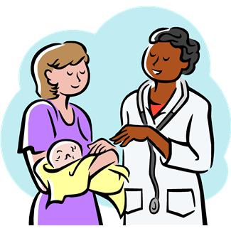
Aims
Explore the maternity experiences of newcomer women:
who have lived in Canada for less than 5 years and
who have had a child in Alberta within the last 2 years
Source: www.microsoft.com

Slide 11
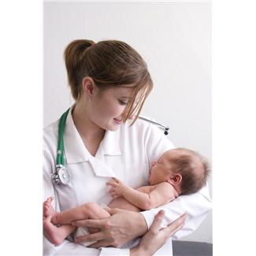
Aims
Explore views of social service providers, policy makers and health professionals in addressing perceived disparities in maternity care
Source: www.microsoft.com

Slide 12
Research Questions
How do immigrant/refugee (newcomer) women experience maternity care in Alberta?
What patterns of maternity care are available for newcomer women?
What maternal characteristics may affect their care?
How do issues of exclusion, cultural values, gender communication and socioeconomic disadvantage interrelate and shape women’s health outcomes?

Slide 13
Research Questions
How do service delivery models and other dimensions of the healthcare setting affect women’s receipt of maternity care and associated levels of satisfaction?
Do immigrant/minority women experience discrimination (or positive integration) related to their country of origin, ethnicity, or religion? In what form?
How do immigrant women and their communities respond to barriers to accessing health services and health-promoting resources?
What culturally-based and community-oriented models and practices currently exist that support and sustain the health of immigrant women?.

Slide 14


Two Locations
Edmonton
Brooks
Source: City of Edmonton (www.edmonton.ca)
Source: City of Brooks (www.brooks.ca)

Slide 15
Locations
Edmonton
Total Population: 1,155, 400¹
Immigrant Population: 189, 775
Percentage of Total Population: 20.9%
Key Immigration Regions: Asia, Middle East, Europe
Visible Minority Population: 175, 295
Visible minority communities: Chinese, South Asian, Black
Brooks:
Total Population: 13,581²
Visible Minority Population: 2,135¹
Percentage of Total Population: ≈17%
Source countries for immigration to Brooks: Ethiopia, Sudan, Somalia, Burundi, Democratic Republic of Congo, Afghanistan, Pakistan and China
Percentage of immigrant population with basic/no fluency in English: 75-80%
Unique demographic profile and challenge for health care provision
¹ Source: Statistics Canada (2010) Downloaded from http://www40.statcan.ca/101/met01/met105-eng.htm
² Source: Alberta Municipal Affairs , City of Brooks (2010)

Slide 16
Methodology
Mixed methodological approach used to:
Generate new understandings of the processes perpetuating disadvantage and potential interventions to improve maternity experiences and outcomes of women
Provide generic theoretical and practical insights of how health systems can promote better health care outcomes for immigrants
Quantitative Research:
Secondary statistical analysis of data arising from the Canadian Maternity Experiences Survey. Additional data may also be derived from provincial health data bases and analysed to facilitate contextualisation of findings
Qualitative Research:
Focused Ethnography^{5,6} to frame research questions, as it is a suitable method to explore distinct groups of people within complex societies and uncovering underlying power relationships within a culture which may influence health care practices, opportunities and care related decisions.
5 Knoblauch, H. (2005). Focused Ethnography. Forum: Qualitative Social Research, 6(3). Art 44, ISSN: 1438-5627.
6 Wood, M.J, & Ross-Kerr, J.C. (2011). Focused Ethnography, Basic Steps in Planning Nursing Research From Question to Proposal (7th ed.). Jones & Bartlelt Publishers, Canada, p. 310-327.

Slide 17
Data Collection/Analysis
Data Collection: Semi-structured interviews with individual participants and focus groups
Data obtained for 45 participants in Edmonton
We are collecting data in Brooks and have conducted 31 interviews with newcomer women, policy makers, health professionals and social service providers.
Data Analysis:
We are using an appropriate framework for analysis of ethnographic data (Roper & Shapira, 2002) ⁷
Atlas.ti© 6.0, a qualitative data analysis software package, is used for data storage and management
⁷ Roper, J., & Shapira, J. (2002). Ethnography in Nursing Research: MNR Methods in Nursing Research. London: Sage

Slide 18
Participants
22 immigrant newcomer women residing in Edmonton, Alberta
Ethnic origins: Sudanese, Chinese, South Asian, Columbian, Tajikistan
16 maternity care providers
Nurses, administrators, midwives, family physicians, special programs (e.g. Best Babies), obstetricians, etc.
5 social services providers and 2 policy makers
Psychologists, Settlement support, human rights lawyer, multicultural officer, etc.

Slide 19
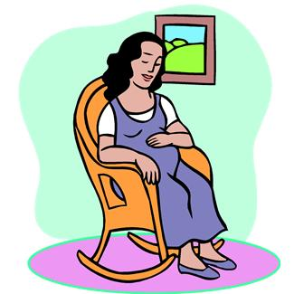
RQ 1: How do immigrant/refugee (newcomer) women experience maternity care in Alberta?
Source: www.microsoft.com

Slide 20
Preliminary Findings
Lack of choice
Newcomer women usually give birth in hospital settings and are delivered by physicians (as are most Canadians)
Most newcomer women do not know about alternative maternity services (e.g. midwives)
Health professionals and community organizations also lack information about alternative maternity services

Slide 21
Preliminary Findings
Navigation of the System
Information may not be available in their language
Newcomer women often are unsure about how to navigate the system
...Mainly they come here asking, “Okay, now what is what I have to do? What do I have to expect?” Because they go to the doctor and no one tells them. Just everyone assumes that they know because everyone in Canada knows what happens when you go to the hospital, right? (Participant 1, settlement support)
Even up to now I know so many people cannot speak English here and they have a lot of trouble. Some, yeah, immigrants and the refugees, special refugees, so they cannot speak English. They even cannot just find exactly the place (to learn). They know nothing. (Participant 7, newcomer woman)

Slide 22
Preliminary Findings
Transportation
Newcomer women may have difficulty getting to appointments or pre-natal classes – having small children with them, bus schedules, expense, etc.
Expensive medication
Newcomer women may not be able to afford certain medications that are prescribed

Slide 23
Preliminary Findings
Engagement with care providers : differing norms can result in tensions between health professionals and newcomer patients
punctuality
showing up for appointments
duration of appointment
Concepts around “normal” birth
What is “normal” birth?
C-sections
Induction of labour
Pain control options (epidural)
Delivery positions

Slide 24
Preliminary Findings
Engagement with care providers:
Many newcomers don’t feel able to complain because health care is free
Need for care providers to have cultural sensitivity
...Ensuring that we have adequate training....I mean if you don’t know what the genocide in Rwanda was about at all and you meet a Rwandan woman who’s experiencing post traumatic stress disorder and, you know, put pregnancy and childbirth on top of that, how are you ever going to - I mean just the scenario is nightmarish and it has the potential to put someone through trauma all over again. (Participant 2, policy maker, health promotion)

Slide 25

RQ 4: How do issues of exclusion, cultural norms and values, gender, communication difficulties and socioeconomic disadvantage interrelate and shape women’s health outcomes?
Source: www.microsoft.com

Slide 26
Preliminary Findings
Interactions in the Healthcare system can be made difficult because of communication problems (the most frequently mentioned issue)
Newcomer women
Medical terms are confusing
Canadians speak very fast for new language learners
Language differences increase time of visit
Even women who speak English may have trouble when they are stressed (e.g. when in labour)

Slide 27
Preliminary Findings
When they talk about some special terms about medical, I don’t understand (Participant 7, newcomer woman)
That is what I found. It’s English, even it’s understandable to me but it’s very fast, the line is so fast compared to (pause), so if you don’t get it, you don’t catch it all, then, “Can you come again please, what you want exactly or what you’re asking about.” (Participant 8, newcomer woman)
They treat you very well but you don’t understand what they are doing and they don’t – [I:Talk to you?]… Yeah.
(Participant 11, newcomer woman)

Slide 28
Preliminary Findings
Health Professionals
Inadequate informed consent
Relaying complex information (genetic tests, family planning, etc.)
It’s one thing to understand the tests that you’re providing somebody, but then to break it down to somebody who doesn’t understand English and then who doesn’t understand biology and chromosomes, you have to guess whether or not sometimes you think they’ve understood or comprehended. (Participant 44, obstetrician)

Slide 29
Preliminary Findings
Social Services Providers
Inability to communicate is frustrating and traumatic for newcomer women
...Just recognizing that some of those women have experienced trauma and, you know, when you’re unwell or when you’re dealing with childbirth it’s really important to have somebody who speaks your language. (Participant 2, policy maker, health promotion)

Slide 30
Preliminary Findings
Issues with interpreters
Lack of interpreters, especially after-hours
Interpreters may not be familiar with health issues
Concerns about confidentiality and modesty
Dependence on family members for interpretation – which may lead to a change in family dynamics

Slide 31
…Perhaps one might have something… something like an illness or something. Just by one having a third person knowing, or how at that moment of the delivery, - you are almost naked- and having a third person come and see what they are doing to you. For me, it is uncomfortable! (Participant 23, newcomer woman)
In the middle of the night you’ll randomly hear the operator saying, “If anybody speaks such and such a language, please contact.” So it’s obviously not just our ward that’s in need of it…Sadly you have people bringing their seven-year-old to interpret. (Participant 44, obstetrician)
...When you use your kids, your own kids as the interpreters for Social Services, for anything, and for health in particular because it’s an intimate thing, it’s a more private thing, it creates - instead of the parents being respected with authority, you reverse that pyramid and you have the kids taking control and saying, “You don’t know anything. I have to do this for you.” (Participant 4, settlement support)

Slide 32
Preliminary Findings
Lack of Social Support
Many newcomer women miss the social support that they receive in their country of origin
They experience social isolation and depression
Increased workload post-partum
…Sometimes just after three days if you come from hospital you have to go to shopping right away to buy food and you have to cook right away and help yourself if you have kids and you help him too and you help your family. ... You feel sad. Sometimes you start crying. (Participant 3, newcomer woman)
So if it is, I don’t know, that their baby’s having just a bad day and he’s crying and you don’t what to do because it’s your first kid and you have no social support around you, then what can the health care system do for you? (Participant 1, settlement support)

Slide 33
Preliminary Findings
Cultural Norms
In patriarchal societies, men or older female relatives may make decisions about women’s health
Women may feel discomfort and shame with male doctors
But when I went for my visit I felt SO uneasy the first visit. Because we Indians are always so attached to only our husband so our whole, our soul, our body, everything, it’s only for him. Except his two eyes can see me, no one can see, no one knows about anything of my inside part. So it makes us insecure and a little shame when a man is seeing... But the very first visit I was so uncomfortable just with my tears in my eyes. (Participant 8, newcomer woman)

Slide 34
Preliminary Findings
Exclusion – immigrant and newcomer women may face racial profiling and stereotyping
You see the person walk in, you get the racial blocking right away. “Oh, my gosh, there she is, she’s got her head covered, she’s black, she’s going to be a problem. Because we’re not going to be able to talk to her, she’s going to refuse things, what are we going to do?” (Participant 21, physician)
...She said, “Please don’t tell the doctor that this is my ninth child,” and so the counsellor said, “Why?” “Because they tell you in the hospitals, they tell you not to do that. It’s bad.” I mean this is broken English that she was speaking, but she obviously have, whether they told her or not, what she has felt is that it’s not a good thing. (Participant 4, settlement support)

Slide 35
Implications
Many of the issues that participants viewed as negatively affecting maternal outcomes are inter-related
e.g. newcomer women who are not fluent in speaking English may experience social isolation and depression
Communication difficulties challenge health care professionals to accurately assess the care needs of newcomer women and evaluate quality outcomes for newcomer women
There are service gaps that newcomer women, health professionals, policy makers and social services providers have identified
e.g. lack of social support, postpartum depression
For optimal physical and mental maternal health, such issues need to be addressed in a holistic way by the stakeholders involved

Slide 36
Thank you

