Slide 1
Ethnicity, Ethnic Identity and Integration: Some Reflections on the Adaptation Process of Immigrant Descendants
Dan Cui
University of Alberta

Slide 2
Outline
The Research Project on Chinese Canadian Youth in Alberta
Theoretical Frameworks and Literature Review
Findings
Conclusion

Slide 3
The Research Project on Chinese Canadian Youth in Alberta
Research Question
What are the adaptation or lived experiences of Chinese Canadian Youth in Alberta? How do they construct identities and negotiate sense of belongings?
Sub-question: What is the relationship between ethnic culture, ethnic identity and integration?
Research Design
Thirty-six first and second generation Chinese Canadian youth were interviewed in Edmonton and Calgary aged between 15-25.

Slide 4
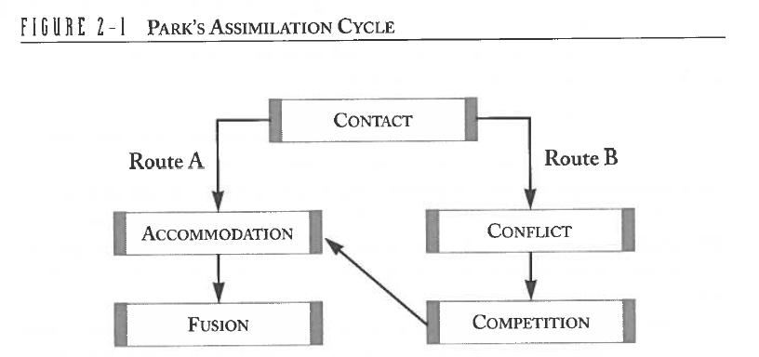
Models on Immigrant Adaptation
The Chicago School and the Assimilation Theory (Park, 1950)
(Driedger, 1996, p. 27)

Slide 5
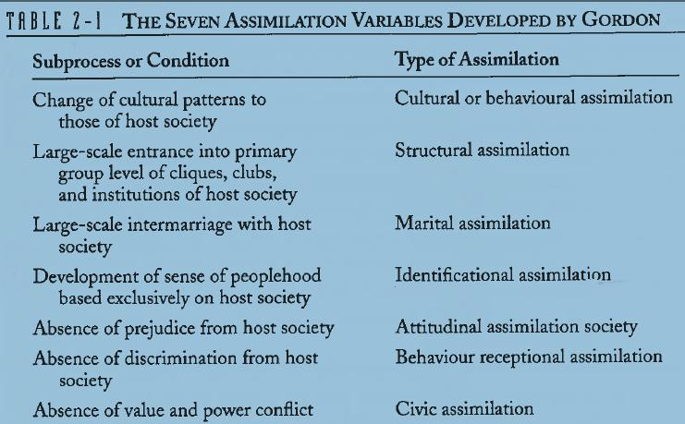
Models on Immigrant Adaptation
A Multi-dimensional Assimilation Model
(Gordon, 1964)
(Driedger, 1996, p. 32)

Slide 6
Models on Immigrant Adaptation
A Bumpy-line Approach (Gans, 1992)
The Segmented Assimilation Model (Portes & Zhou, 1993)

Slide 7
Approaches to Ethnic Identity
Ethnic identity retention across generations, esp in relation to assimilation (2nd G rebels, 3rd G returns)
Gans: symbolic ethnicity (not returns, a new form of assimilation)
The relationship between ethnicity and incorporation is not zero sum (Breton, Isajiw, Kalbach, & Reitz, 1990)
Wilkinson (2008) national identity and ethnic identity
Frideres & Goldenberg (1982) Ethnic identification related to instrumental concerns.

Slide 8
Isajiw (1990)
External or behavioral aspects of ethnic identity
1) ethnic language retention
2) ethnic friends
3) participation in ethnic group functions
4) ethnic media (ethnic radio, television, pre)
5) ethnic tradition (ethnic food, holiday
Internal aspects of ethnic identity
1) the cognitive aspect: self-identification
2) the moral aspect: ethnic group obligations (marry in group, support group needs, ask children to learn ethnic language)
3) the affective aspect: attachment to the group

Slide 9
Driedger (1996)
Cultural identity index
1. Religious practice
2) Endogamy
3) Ethnic language use
4) Ethnic organization participation
5) Attendance in parochial schools
6) Choice of ethnic friends

Slide 10
Li (1999, 2001)
For Li (1999) , “equating ethnicity with culture is not only presumptuous but also leads to blaming the victims for their own woes by attributing their problems, which in many instances, are caused by societal forces, to their supposed culture deficiencies”(p. 4-5).
Ethnicity shouldn’t be examined as ethnic identity but unequal power relations among different groups.

Slide 11
Stuart Hall (1990, 1996)
Hall notes again that cultural identity is not “an already accomplished fact” but “a ‘production’ which is never complete, always in process” (p. 222)
“…between different positions; that draw on different cultural traditions at the same time; and that are the product of those complicated crossovers and cultural mixes that are increasingly common in a globalized world” (p. 310).

Slide 12
Findings
1. Can we assume that first generation has a larger extent of ethnic cultural maintenance than the second generation?

Slide 13
Generation and Ethnic Culture Maintenance
 | CB or Age of Arrival | EL | Bilingual school | Friend | Website | Music | TV Movie | Food | Ask children to learn Chinese | Self- identification
M2 | 13 | C | Y | N/Y | N | N | N | N | N/A | Canadian
M14 | CB | C/d | Y | Y | Y% | N | Y | Y | Y | Chinese Canadian

Slide 14
Findings
2. Can we interpret these behaviors as a personal preference or choice? What are the factors that contribute to their varying degree of ethnic cultural maintenance?

Slide 15
Restricted by Social Conditions
Small Town and School Resources
Like I would say I have younger cousins and they live in a small town out of Edmonton and so they have no bilingual program and because their parents worked all the time, they didn’t have much of an opportunity to speak Chinese with them. Even now, they’ve moved back to Edmonton and they take Chinese on weekends but they speak English predominantly at home and their Chinese culture has kind of dropped off and they associate themselves as just Canadian. They don’t really talk to Asian people and they aren’t in bilingual program and they don’t even take Chinese at school. So they really associate with all the Canadian Caucasian people. (M14)

Slide 16
By Contrast …
M14 enrolled in Bilingual School, AC & IB Program. Friends
…your friends play a big role because I hang out with Asian people. I hang out with Chinese people. Sometimes we speak Chinese together…not that often but we do. (M14)

Slide 17
Factors
Family
I watch (movies in Chinese)…now my skills in Mandarin aren’t that great so primarily we watch Cantonese shows at home and there are those shows that are on every day on the Fairchild channel 6:00 and 7:00. So at least two hours of TV a day actually. (M14)

Slide 18
Restricted by Social Conditions
School Context
Senior high was where my group of friends began to change. I started having more Asian friends. The main reason for that is because Old Scona is such a small school that’s concentrated with East Indian students and Asian students and Caucasian students are basically a minority there. It was pretty hard to find a Caucasian friend so I just had to make do with what was available (M9)

Slide 19
Factors
Family resources – music
I: Do you still listen to Chinese music or watch Chinese movies?
M2: No I don’t watch any of that right now. Actually I wasn’t big on those to begin with so I moved here and I only had 56K internet…not like now there’s YouTube and you can download stuff very easily with high speed. I just never really kept up to it and the songs I knew were still really from when I was in China. I didn’t learn anything new. The three weeks when I went back, we went to karaoke and I tried really hard to dig up something that I knew…

Slide 20
Factors
Travel back
I remember when I was in grade 8, after I came back from China last time, I was very, very interested in building my Chineseness. I felt when I went back, I really liked my relatives. I felt a little…not embarrassed but I felt like my Chinese wasn’t good and I wanted to make my Chinese better. When I came back in grade 8 I felt like I really wanted to become more Chinese. At that point, I stopped listening to Western music completely for two years I always downloaded Chinese…like (Chinese singer’s names) S-H-E. F-I-R. Really intense I was downloading all the newest albums and stuff like that and try to learn to sing it and learn the words and stuff like that. But then in about grade 10 or 11 I was kind of like the Chinese is nice but I don’t mind Western music so I started listening to Western music again and now I don’t download Chinese music anymore. If you look at my iPod, maybe a third of the songs are Asian music or Chinese, Korean, Japanese but the rest is all White, English music (M7)

Slide 21
Findings
3. When youth identify themselves as Canadian, do they mean the same thing?

Slide 22
“I am Canadian”
M2: I like to identify myself as just Canadian because I’ve pretty much lived the same life as everyone else I work with but I can’t really control what they think of me right so obviously I’m still visible…definitely visible minority. I try to…everything I do I think I’m fairly Canadian.
I: You don’t actually identify yourself as Chinese Canadian or Canadian Chinese?
M2: I just like to be treated like anyone else. That’s all I ask for. I don’t need to be held in a weaker or stronger standard than anyone else.

Slide 23
“ I am Chinese but …”
Like if anybody stepped up to me now and asked me oh what ethic background are you from? It’s unlikely I would say Canadian because you kind of assume that being in Canada that you’d be Canadian so I say Chinese but I mean when somebody asks you your ethnic background or whatever, I don’t really do a lot of Chinese things and the customs have kind of dropped off through the generations. My mom doesn’t do a lot of the Asian customs are home like the incense burning and the paper burning and those kind of traditions. My grandma will do them, my grandparents will do them but my mom doesn’t do it anymore. The chances of me doing that are probably very slim

Slide 24
Findings
4. How should we understand the relationship between one’s ethnic identity and sense of belonging?

Slide 25
“Although I am Canadian but…”
Connection with China
It’s always going to be there for sure. When I hear news that portrays China in favorably I feel pretty bad because I feel the culture…I don’t know the news outlets they just want to sell the news, create a sense of urgency and whatnot. Sometimes China becomes the target unlucky just in a bad place. I still feel that way and obviously none of my friends really share that…

Slide 26
Conclusion
One’s generation status may not be an accurate indicator for the salience of ethnic identity.
The behavioral and internal aspects of ethnic identity are not fixed but kept changing.
To what extent ethnic culture can be maintained is not simply based on personal choices but restricted by many inter-related factors under specific social conditions.
Ethnic identity is not equivalent to ethnic culture.
One’s self-identification does not mean the same thing as one’s belonging or attachment to a certain group, given the divergent assumptions youth have on the “Canadian” identification.

