Slide 1
Federal and Provincial Immigration Policy and Housing Outcomes Presentation by Tom Carter To Prairie Metropolis and Beyond Edmonton Alberta November 5th 2011
Prepared by: Tom Carter
Carter Research Associates Inc.

Slide 2
Presentation Objectives
Brief overview of housing policy
Immigration trends
Market specifics
Housing challenges
Key questions for government
Community readiness
What can successful partnerships do?
Prepared by: Tom Carter
Carter Research Associates Inc.

Slide 3
Recent Housing Policy Characteristics
Reduced funding for low income social/public housing
Some assistance for “affordable housing”
More emphasis on homelessness
Greater emphasis on energy upgrading
Devolution of more responsibility to the provinces
Provincial reluctance to make up the federal reductions
A mismatch between immigration and housing policy
Prepared by: Tom Carter
Carter Research Associates Inc.

Slide 4
The Perfect Housing Storm
Prepared by: Tom Carter
Carter Research Associates Inc.

Slide 5
Arrival of Immigrants, Temporary Foreign Workers
and Foreign Students: Saskatchewan - 2000-2010
Prepared by: Tom Carter
Carter Research Associates Inc.
*Resident in the Province as of December 1st each year
Source: Citizenship and Immigration Canada

Slide 6
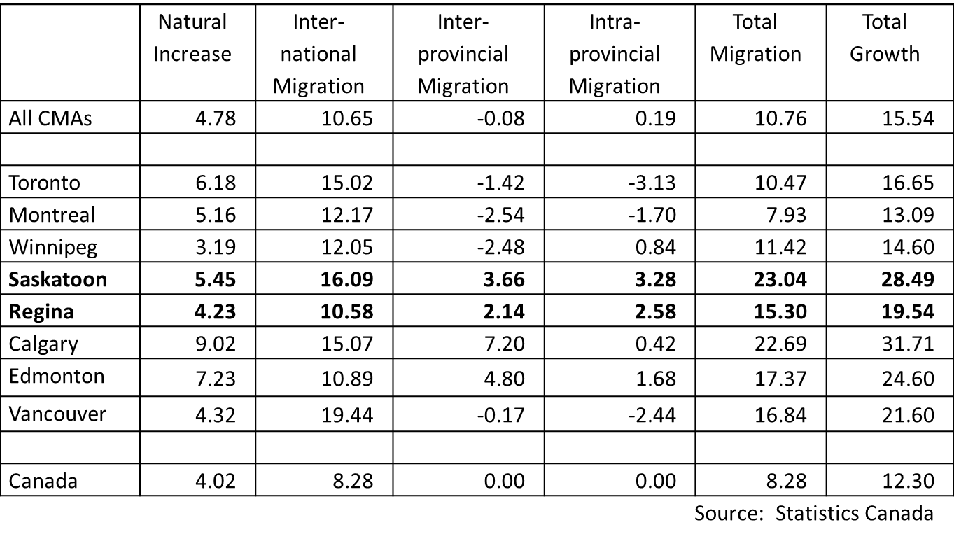
Demographic Growth Factors by Selected Metropolitan Areas 2008/2009 (Rates per Thousand)
Prepared by: Tom Carter
Carter Research Associates Inc.

Slide 7
Immigration to Winkler
 | 1996 | 2001 | 2006
Population | 7,241 | 7,943 | 9,106
% Change |  | 9.7 | 14.6
Immigrants destined to Winkler
1999 – 2005 |  | 2,433
% 2001 Population |  | 31
2006 – 2010 |  |  | 3,375
% 2006 Population |  |  | 37
Source: Statistics Canada and Manitoba Labour and Immigration
Prepared by: Tom Carter
Carter Research Associates Inc.

Slide 8
Starts by Intended Market – Freehold and Condominium Share:
Saskatchewan 2006 – 2010
Source: CMHC Canadian Housing Observer 2010
Prepared by: Tom Carter
Carter Research Associates Inc.

Slide 9
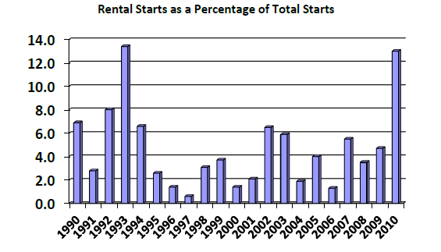
Housing Starts by Intended Market 1990-2010 Saskatchewan Urban Centres
Prepared by: Tom Carter
Carter Research Associates Inc.

Slide 10
Rental Rate Increases for Saskatchewan Centres
2005 – 2011 (2 bedroom units)
 | 2005 $ | 2011 $ | Percentage Change %
Saskatoon | 584 | 936 | 60
Regina | 607 | 897 | 48
Moose Jaw | 551 | 741 | 34
Estevan | 549 | 956 | 74
Lloydminster | 636 | 885 | 39
North Battleford | 460 | 734 | 60
Prince Albert | 525 | 763 | 45
Swift Current | 470 | 668 | 42
Yorkton | 475 | 721 | 52
Source: CMHC Rental Statistics 2011
Prepared by: Tom Carter
Carter Research Associates Inc.

Slide 11
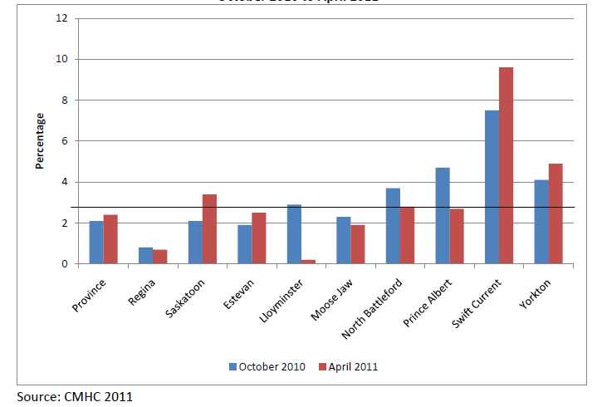
Saskatchewan Vacancy Rate Changes
October 2010 to April 2011
Source: CMHC 2011
Prepared by: Tom Carter
Carter Research Associates Inc.

Slide 12
Whither the Rental Market?
The rental inventory is declining
The age groups most likely to rent are declining
Seniors are turning to other options
Low interest rates have facilitated a shift to ownership
Investors can make better returns in other areas
Prepared by: Tom Carter
Carter Research Associates Inc.

Slide 13
Whither the Rental Market? (cont’d)
Changes to the income tax regulations have made rental investments less attractive
The cost of new construction and operating costs have pushed rents in new construction beyond the ability of many people to pay
Investing in the rental sector is not viewed as a positive place to put one’s money.
Prepared by: Tom Carter
Carter Research Associates Inc.

Slide 14
Consumer Price Index – Saskatchewan
2006 – 2010
 | 2006 | 2007 | 2008 | 2009 | 2010 | 2006-2010
All Items | 2.1 | 2.8 | 3.3 | 1.0 | 1.4 | 9.6
Food | 2.4 | 3.3 | 3.7 | 6.0 | 0.7 | 14.4
Shelter | 3.5 | 8.5 | 9.7 | 3.2 | 0.8 | 23.7
Rented Accommodation Owner Accommodation Water, Fuel, Electricity | 1.5 3.8 4.0 | 2.1 13.0 2.9 | 5.7 14.4 1.6 | 6.4 3.1 1.4 | 4.7 0.1 0.2 | 20.2 33.3 6.3
Source: Statistics Canada 2011
Prepared by: Tom Carter
Carter Research Associates Inc.

Slide 15
Real Median Household Income after Tax
Dollars and Percentage Change 2000 – 2008
 | Saskatchewan |  | Regina |  | Saskatoon
 | $ | % change | $ | % change | $ | % change
2000 | 40,700 | − | 50,900 | − | 42,000 | −
2001 | 43,300 | 6.4 | 53,100 | 4.3 | 44,500 | 5.9
2002 | 42,300 | -2.3 | 52,600 | -0.9 | 45,500 | 2.2
2003 | 42,800 | 1.1 | 50,200 | -4.6 | 47,700 | 4.8
2004 | 42,500 | -0.7 | 49,200 | -1.9 | 46,300 | -2.9
2005 | 44,000 | 3.5 | 53,300 | 8.3 | 44,600 | -3.7
2006 | 45,800 | 4.1 | 54,500 | 2.3 | 47,200 | 5.8
2007 | 48,800 | 6.6 | 55,400 | 1.7 | 51,400 | 8.9
2008 | 51,100 | 4.7 | 58,400 | 5.4 | 52,300 | 1.8
Source: Statistics Canada, Survey of Consumer Finances 1998-2008
Prepared by: Tom Carter
Carter Research Associates Inc.

Slide 16
Median After Tax Income by Economic Family Type
Saskatchewan 2000 – 2009
 | 2000 | 2005 | % change | 2009 | % change | 2000-2009 % change
All family units | 38,000 | 40,600 | 6.8 | 49,500 | 21.9 | 30.3
Married couples | 52,700 | 59,100 | 12.1 | 70,800 | 19.8 | 34.3
Two parent families with children | 58,700 | 65,200 | 11.1 | 84,600 | 29.8 | 44.1
Lone parent families | 26,200 | 30,400 | 16.0 | 34,700 | 14.1 | 32.4
Unattached individuals | 19,600 | 20,100 | 2.3 | 25,100 | 24.9 | 28.1
Source: Statistics Canada Catalogue #202-0605 2011
Prepared by: Tom Carter
Carter Research Associates Inc.

Slide 17
Annual Price Increases in New and Existing Units
 | Saskatchewan | Saskatoon | Regina
New Units 2006 2007 2008 2009 2010 | percent 8.9 31.2 23.3 -1.4 N/A | percent 9.1 38.8 20.6 -7.6 2.8 | percent 8.6 22.2 26.2 5.6 5.2
Existing Units 2006 2007 2008 2009 2010 | percent 8 32 29 4 4 | percent 11 45 24 -3.1 6.2 | percent 7 26 39 6 6
Source: Canadian Housing Observer 2010
Prepared by: Tom Carter
Carter Research Associates Inc.

Slide 18
Qualifying Incomes for New and Resale Homes – 2010
Type of Unit | Average Price $ | Down Payment $ @ 5% | Mortgage Payment ²⁾ $ | Qualifying Income ³⁾ $
Existing Units Saskatchewan Regina Saskatoon | 242,300 258,000 296,000 | 12,115 12,900 14,800 | 1,350 1,439 1,650 | 50,625 53,960 61,875
New Units ¹⁾ Saskatchewan Regina Saskatoon | 369,900 400,000 358,000 | 18,495 20,000 17,900 | 2,063 2,232 1,997 | 77,400 83,700 74,900
Notes: ¹⁾ Single detached absorbed units and median price ²⁾ Based on a 5.1% interest rate, five year term, monthly payments and 25 yr amortization period. This does not include taxes, utilities, or insurance ³⁾ Based on 32% GDS ratio. This represents pre-tax income
Source: CMHC 2011
Prepared by: Tom Carter
Carter Research Associates Inc.

Slide 19
Housing Affordability by Income
Annual Income (Before tax) $ | Ability to Pay @30% of Gross Before Tax Income $
20,000 | 500
25,000 | 625
30,000 | 750
35,000 | 875
40,000 | 1,000
45,000 | 1,125
50,000 | 1,250
55,000 | 1,375
60,000 | 1,500
65,000 | 1,625
70,000 | 1,750
Source: Calculated by the author
Prepared by: Tom Carter
Carter Research Associates Inc.

Slide 20
Employee Distribution by Income
Saskatchewan
Income Range | Percentage Distribution
Under $25,000 | 10
$25–40,000 | 40
$40–60,000 | 20
$60,000 plus | 30
Source: Pederson 2011
Prepared by: Tom Carter
Carter Research Associates Inc.

Slide 21
Income and Poverty Levels: Manitoba
Provincial Nominees
Incomes are lower than the Provincial average and poverty levels are surprisingly high.
 | Manitoba | Sample
Annual household income Mean Median | $60,242 $47,875 | $49,066 $43,200
Households in poverty | 12% | 40%
Source of income Employment wage/salary Government transfer Other | 75 13 12 | 85 11 3
Tom Carter
Professor of Geography
The University of Winnipeg

Slide 22
Refugee Income Trajectory: Winnipeg
 | Year One | Year Two | Year Three | % Change Year One to Year Three
Under $20,000 | 29.4 | 28.6 | 14.7 | -14.7
$20,000 - $29,999 | 52.9 | 34.3 | 23.5 | -29.4
$30,000 - $39,999 | 17.6 | 14.3 | 26.5 | +8.9
$40,000 - $49,999 | 2.9 | 14.3 | 17.6 | +14.7
$50,000 + | 0.0 | 8.6 | 17.6 | +17.6
Total | 34 | 35 | 34 | —
Mean | $23,636 | $28,276 | $35,411 | +49.8
Median | $23,208 | $26,400 | $30,570 | +31.7
Tom Carter
Professor of Geography
The University of Winnipeg
Source: Study Sample

Slide 23
Refugee Incidence of Poverty: Winnipeg
Tom Carter
Professor of Geography
The University of Winnipeg
Source: Study Sample

Slide 24
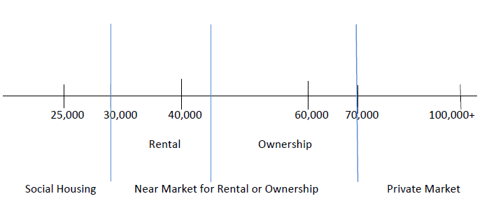
The Housing and Income Continuum
Prepared by: Tom Carter
Carter Research Associates Inc.

Slide 25
The New Housing Continuum
Emergency Shelters | Transitional Housing | Social Housing | Affordable Rental Housing | Affordable Home Ownership | Rental Housing | Home Ownership
Government Subsidized Housing |  |  | Near Market Housing |  | Market Housing
Prepared by: Tom Carter
Carter Research Associates Inc.

Slide 26
Key Questions for Government
Expand mandate to provide housing for this group
Help the private sector provide housing
Let the market sort the problem out over a long period of time
Prepared by: Tom Carter
Carter Research Associates Inc.

Slide 27
Summary of Housing Needs/Issues
Housing Needs/Issues: Theme Areas
Lack of Affordable Rental
Need for Temporary Housing
Need for Entry Level Ownership
Poor Quality of Existing Units
Lack of Municipal Readiness
Lack of Community Readiness
Developer Hesitancy
Local Developer Capacity and Expertise
Capacity of Sewer and Water Infrastructure
Shortage of Serviced Lots
Streamlining the Development Process
A Need for Better Housing Needs Data
Better Coordination Between Regions
Better Cooperation Within Regions
A Role for Employers
The Negative Effects on Business Investment
Risk Avoidance – The Boom Can’t Last
The Broader Policy Environment
The Need for Local Leadership and Local Initiative
Prepared by: Tom Carter
Carter Research Associates Inc.

Slide 28
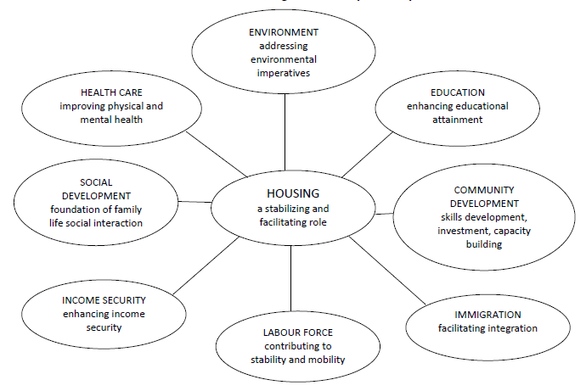
Central Role of Housing in Community Development
Prepared by: Tom Carter
Carter Research Associates Inc.

Slide 29
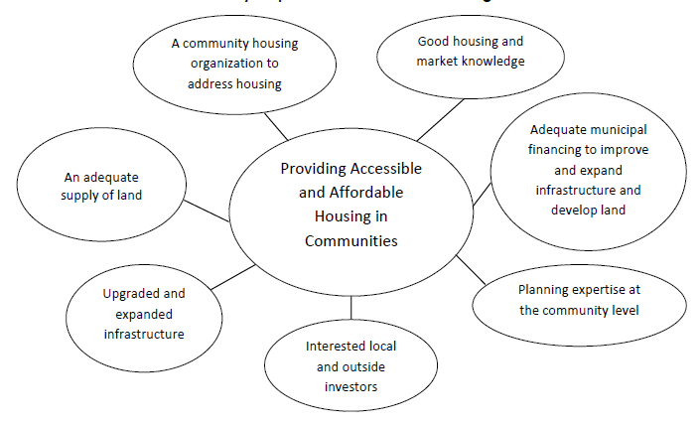
Community Requirements to Deliver Housing
Prepared by: Tom Carter
Carter Research Associates Inc.

Slide 30
Local Partnerships Work Best
Provincial Governments:
Down payment grants to homeowners
Per door rental incentives
Streamlining the planning and development process
Municipalities:
Property tax forgiveness
Reducing land costs
Reducing fees
Prepared by: Tom Carter
Carter Research Associates Inc.

Slide 31
Local Partnerships Work Best (cont’d)
Builders:
More cost effective designs
Builder rebates
Lenders:
Do not bend the rules but work with partners
Federal Government:
Forget about a national housing strategy
More definite statement of spending plans and target groups
Prepared by: Tom Carter
Carter Research Associates Inc.

Slide 32
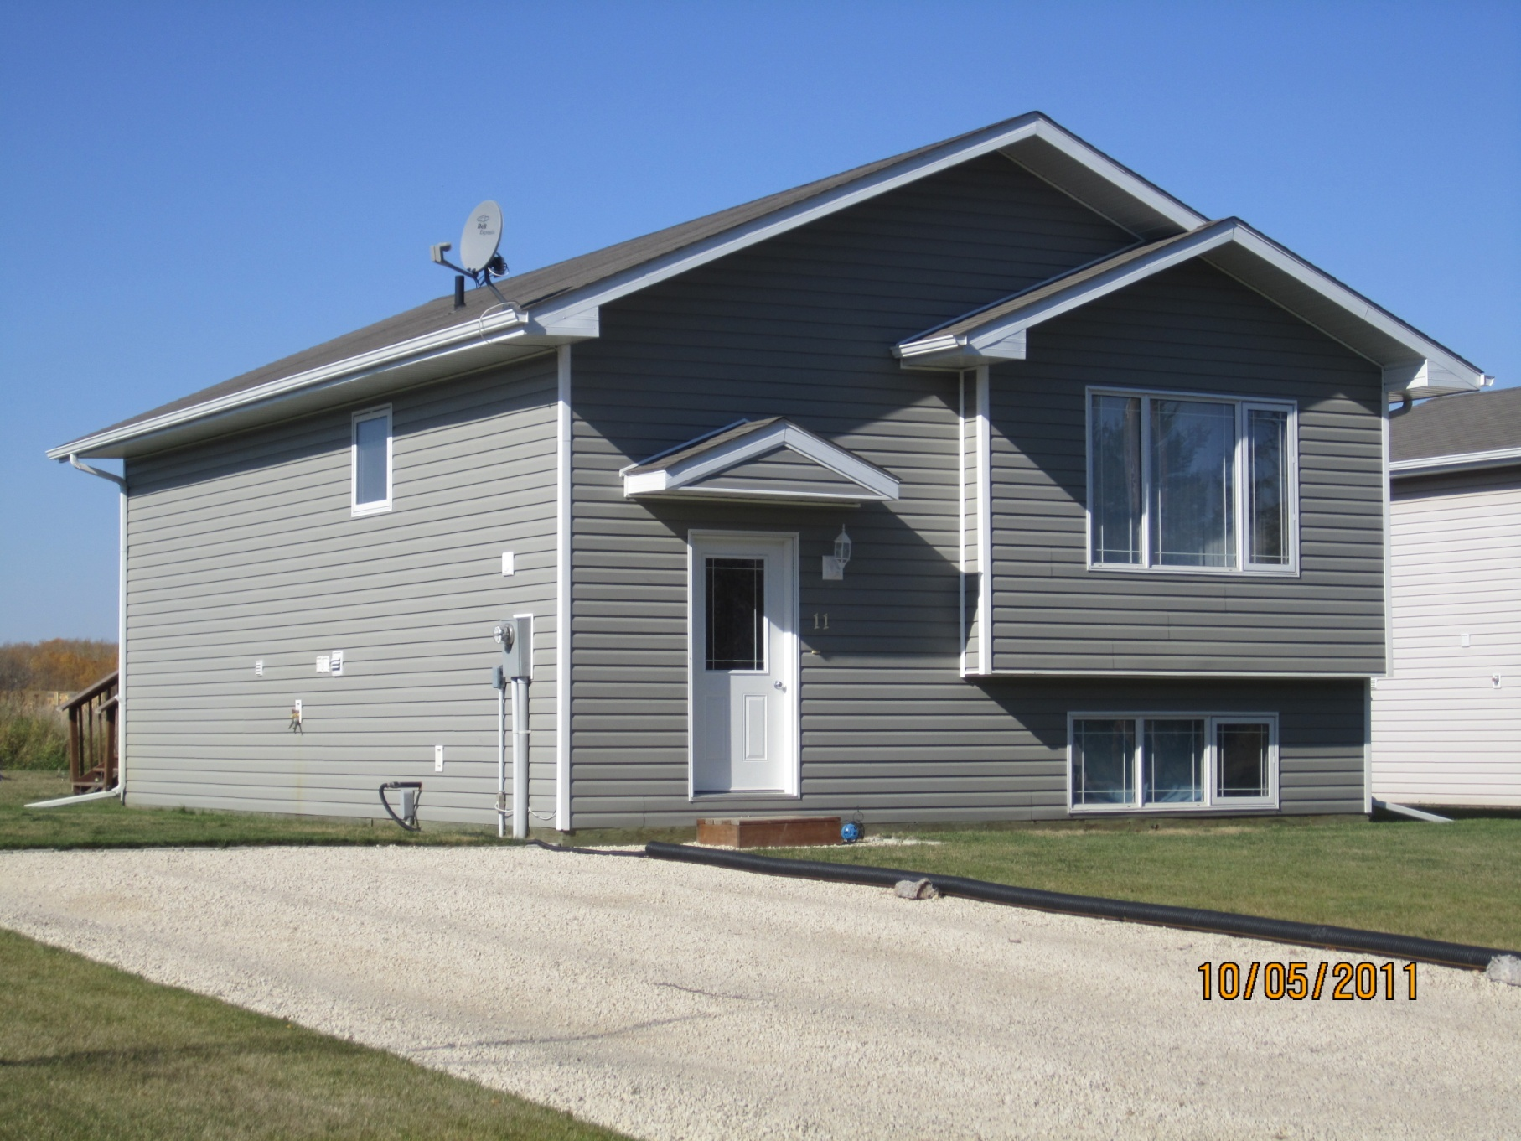
2 Bedroom Entry Level Home Ownership
Purchase Price $184,000
Prepared by: Tom Carter
Carter Research Associates Inc.

Slide 33
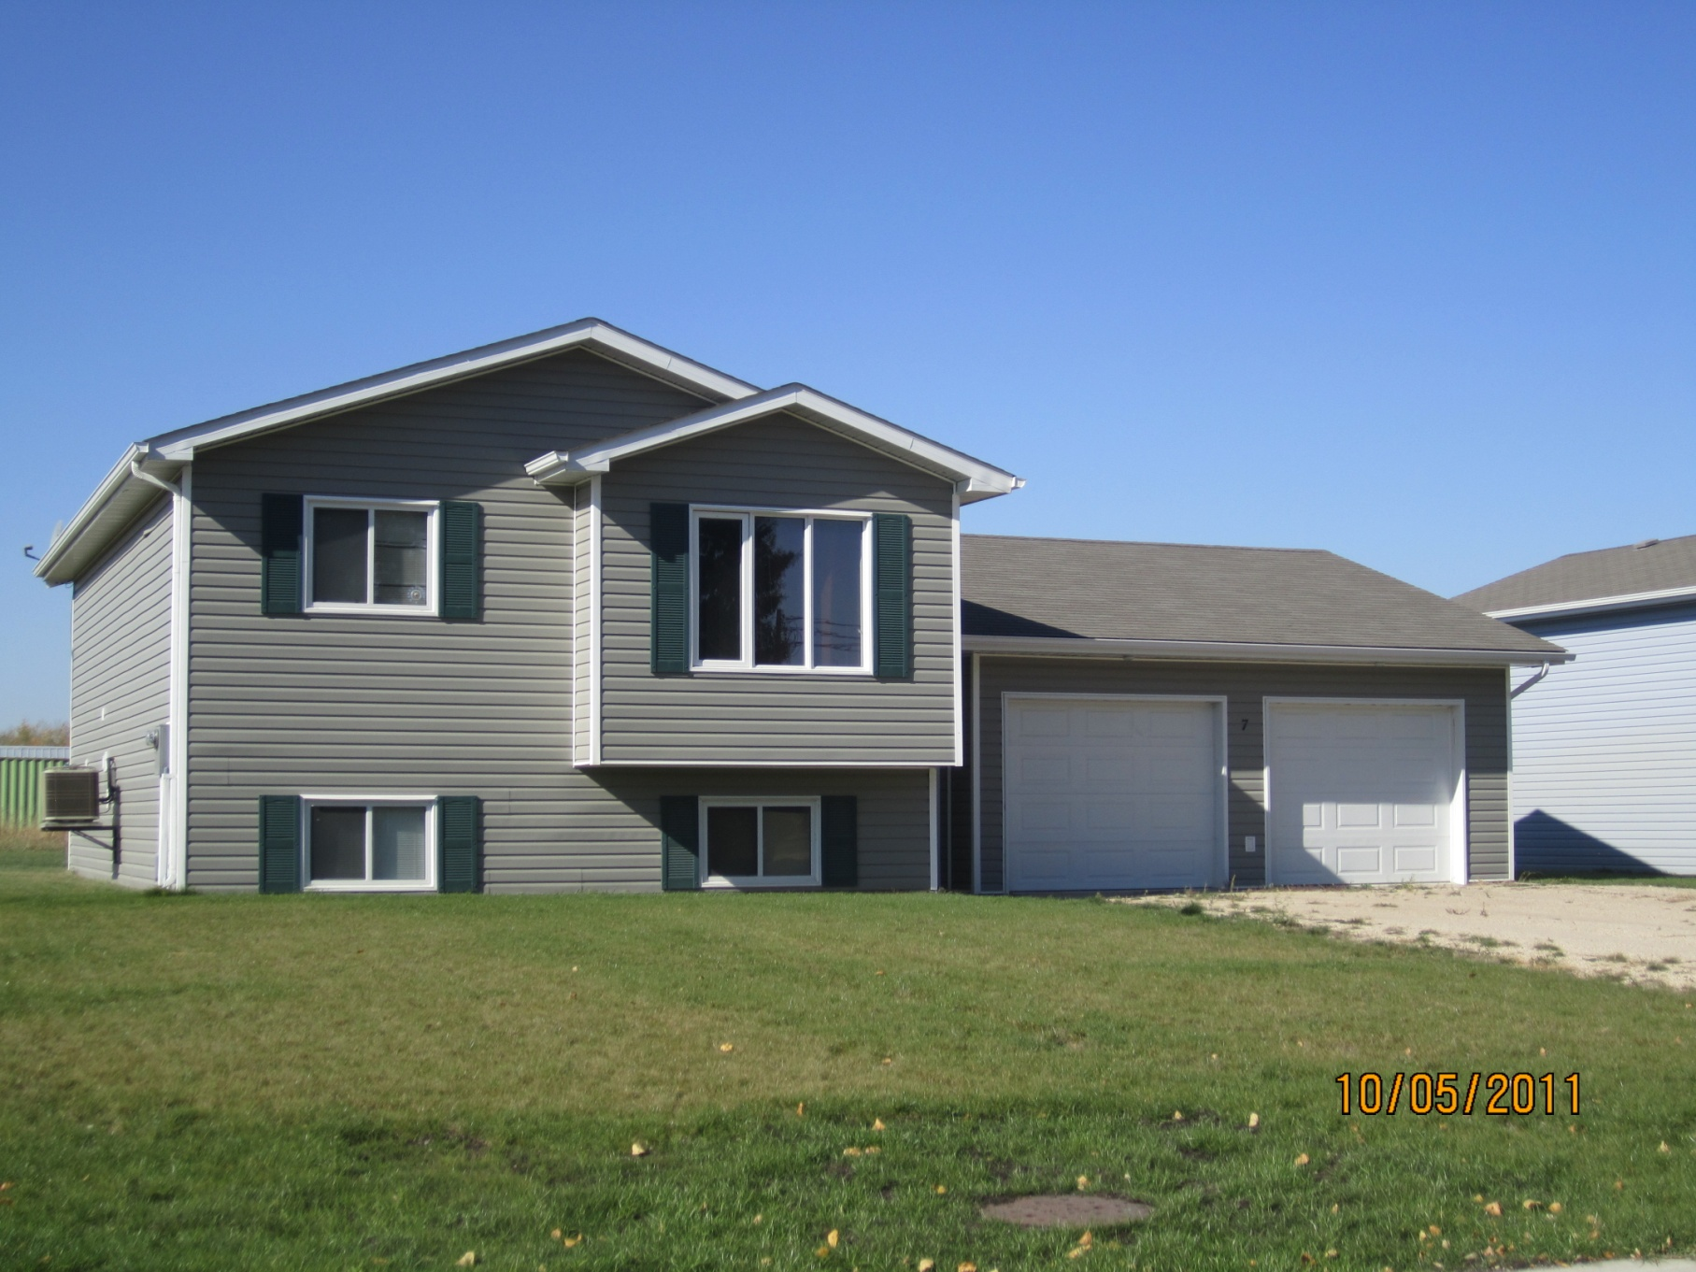
3 Bedroom Entry Level Home Ownership
Prepared by: Tom Carter
Carter Research Associates Inc.
Purchase Price $212,000

Slide 34
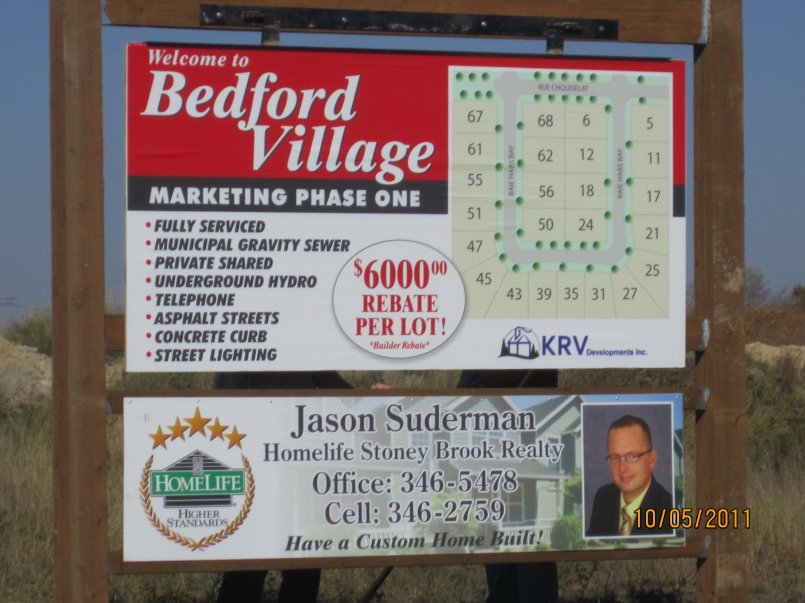
Builder Rebate
$6,000 rebate
Prepared by: Tom Carter
Carter Research Associates Inc.

Slide 35
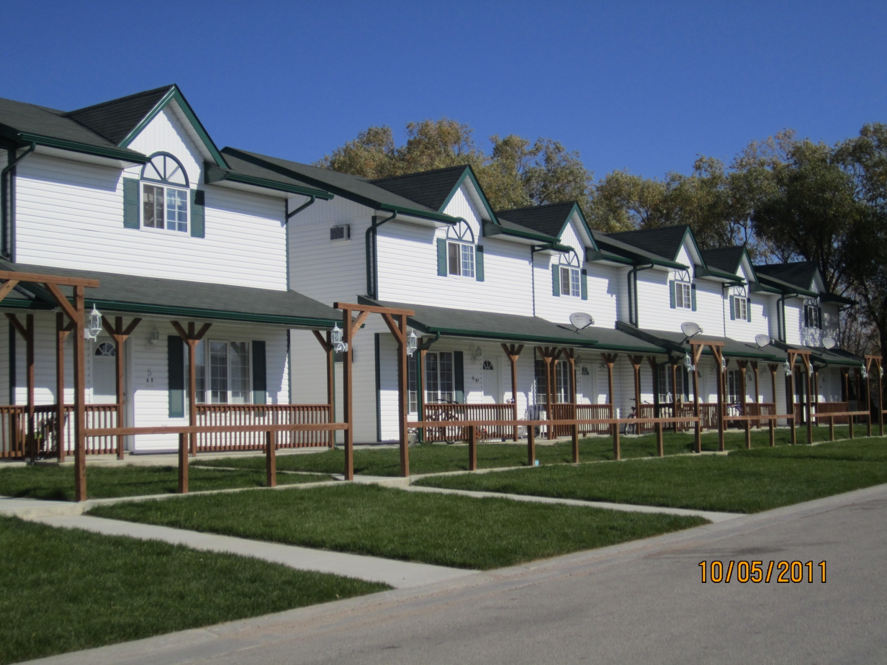
Rental Housing
Prepared by: Tom Carter
Carter Research Associates Inc.
2 bedroom $750 | 3 Bedroom $900

Slide 36

Prepared by: Tom Carter
Carter Research Associates Inc.

Slide 37
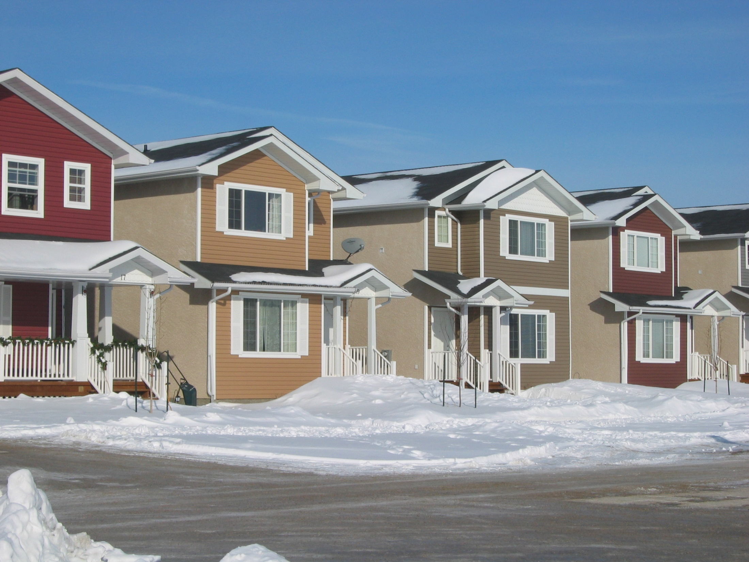
Prepared by: Tom Carter
Carter Research Associates Inc.

Slide 38
Questions ?
Prepared by: Tom Carter
Carter Research Associates Inc.

