Slide 1
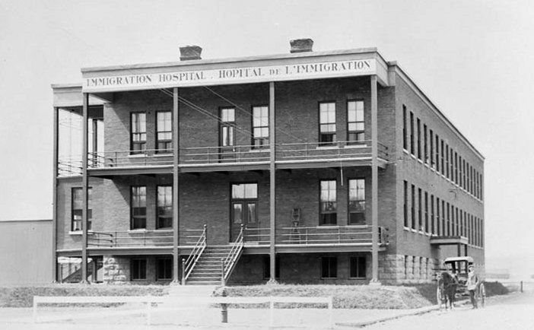
Immigration Policy and Immigrant Heath
The impact of Immigration Policies on the health
and well-being of immigrants over the years
Robert Vineberg
January 2010

Slide 2
Contents
Quarantine
Passenger Protection
Strengthening Quarantine
Prohibited Categories
Today’s Immigration Health Program
Delivering the Immigration Health Program

Slide 3
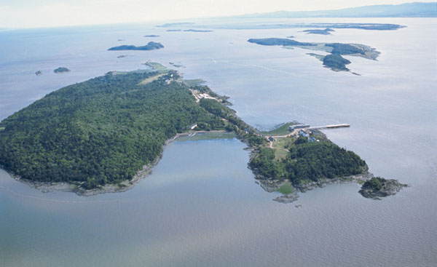
Protect the emigrant;
Protect yourself
Grosse Ile Quarantine Station from the Air

Slide 4
Quarantine - 1
“Quarantine”
  from the French “a period of forty days”
1348
  First measures applied in Venice to attempt to contain the “Black Death”
1403
  Venice opened the first lazaretto (quarantine facility) on an offshore island.
1720
  First use of quarantine in Canada was during the great plague epidemic in Marseille when Governor Vaudreuil ordered vessels to be examined at Isle aux Coudres.

Slide 5
Quarantine - 2
In 1761, Nova Scotia passed its first act regarding Distempers, to prevent the spreading thereof
In1795, Lower Canada passed a Quarantine Act, requiring “ships and vessels coming from places infected with the plague or any pestilential fever or disease, to perform Quarantine, and prevent the communication thereof.

Slide 6
Passenger Protection - 1
The bulk of immigrants in the early 1800s were Scots
  a Committee of the British House of Commons was struck to look into issues affecting Scotland, including emigration.
    It observed, “That Persons emigrating from different Parts of the United Kingdom, have in various Instances, suffered great Distress and Hardship, on account of the crowded State of the Vessels, the want of a sufficient stock of Provisions, Water, and other Necessaries for the Voyage, and in various other Respects.”

Slide 7
Passenger Protection - 2
The committee recommended:
  That, it is expedient to regulate Vessels carrying Passengers from the United Kingdom to His Majesty’s Plantations and Settlements abroad, or to Foreign Parts, with respect to the Number of Passengers which they shall be allowed to take on board, in proportion to the Tonnage of such Vessels, as well as with respect to the Provision of proper Necessaries for the Voyage.

Slide 8
Passenger Protection - 3
First Passenger Act was passed, by the Imperial Parliament, in 1803.
  Healthy immigrants were more likely to survive and succeed but, more importantly, healthy immigrants were not going to infect the British North American population with disease
  But the British act did nothing to help emigrants once they arrived in Canada, often penniless after ships’ masters charged exorbitant prices for food and water on board so immigrants still often arrived unhealthy
  In 1823, Lower Canada established an Emigrant Hospital at Québec City

Slide 9
Passenger Protection - 4
British North American Legislation
  In 1832, Nova Scotia passed its own Act relating to Passengers from Great-Britain and Ireland, arriving in this Province
    Imposed 5 shilling land fee or head tax to be applied “to such uses and purposes, for the benefit of poor Emigrants arriving in this Province…”
  Within weeks similar legislation passed in Lower Canada and New Brunswick
  Fees helped fund Emigrant Aid Societies

Slide 10
Strengthening Quarantine - 1
1831 Cholera epidemic in England quickly carried to Canada
All provinces tried to reinforce quarantine:
  Facilities at Grosse Ile made permanent
  New Brunswick opens station on Partridge Island in 1830
  Nova Scotia continues to use shipboard quarantine until 1866 cholera epidemic leads to purchase of Lawlor’s Island

Slide 11
Strengthening Quarantine - 2
1848 Act to make better provision with respect to Emigrants …
  Province of Canada authorizes Medical Superintendent of Quarantine at Grosse Ile to examine all immigrants on arrival.
  1849 Emigrants Act
    Ship’s Master to put up £75 bond for any passenger found to be “Lunatic, Idiotic, Deaf and Dumb, Blind or Infirm.” Except if family could support or Medical Superintendent thought not likely to become a public charge (repeated in 1852, 1866 and 1869 acts)
1852 - Province of Canada passed legislation to “consolidate the laws respecting Emigrants and Quarantine”
  Start of the concept of an immigration health policy

Slide 12
Strengthening Quarantine - 3
1858 – Emigrants and Quarantine Act
  amended to allow ship’s masters to recover bond if the lunatic, idiotic, deaf and dumb, blind or infirm person were returned to port of departure
Confederation
  Dominion Government takes over quarantine stations (confirmed in 1869 Immigration Act)
    Immigration and Quarantine with Dep’t of Agriculture
1873-1882
  seven other quarantine stations established
1892 – Immigration to Dep’t of Interior
1903 - Quarantine and Immigration Health responsibilities transferred to Dep’t of Interior

Slide 13
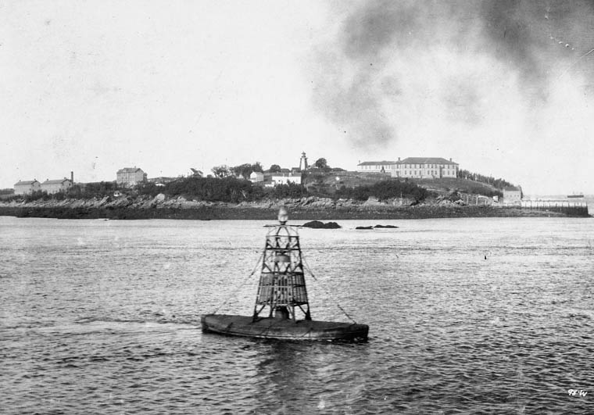
Partridge Island Quarantine Station Saint John Harbour

Slide 14
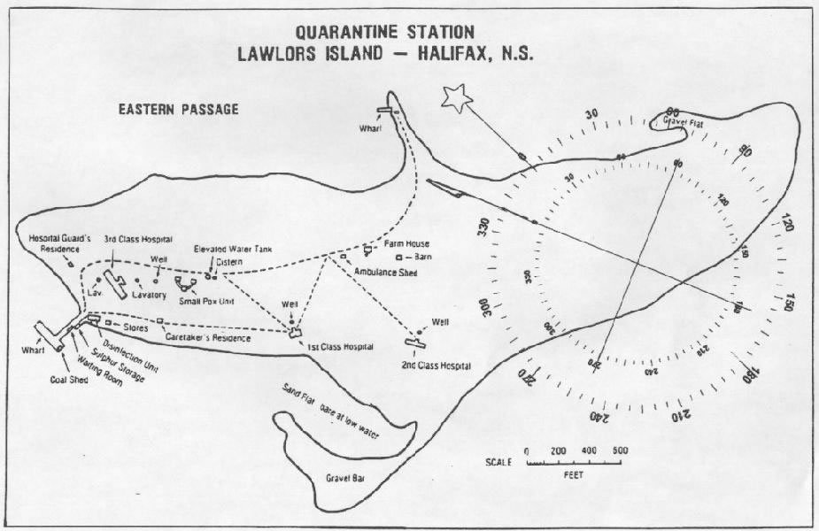
Layout of a Quarantine Station

Slide 15
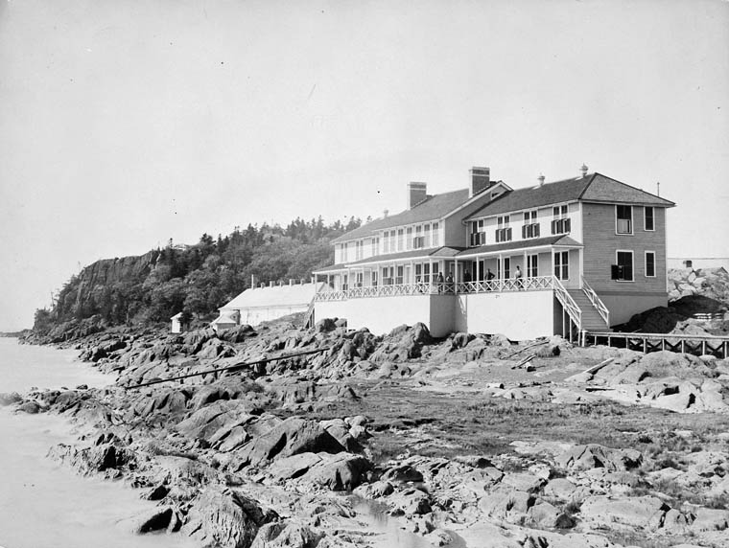
Second Class Hotel
Grosse Ile

Slide 16
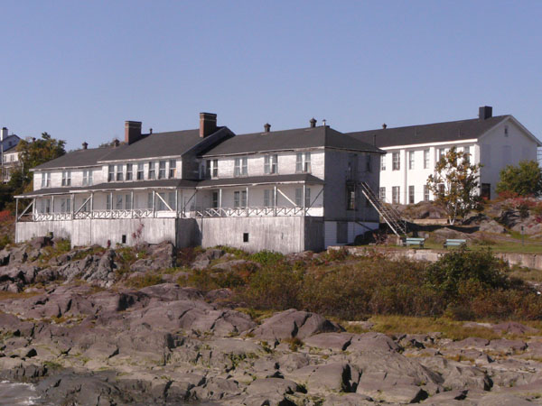
Second Class Hotel
Grosse Ile - 2007

Slide 17
Prohibited Categories - 1
1885 Chinese Immigration Act
  social Darwinism/eugenics and fear of “Yellow Peril” in BC
1902 Amendments to the Immigration Act
  Proclamation (Order-in-Council PC1902-1293) “prohibiting the landing in Canada absolutely of any immigrant or other passenger who is suffering from any loathsome, dangerous or infectious disease ...” This led to medical staff being hired for inspections of immigrants in Canada.
1906 Immigration Act
  s.26 – feeble-minded, idiots, epileptics, insane (or having had an attack of insanity within five years), deaf and dumb, or dumb, blind or infirm unless belongs to a family offering permanent support or not likely to be a public charge
  s.27 – afflicted with a loathsome disease or with a disease which is contagious or infectious and which may become dangerous to the public health

Slide 18
Prohibited Categories -2
1910 Immigration Act
  s.3(a) – “Persons mentally defective”
    idiots, imbeciles, feeble minded, epileptics, insane (or have been insane within five years previous)
  s.3(b) – “Diseased Persons”
    afflicted with a loathsome disease or with a disease which is contagious or infectious and which may become dangerous to the public health
  s.3(c) “Persons physically defective”
    Dumb, blind, or otherwise physically defective unless family will support or can prove they will not be a public charge
  s.38(c) Eugenics again!
    May prohibit “immigrants belonging to any race deemed unsuited to the climate or requirements of Canada...”

Slide 19
Prohibited Categories - 3
1919 Amendments to Immigration Act add:
  Tuberculosis specifically mentioned in diseased persons prohibitions in s. 3(b)
  3(k) Persons of a constitutional psychopathic inferiority
  3(l) Persons with chronic alcoholism
  3(m) Persons not included within any of the foregoing prohibited classes, who upon examination by a medical officer are certified as being mentally or physically defective to such a degree as the affect their ability to earn a living
  38(c) amended to include “may prohibit ... any nationality or race ... because such immigrants are deemed undesirable owing to their particular customs, habits, modes of life ... and because of their probable inability to become readily assimilated ...”

Slide 20
Prohibited Categories -4
1952 Immigration Act
  s.5(a) “Mentally defective persons, etc.”
    (i) idiots, imbeciles or morons
    (ii) insane or, if immigrants have even been insane
    (iii) constitutional psychopathic personalities
    (iv) epileptics, if immigrants
  s.5(b) “Diseased Persons”
    Persons afflicted with TB in any form, trachoma or any contagious or infectious disease or with any disease that may become dangerous to the public health
  s.5(c) “Physically defective persons”
    Same as 1910 provisions

Slide 21
Prohibited Categories -5
1952 Immigration Act – con’t
  s.5(j) “Drug addicts”
    Persons addicted to any substance that is a drug within the meaning of the Opium and Narcotic Drug Act
  s.5(s) “Persons medically certified as impaired”
    Persons not included in any other prohibited class who are certified by a medical officer as being mentally or physically abnormal to such a degree as to impair seriously their ability to earn a living
1976 Immigration Act
  s.19(1)(a)(i) - danger to public health or public safety
  s.19(1)(a)(ii) – excessive demand on health or social services

Slide 22
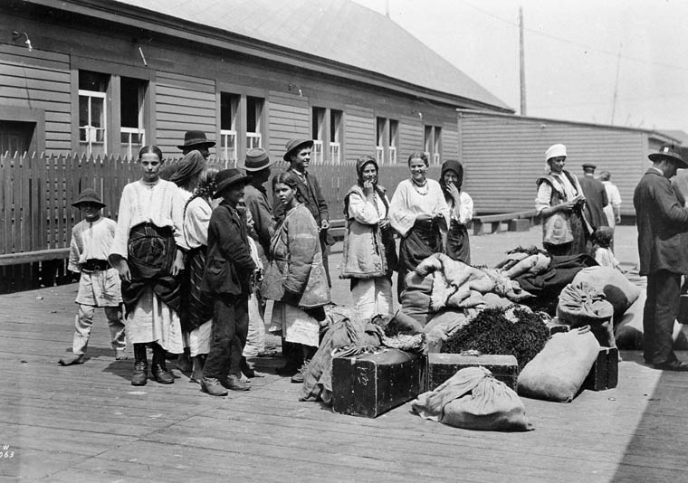
Galacian Immigrants at Grosse Ile

Slide 23
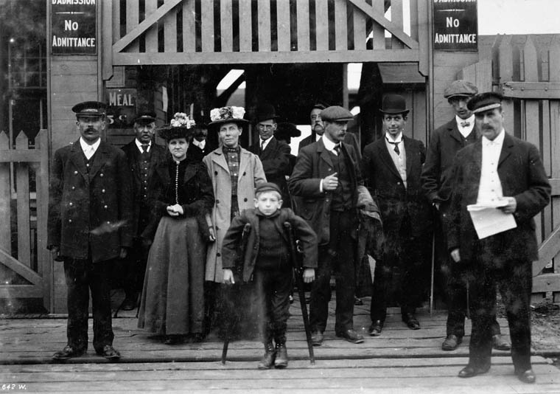
Deportees outside Québec Immigration Sheds - 1912

Slide 24
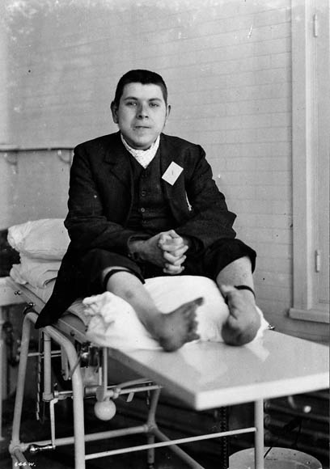
“Deformed Idiot to be Deported”
Québec City - 1908

Slide 25
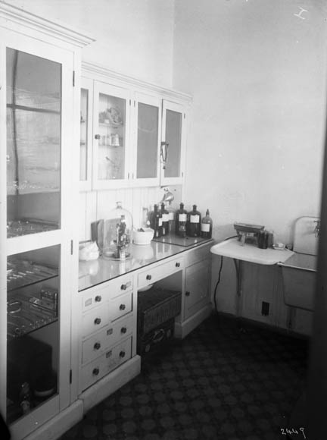
Laboratory – Immigrant Hospital Québec City - 1911

Slide 26
Overseas Medical Examinations
Began after First World War
  Virtually all from European Continent
  All from UK receiving passage assistance were required to submit a medical certificate
  Limited to “steerage” (3rd class) passengers until 1928
By 1926
  Some 2,000 “roster doctors” in Europe
About same time
  Concerns about quality assurance led to deploying Canadian medical staff abroad, first in London, in 1925, then at other offices
  Result: medical refusals on landing declined from 742 in 1928 to 196 in 1930

Slide 27
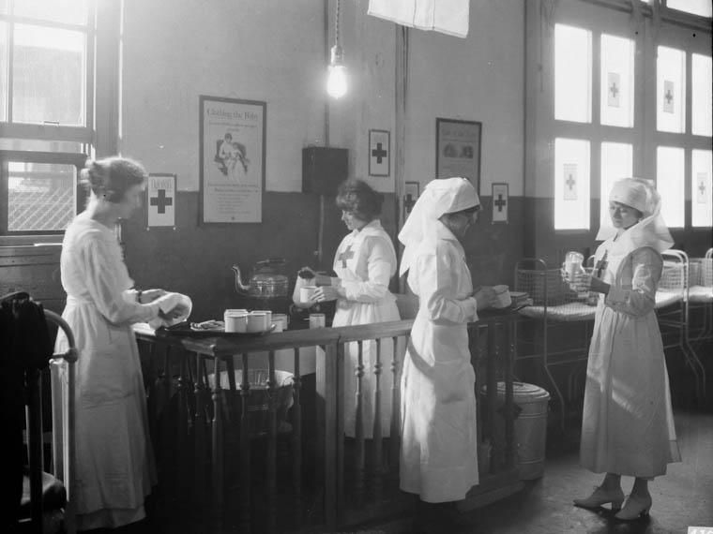
Red Cross Workers at Québec Immigration Sheds c. 1920

Slide 28
Today’s Immigration Health Program - 1
Legislative Authority: the Immigration and Refugee Protection Act (IRPA) (2002) and Regulations govern the health screening of foreign nationals coming to Canada.
One of the objectives of IRPA is to protect the health and safety of Canadians – this objective first appeared in the 1976 Act

Slide 29
Today’s Immigration Health Program - 2
IRPA Section 38(1) A foreign national is inadmissible on health grounds if his/her health condition:
      a) is likely to be a danger to public health
      b) is likely to be a danger to public safety
      c) might reasonably be expected to cause excessive demand on health or social services
IRPA Section 38(2): exempts some categories of immigrants from the excessive demand assessment:
      Spouse, conjugal partner or common law partner of a Canadian resident/citizen
      Dependent child
      Convention refugee/Refugee Claimant
      Protected person

Slide 30
Today’s Immigration Health Program - 3
Regulation 30(1): the following applicants require immigration medical examinations:
    all individuals applying for permanent residency
    temporary residents who are seeking to work in Canada in an occupation in which the protection of public health is essential (e.g. Health care, food services etc.)
    any applicant who an officer has reasonable grounds to believe is inadmissible under IRPA s.38(1)
    temporary residents (worker-student-visitor)
      who will reside in Canada for a period of six consecutive months AND
      who have resided or sojourned for a period of six consecutive months in a designated country, during the one-year period immediately preceding the date they sought entry or made their application

Slide 31
Today’s Immigration Health Program - 4
Designated Countries are not defined in the legislation
    Based on the public health risk related to Tuberculosis
Canada’s Criteria: A country having a three year estimated sputum smear positive pulmonary tuberculosis (TB) rate ≥ 15/100 000
  International Tuberculosis Incidence Rates are available at the PHAC website http://www.phac-aspc.gc.ca/tbpc-latb/itir_e.html
  Data is derived from the World Health Organization's (WHO) most recently available three year estimated sputum smear positive pulmonary tuberculosis (TB) rates
Designated Country/Territory List- CIC website
  http://www.cic.gc.ca/english/information/medical/dcl.asp

Slide 32
Today’s Immigration Health Program - 5
Dangers to Public Health:
IRPA Regulation 31 - Before concluding whether a foreign national's health condition is likely to be a danger to public health, an officer who is assessing the foreign national's health condition shall consider
  (a) any report made by a health practitioner or medical laboratory with respect to the foreign national;
  (b) the communicability of any disease that the foreign national is affected by or carries; and
  (c) the impact that the disease could have on other persons living in Canada
Two conditions are currently considered to be a danger to public health:
  Active Tuberculosis
  Untreated Syphilis

Slide 33
Today’s Immigration Health Program - 6
Conditions that may be imposed:
Regulation 32 is the authority for requiring “medical surveillance” as a condition of entry to Canada”
  A CIC Officer may impose conditions of entry to certain individuals who enter Canada on a permanent or temporary basis
    To report at the specified times and places for medical examination, surveillance or treatment; and
    To provide proof, at the specified times and places, of compliance with the conditions imposed

Slide 34
Today’s Immigration Health Program - 7
Dangers to Public Safety:
IRPA Regulation 33 - Before concluding whether a foreign national's health condition is likely to be a danger to public safety, an officer who is assessing the foreign national's health condition shall consider
    (a) any reports made by a health practitioner or medical laboratory with respect to the foreign national; and
    (b) the risk of a sudden incapacity or of unpredictable or violent behaviour of the foreign national that would create a danger to the health or safety of persons living in Canada
Occasionally used for conditions such as:
  Drug addiction with history of violent behaviour
  Uncontrolled psychotic conditions with history of violent behaviour

Slide 35
Today’s Immigration Health Program - 8
Excessive Demand
Authority to determine if an applicant would cause excessive demand is in IRPA Regulation 34:
  Before concluding whether a foreign national's health condition might reasonably be expected to cause excessive demand, an officer who is assessing the foreign national's health condition shall consider
    (a) any reports made by a health practitioner or medical laboratory with respect to the foreign national; and
    (b) any condition identified by the medical examination

Slide 36
Today’s Immigration Health Program - 9
Excessive Demand
  Defined in IRPA Regulation 1 as:
    (a) a demand on health services or social services for which the anticipated costs would likely exceed average Canadian per capita health services and social services costs over a period of five consecutive years immediately following the most recent medical examination required by these Regulations, unless there is evidence that significant costs are likely to be incurred beyond that period, in which case the period is no more than 10 consecutive years; or
    (b) a demand on health services or social services that would add to existing waiting lists and would increase the rate of mortality and morbidity in Canada as a result of an inability to provide timely services to Canadian citizens or permanent residents.

Slide 37
Delivering the Immigration Health Program - 1
Approximately 450,000 to 500, 000 Immigration Medical Examinations (IMEs) performed annually
  by 1,200 Designated Medical Practitioners (DMPs) around the world (Immigration Medical Officers no longer do the exam themselves.)
Processed in 10 regional medical offices
  Ottawa, Port of Spain, Paris, London, Vienna, Nairobi, Delhi, Singapore, Beijing, Manila
  By Immigration Medical Officers
Medical Officers responsible for:
  Review of the IMEs and recommendations of inadmissibility
  Quality Assurance visits of DMPs, radiology clinics and laboratories
  Medical intelligence
Note: Information in this section courtesy of CIC Immigration Health Branch

Slide 38
Delivering the Immigration Health Program - 2
The IME consists of:
  Pre-2002
  History and complete physical examination for all applicants
  Urinalysis – those 5 years of age and older
  Syphilis testing (VDRL) and HIV testing - those 15 years of age and older
  Chest X-ray – those 11 years of age and older
  Further tests as required upon review of the initial examination
  Since January 15, 2002 – All of the above plus:
  Routine HIV testing all applicants 15 years of age and over or at any age if known risk factor (s)
    Based on Health Canada’s advice received in 2001
    HIV testing is fundamental to Canada’s objective of preventing transmission
    Not considered a danger to public health
      Transmission completely preventable
      Risk determined by individual behaviour
      Risk can be mitigated by education and counselling
    May be deemed inadmissible if their health requirements are likely to create excessive demand on health or social services
The IME is usually valid for one year

Slide 39
Delivering the Immigration Health Program - 3
Outcomes
Admissible on health grounds (approximately 97%)
  Normal or having a health condition considered not significant for the purposes of IRPA
Admissible under condition – requiring medical surveillance (approximately 2-3%)
  Inactive tuberculosis (the vast majority of cases) and syphilis must have been adequately treated
Inadmissible on health grounds (approximately 0.3%)
  Vast majority for excessive demand on health or social services
  Threshold used for ED assessment: $4,806/year
      Composite figure developed by adding the average Canadian cost published annually by the Canadian Institute of Health Information (CIHI) to a supplementary amount covering certain social services not included in the CIHI average
    An applicant is likely to create excessive demand on health or social services if:
      Requirements’ costs exceed $24,030 over 5 years ($48,060 over 10 years) and/or
      Requirements add to the waiting list

Slide 40
Delivering the Immigration Health Program - 4
Enhanced Health Management for Refugee groups at higher public health risk
  Based on gathering of health intelligence and collaboration with IOM, UNHCR and other countries working in the areas (USA, Australia, UK).
  Routine Pre-departure process can be modified when needed to manage the special needs or risks of certain groups.
    IME validity date
    Treatment of specific medical conditions
    Pre-departure fitness to fly examination
  Post Arrival process
    all refugees have access to Interim Federal Health (IFH), which pays for all essential care plus some coverage for dental, eye care, drugs and prosthesis

Slide 41
Delivering the Immigration Health Program - 5
Interim Federal Health Program
  Under the IFH Program, the Federal Government pays for health care for certain migrants who are not covered by provincial health plans and are unable to pay for expenses related to urgent and essential services.
IFH coverage is provided to:
  Protected persons in Canada;
  Refugees selected abroad;
  Refugee claimants;
  Applicants in the Pre-Removal Risk assessment (PRRA) process;
  Canadian Border Service Agency (CBSA) detainees; and
  Trafficked persons in Canada

Slide 42
Delivering the Immigration Health Program - 6
Services covered by IFH
  Essential health services for the treatment and prevention of serious medical/dental conditions
  Essential prescription medications
  Contraception, prenatal and obstetrical care
  Assistive devices, eyewear, and limited medical transportation and interpretation services.
  Immigration Medical Examination
Data (2007)
  Number of IFH users: 75,000
  Number of medical claims: 523,000
  Number of providers nationwide: 18,000
  Average number of claims per person: 7
  Total IFH expenditures: $50,000,000
  Average expenditure per IFH user: $608
  Average cost per claim: $87

Slide 43
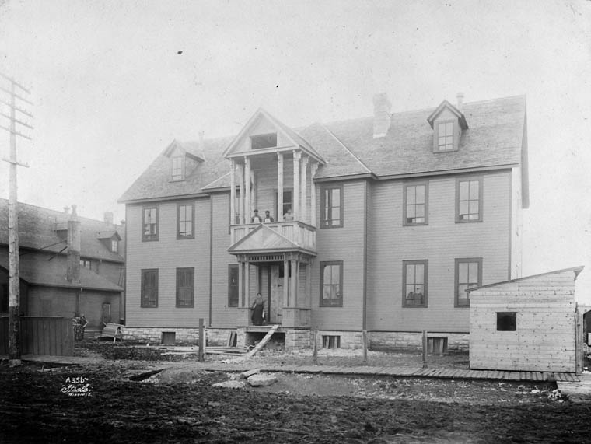
Thank You!
New Immigrant Hospital Winnipeg c.1900

Slide 44
Photo Credits
Slide - Title Page: Immigrant Hospital Québec City, 1908 – Library and Archives Canada (LAC) a023209
Slide 3: Grosse Ile from the air - LAC - xx014988-v6
Slide 13: Partridge Is Quarantine Station - LAC - a020640
Slide 14: Lawlor Is Quarantine Station – Friends of McNabb Island http://www.mcnabsisland.ca/Gallery/Old_Lawlors_Island/index.htm
Slide 15: Grosse Ile 2nd class hotel c1905 - LAC -c079029
Slide 16: Grosse Ile 2nd class hotel 2007 - LAC - c015099
Slide 22: Galacian immigrants at Grosse Isle (undated) - LAC - c005611
Slide 23: Quebec - deportees 1912 - LAC - a020910
Slide 24: Deformed Idiot to be Deported [sic]- 1908 - LAC -a020911
Slide 25: Que Imm Hosp - Lab c1911- LAC - a010283
Slide 27: Red Cross Workers - Quebec City Immigration sheds - LAC - a048700
Slide 43: New Immigrant Hospital Winnipeg c.1900 – LAC – a046607

