Slide 1
Inclusion of newcomers to Fransaskois schools: Challenges and opportunities
Dr. Laurie Carlson Berg
University of Regina

Slide 2
Presentation Overview:
Research overview and objectives
Saskatchewan context: Host communities and newcomers
Challenges: Newcomer and student perspectives on inclusion
Opportunities: Towards cultural reciprocity

Slide 3
Objectives :
To identify
barriers to optimal participation in schools both on an academic and social level;
educational needs of newcomers and the resources necessary for full inclusion in francophone schools; and
principal characteristics and challenges of newcomers, particularly those pertaining to culture and education in Fransaskois minority language communities.

Slide 4
Overview of three-year study:
Phase 1: Interviews with 29 new immigrants about current and previous educational experiences, perspectives on inclusion, and educational expectations and needs.
Phase 2: Interviews with school personnel from 3 fransaskois schools and sociogrammes with students from 26 classrooms;
Phase 3: Community consultation in progress

Slide 5
Saskatchewan context – host communities and newcomers
Fransaskois 2% of population with 12 schools and multiple small communities throughout the province;
Discussion of who is fransaskois (Rapport sur l’inclusion de Wilfred Denis)
Newcomers who self-identify as francophone
Diversity of newcomers (experiences, religion, skin colour)

Slide 6
My orientation as researcher: cultural reciprocity
Johnson & Johnson (1988);
  Each is a learner and a teacher
  Home-School Collaboration
Harry, Rueda & Kalyanpur (1999);
  Mutual respect for family and school cultures
Appreciative Inquiry (Hammond, 1998)
  “In every society, organization, or group, something works.” (p. 20)

Slide 7
Phase 1: Participants and methods:
Interviews with 12 families (29 participants)
Participants
  from Republic of Burundi, the Central African Republic, the Democratic Republic of Congo, Ivory Coast, Mauritius, Morocco and Sudan;
  Represented all immigration categories (refugee, family reunification, and economic);
  Self-identify as francophone.

Slide 8
Phase 1 Results: School is “an upside down world.”
A clash of cultures and paradigms;
School life themes included:
  Level of parental participation;
  Free, freedom, free for all; and
  Racism.

Slide 9
Parental participation
Desired level of contact:
Challenges of student parents

Slide 10
Free, freedom, free for all:
Universal access to education
  public funding of education;
  diversity of students in regular classrooms, and
  children’s rights and the nature of discipline in the Canadian school their child(ren) attended.
Notes:
10

Slide 11
Racism in schools:
“Is brown skin a sign of illness?”
(Translation) There were some children who thought my children were ill because their skin colour was different from theirs. So, when they sat down, someone said, “No, I don’t want you to sit beside me because I don’t want to get the same illness as you.” My daughter then asked, “What do you mean by the same illness?”. [The other child replied,] “Because you are black so if I sit beside you I will get the same colour of skin as you.” That [statement] could have come out of ignorance but, at the same time, you need to educate children when your city has a certain number of immigrants and especially people of colour. So, that ticked me off a bit because my daughter didn’t want to go to school in the morning and she is a very sociable person who loves to have her friends around her. But, all of a sudden, she decided she no longer wanted to go [to school]. When we tried to question her, she finally told us that she had heard some things said that she wasn’t comfortable with and she wanted to know more. So, she came to us and asked us to explain whether indeed being brown, as it was said here, is an illness. Now, we had to intervene, because with that it’s the self-esteem that takes a blow. (Véronique, p.3)

Slide 12
Racism in schools (cont’d)
(Translation) At times, there were even children who said, “Oh, it stinks of Blacks” and that, compared to the child who thought that having brown skin was an illness (pause) but a child who says, “It stinks of Blacks” that is another way of saying, “I don’t want you near me”. Those children must have heard something , you can’t always interpret but they must have heard something to have said that Blacks stink. There were very hurtful words that our children heard when we first arrived [in Saskatchewan].

Slide 13
Racism in schools (cont’d)
(Translation) Often there are students who behave badly in class. I can’t say they’re racist because they are so young that maybe they don’t know what racism really is, when they are older they will understand. But that’s okay because, even in Africa there are people like that. We are all black but there are people who will say, “You’re not from my country, I don’t like you.” You can’t call them racist because we’re all black, it’s the same thing here in Canada. Even if the younger students say things like that to me, young people fifteen or sixteen years old, I can’t say anything, I will only laugh. (Martin, p.12)

Slide 14
Racism in schools (cont’d)
(Translation) I remember a time when there were three of us immigrants, and all the rest were Canadian [classmates]. We were together playing but we didn’t do everything together because we, the immigrants, were always on one side, we don’t get along so well [with the Canadians], I don’t know. I felt like we were on one side and they were on the other side. It’s not that they didn’t want to [be with us], they wanted us with them but maybe there were things that caused us to be on the other side because if there wasn’t something there, we would all be together. But I felt like we immigrants were on one side and they were on the other side. (pause) I think it’s because we are not accustomed to them and all they do that is different. It’s not as though they are racist but everything they do, it’s different from us. (pause) Even in sports because we immigrants, we like soccer. We played soccer and they would go play volleyball and we would leave to go play our sport. We didn’t get along too well. There was no problem, we laughed well, we had good fun. (Martin, p. 13)

Slide 15
Sociogramme (Carlson Berg, 2007)
Translation
Circle the names of the three classmates you would most like to play with at recess.
Circle the names of the three classmates you would most like to do a group project at school.
Circle the names of the three classmates you actually spend the most time with at school.
Circle the names of the three classmates whom you believe to have the best handwriting.
Circle the names of the three classmates whom you believe to be the strongest readers.
Circle the names of the three classmates whom you believe to be the strongest in arithmetic.
Circle the names of the three classmates whom you believe to be the best athletes.
Circle the names of the three classmates whom you believe to have the most musical talent.
Circle the names of the three classmates you admire the most.
Circle the names of the three classmates who are the most like you.

Slide 16
Sociogramme analysis:
the relationship between being a visible minority and lower academic status is statistically significant;
the higher one’s academic status, the greater the likelihood of being central in a social network;
if a student is central in one network, the chance of being central in the other networks is very high;
Newcomers and visible minorities are not likely to be central to a social network.

Slide 17
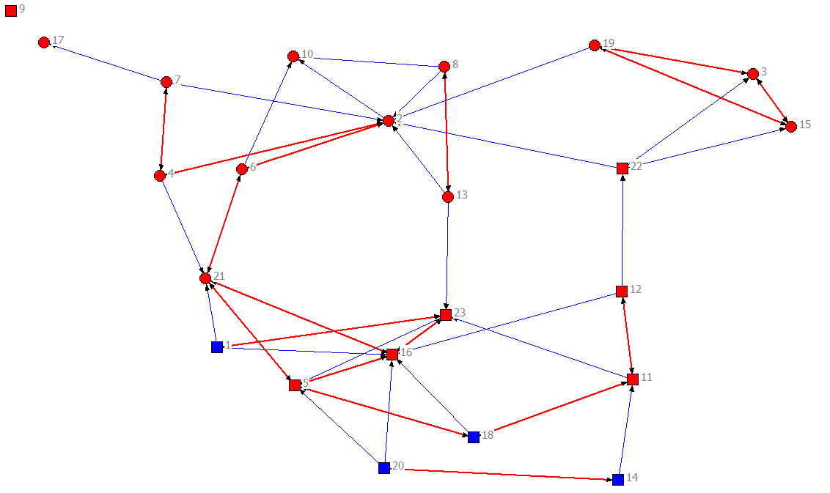
Desired social partner
School X
Absent: 9, 10, 17
No answer: -
Circle: boy/ square: girl
Blue ties: directed/ red ties: mutual
Blue nodes: visible minority/ red nodes: majority
Number of ties: 57
Density: 0.11 (the max. den. is 0.14)
Centralization (indegree): 0.21
Average Distance: 3.66
Notes:
17

Slide 18
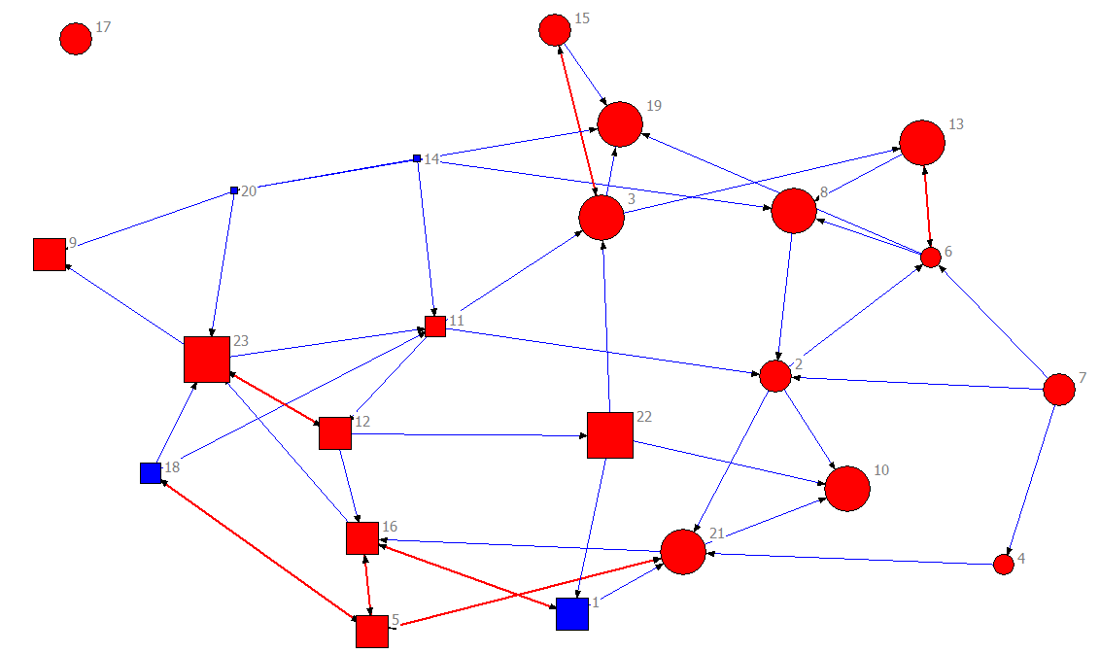
Desired academic partner
School X
Absent: 9, 10, 17
No answer: -
Circle: boy/ square: girl
Blue ties: directed/ red ties: mutual
Blue nodes: visible minority/ red nodes: majority
Bigger = better academic status
Number of ties: 50
Density: 0.10 (the max. den. Is 0.14)
Centralization (indegree): 0.09
Average Distance: 3.31

Slide 19
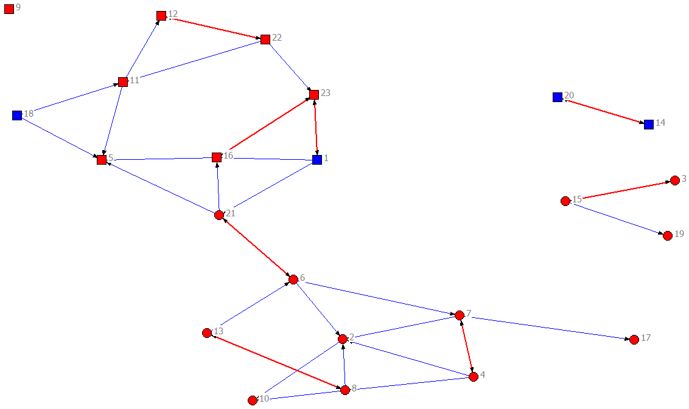
Actual Partner
School X
Absent: 9, 10, 17
No answer: -
Circle: boy/ square: girl
Blue nodes: visible min./ red nodes: majority
Blue ties: directed/ red ties: mutual
Number of ties: 38
Density: 0.08 (the max. den. Is 0.14 )
Centralization (indegree): 0.11
Average Distance: 3.79

Slide 20
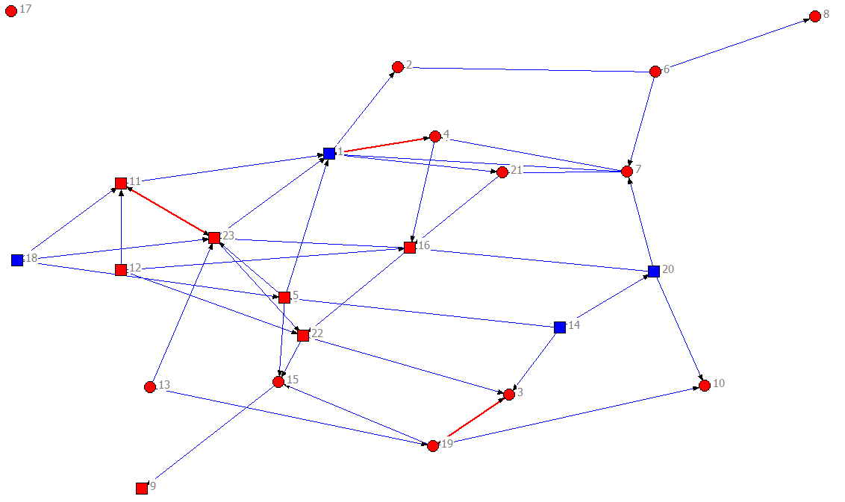
Admiring
School X
Absent: 9, 10, 17
No answer: 2, 8
Circle: boy/ square: girl
Blue ties: directed/ red ties: mutual
Blue nodes: visible minority/ red nodes: majority
Number of ties: 43
Density: 0.09 (the max. den. Is 0.14 )
Centralization (indegree): 0.15
Average Distance: 2.58

Slide 21
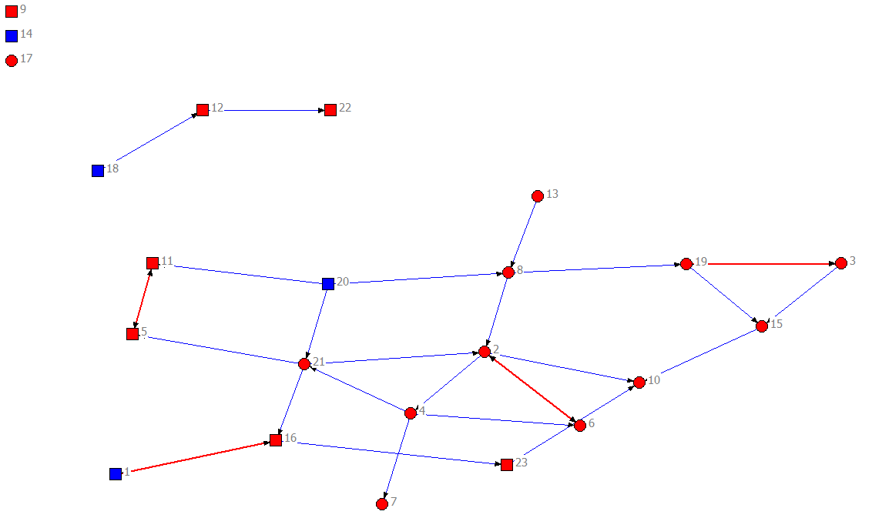
“Most like me”
School X
Absent: 9, 10, 17
No answer: 7, 14
Circle: boy/ square: girl
Blue ties: directed/ red ties: mutual
Blue nodes: visible minority/ red nodes: majority
Number of ties: 29
Density: 0.06 (the max. den. is 0.14)
Centralization (indegree): 0.08
Average Distance: 2.50

Slide 22
Inferential Statistics
Crosstab: ‘Visible Minority’ & ‘Academic Status’
School X
The academic status has been recoded into 2 groups in this tabulation. And as the red cells show the relationship between being visible minority and lower academic status is statistically significant.
‘Recoded Academic status into 2 groups’ * ‘Visible Minority’ Crosstabulation
 |  | VIS_MIN |  | Total
 |  | non | oui
Recoded Academic status into 2 groups | domaine de force and force relative | 38 80.9% | 5 20.0% | 43 59.7%
 | defi relatif and domain de defi | 9 19.1% | 20 80.0% | 29 40.3%
Total |  | 47 100.0% | 25 100.0% | 72 100.0%
Chi-Square Tests
 | Value | df | Asymp. Sig. (2-sided) | Exact Sig. (2-sided) | Exact Sig. (1-sided)
Pearson Chi-Square | 25.121ª | 1 | .000
Fisher's Exact Test |  |  |  | .000 | .000

Slide 23
Inferential Statistics
Centrality and Academic Status
School X
Group Statistics
 | Recoded Academic status into 2 groups | N | Mean | Std. Deviation | Std. Error Mean
Q1X | domaine de force and force relative | 43 | 2.91 | 2.080 | .317
 | defi relatif and domain de defi | 29 | 2.03 | 1.149 | .213
Q2X | domaine de force and force relative | 43 | 2.84 | 2.035 | .310
 | defi relatif and domain de defi | 29 | 1.83 | 1.649 | .306
Q3X | domaine de force and force relative | 43 | 2.28 | 1.533 | .234
 | defi relatif and domain de defi | 29 | 1.72 | 1.386 | .257
Q4X | domaine de force and force relative | 43 | 3.35 | 3.933 | .600
 | defi relatif and domain de defi | 29 | .59 | .907 | .168
Q5X | domaine de force and force relative | 43 | 3.63 | 3.873 | .591
 | defi relatif and domain de defi | 29 | .55 | .827 | .154
Q6X | domaine de force and force relative | 43 | 3.53 | 5.369 | .819
 | defi relatif and domain de defi | 29 | .41 | 1.018 | .189
Q7X | domaine de force and force relative | 43 | 2.93 | 3.719 | .567
 | defi relatif and domain de defi | 29 | 1.45 | 2.654 | .493
Q8X | domaine de force and force relative | 43 | 3.56 | 4.521 | .690
 | defi relatif and domain de defi | 29 | .69 | 1.168 | .217
Q9X | domaine de force and force relative | 43 | 2.77 | 2.224 | .339
 | defi relatif and domain de defi | 29 | 1.17 | 1.256 | .233
Q10X | domaine de force and force relative | 43 | 2.14 | 1.187 | .181
 | defi relatif and domain de defi | 29 | 1.14 | 1.217 | .226
QTOTAL | domaine de force and force relative | 43 | 29.93 | 23.201 | 3.538
 | defi relatif and domain de defi | 29 | 11.59 | 8.175 | 1.518
 | t-test for Equality of Means
 | t | df | Sig. (2-tailed) | Mean Difference | Std. Error Difference
Q1X | 2.283 | 67.793 | .026 | .872 | .382
Q2X | 2.223 | 70 | .029 | 1.010 | .454
Q3X | 1.565 | 70 | .122 | .555 | .355
Q4X | 4.434 | 48.433 | .000 | 2.763 | .623
Q5X | 5.040 | 47.551 | .000 | 3.076 | .610
Q6X | 3.714 | 46.402 | .001 | 3.121 | .840
Q7X | 1.850 | 70 | .069 | 1.482 | .801
Q8X | 3.968 | 49.991 | .000 | 2.868 | .723
Q9X | 3.876 | 68.225 | .000 | 1.595 | .412
Q10X | 3.477 | 70 | .001 | 1.002 | .288
QTOTAL | 4.765 | 56.037 | .000 | 18.344 | 3.850
This column shows that the relationship is statistically significant.

Slide 24
Inferential Statistics
Indegree Centrality in different networks
School X
Correlations
 |  | Q1X | Q2X | Q3X | Q4X | Q5X | Q6X | Q7X | Q8X | Q9X | Q10X
Q1X | Pearson Correlation | 1 | .706** | .710** | .515** | .499** | .462** | .615** | .536** | .569** | .517**
 | Sig. (2-tailed) |  | .000 | .000 | .000 | .000 | .000 | .000 | .000 | .000 | .000
 | N | 72 | 72 | 72 | 72 | 72 | 72 | 72 | 72 | 72 | 72
Q2X | Pearson Correlation | .706** | 1 | .722** | .396** | .615** | .577** | .586** | .515** | .594** | .479**
 | Sig. (2-tailed) | .000 |  | .000 | .001 | .000 | .000 | .000 | .000 | .000 | .000
 | N | 72 | 72 | 72 | 72 | 72 | 72 | 72 | 72 | 72 | 72
Q3X | Pearson Correlation | .710** | .722** | 1 | .382** | .445** | .392** | .509** | .352** | .474** | .484**
 | Sig. (2-tailed) | .000 | .000 |  | .001 | .000 | .001 | .000 | .002 | .000 | .000
 | N | 72 | 72 | 72 | 72 | 72 | 72 | 72 | 72 | 72 | 72
Q4X | Pearson Correlation | .515** | .396** | .382** | 1 | .606** | .413** | .401** | .705** | .758** | .420**
 | Sig. (2-tailed) | .000 | .001 | .001 |  | .000 | .000 | .000 | .000 | .000 | .000
 | N | 72 | 72 | 72 | 72 | 72 | 72 | 72 | 72 | 72 | 72
Q5X | Pearson Correlation | .499** | .615** | .445** | .606** | 1 | .698** | .351** | .665** | .625** | .418**
 | Sig. (2-tailed) | .000 | .000 | .000 | .000 |  | .000 | .003 | .000 | .000 | .000
 | N | 72 | 72 | 72 | 72 | 72 | 72 | 72 | 72 | 72 | 72
Q6X | Pearson Correlation | .462** | .577** | .392** | .413** | .698** | 1 | .558** | .618** | .447** | .459**
 | Sig. (2-tailed) | .000 | .000 | .001 | .000 | .000 |  | .000 | .000 | .000 | .000
 | N | 72 | 72 | 72 | 72 | 72 | 72 | 72 | 72 | 72 | 72
Q7X | Pearson Correlation | .615** | .586** | .509** | .401** | .351** | .558** | 1 | .392** | .478** | .423**
 | Sig. (2-tailed) | .000 | .000 | .000 | .000 | .003 | .000 |  | .001 | .000 | .000
 | N | 72 | 72 | 72 | 72 | 72 | 72 | 72 | 72 | 72 | 72
Q8X | Pearson Correlation | .536** | .515** | .352** | .705** | .665** | .618** | .392** | 1 | .644** | .433**
 | Sig. (2-tailed) | .000 | .000 | .002 | .000 | .000 | .000 | .001 |  | .000 | .000
 | N | 72 | 72 | 72 | 72 | 72 | 72 | 72 | 72 | 72 | 72
Q9X | Pearson Correlation | .569** | .594** | .474** | .758** | .625** | .447** | .478** | .644** | 1 | .607**
 | Sig. (2-tailed) | .000 | .000 | .000 | .000 | .000 | .000 | .000 | .000 |  | .000
 | N | 72 | 72 | 72 | 72 | 72 | 72 | 72 | 72 | 72 | 72
Q10X | Pearson Correlation | .517** | .479** | .484** | .420** | .418** | .459** | .423** | .433** | .607** | 1
 | Sig. (2-tailed) | .000 | .000 | .000 | .000 | .000 | .000 | .000 | .000 | .000
 | N | 72 | 72 | 72 | 72 | 72 | 72 | 72 | 72 | 72 | 72
**. Correlation is significant at the 0.01 level (2-tailed).
Indegree centrality: the number of times a student has been selected in a given question.
The result shows if a student is central in one network, the chance of being central in the other networks is very high.

Slide 25
Inferential Statistics
Centrality and Newcomer
School X
 | t-test for Equality of Means
 | t | df | Sig. (2-tailed) | Mean Difference | Std. Error Difference
Q1X | 1.940 | 70 | .056 | 1.053 | .543
Q2X | 4.186 | 46.986 | .000 | 1.464 | .350
Q3X | 1.605 | 70 | .113 | .725 | .452
Q4X | 3.140 | 60.407 | .003 | 1.790 | .570
Q5X | 5.245 | 65.758 | .000 | 2.540 | .484
Q6X | 3.861 | 64.918 | .000 | 2.498 | .647
Q7X | 2.887 | 39.434 | .006 | 1.909 | .661
Q8X | 4.382 | 67.767 | .000 | 2.463 | .562
Q9X | 2.881 | 29.324 | .007 | 1.279 | .444
Q10X | .608 | 70 | .545 | .241 | .397
QTOTAL | 4.728 | 62.022 | .000 | 15.962 | 3.376

Slide 26
Inferential Statistics
Centrality and Visible Minority
School X
 | t-test for Equality of Means
 | t | df | Sig. (2-tailed) | Mean Difference | Std. Error Difference
Q1X | 2.806 | 69.672 | .006 | 1.035 | .369
Q2X | 2.622 | 70 | .011 | 1.211 | .462
Q3X | 1.750 | 70 | .084 | .637 | .364
Q4X | 2.377 | 69.738 | .020 | 1.649 | .694
Q5X | 4.377 | 63.785 | .000 | 2.679 | .612
Q6X | 3.200 | 60.788 | .002 | 2.631 | .822
Q7X | 3.434 | 68.133 | .001 | 2.226 | .648
Q8X | 3.808 | 53.934 | .000 | 2.578 | .677
Q9X | 2.714 | 66.907 | .008 | 1.172 | .432
Q10X | 2.206 | 46.350 | .032 | .699 | .317
QTOTAL | 4.340 | 66.944 | .000 | 16.517 | 3.806

Slide 27
Towards cultural reciprocity: Challenges and opportunities
Appreciative Inquiry approach: Respect for multiples perspectives
Gergen (2003) :
  (Translation) “constructionism emphasizes the co-creation of other realities and permits us to bring them to existing relations happening in the community” (p. 119)

Slide 28
Towards cultural reciprocity: Challenges and opportunities
“I feel that we are all part of the relationship between oppression and resistance” (Lund & Nabavi, 2008).
Racism needs to be openly named and discussed, but how?
  Beginning with myself
  Silent Racism
  Discussions with school personnel, students and parents
    Provide a historical overview and some basic ideas about racism (e.g. Trepagnier, 2006; Marx, 2006; Earick, 2009)

Slide 29
Trepagnier (2006): Silent Racism
Trepagnier
  Defines “silent racism” as “the shared images and assumptions of members of the dominant group about the subordinate group” (p. 15);
  suggests moving beyond the binary of “racist” and “non-racist” as they impede frank discussions of silent racism;
  Members of the white majority may be engaging daily in routine acts that, while non-intentional contribute to the maintenance of the status quo of racial inequality.

Slide 30
Trepagnier (cont’d)
Trepagnier puts forward the idea of a continuum of racism, from “less racist” to “more racist” and contends that “racially progressive whites will welcome the suggestion of a racism continuum, knowing perhaps that without realizing it, they have racist thoughts at times and may act on them… .The concept of silent racism gives well-meaning white people permission to explore their own racism. Instead of asking, ‘Am I racist or not?’ progressive whites will ask, ‘How am I racist?’ ” (p.43).

Slide 31
Towards cultural reciprocity
Recommendations to explore collaboratively
  Sharing of perspectives
  Home-School Collaboration
  Representation of diversity
  Evaluation of strengths and needs
  Participation of young people
  Home & School strategies for positive behaviour
  Racism : A community challenge

Slide 32
School-based collaboration
Visible minorities seldom chosen
  Mise en pairs et en groupes faite tant par l’enseignant que par les élèves eux-mêmes;Travail explicitement les habiletés reliées au travail efficace en groupe (p.ex. leur assigner des rôles spécifiques);Habiletés sociales et des variations culturelles (p.ex. Regarde-moi dans les yeux)
Low response rate for “classmates I admire”
  Identifier et célébrer les dons et talents de tous et chacun; Étudier des héros de la francophonie mondiale
Integrate the student’s individual stories
  «Ma journée»;Rédaction et lecture faite à base des livres crées par les élèves;S’assurer une représentation équitable et non-stéréotypée des francophones divers

Slide 33
Professional Development for Teachers
Exploration of discourses related to newcomers;
Social networks and how to facilitate their development;
How to identify strengths and talents in each member of the school community;
Discourses around difference, diversity, forms of racism, and silent racism.

Slide 34
Future research
Interviews with students and parents about their social networks;
Exploration of the nature of social ties (relative strength of relationships).

Slide 35
Merci!
I invite your comments and questions.
I wish to thank my community partners, the Conseil des Écoles Fransaskoises and the French Education Branch of the Ministry of Education, and my research assistants Irène Gbaka and Kosar Karimi Pour.
Funding for this study was received from the Humanities Research Institute, the Centre de recherches sur les francophonies en milieu minoritaire (CFRM) and a SSHRC CURA grant.
The present study is Cluster 3 of the Identités francophones de l’Ouest Canadien research project, overseen by Dr. Len Rivard from CUSB.
Notes:
35

Slide 36
Public funding of education
School bus and nature of contact with the school;
Do publicly funded schools offer quality instruction?

Slide 37
Classroom Diversity
In Canada, laws govern school attendance and education is meant to be universally accessible;
Diversity in student characteristics and needs;
Preference for segregated classrooms;
Age-based placement ; and
“No Fail” System.

Slide 38
“No Fail” System
(Translation) It is true that, psychologically and otherwise, it is wrong to reject those who are weaker but it [their presence in regular classrooms] causes dysfunctionality in the classroom. From Kindergarten to Grade 8…I see that it is a veritable puzzle for the teachers and it is a bit difficult. In Quebec, there are special schools … .Here, promotion from one grade to another is according to age. Even if your grades are mediocre, you will be promoted. In our home country, that wouldn’t happen. (Jean, p.24)

Slide 39
Children’s rights and school discipline
Classroom behaviour, as described by one student participant:
  (Translation) In front of the teachers, [the students] don’t care what anyone thinks, they will kiss each other and the teachers can’t say anything. Only the teachers who are immigrants, like us, they will say, “No, stop, or leave the classroom.” But the other teachers won’t say anything because here in Canada, each person has the right to do what he wants and you can’t say anything. (Martin, p.17)

Slide 40
Classroom Diversity
In Canada, laws govern school attendance and education is meant to be universally accessible;
Diversity in student characteristics and needs;
Preference for segregated classrooms;
Age-based placement ; and
“No Fail” System.

Slide 41
“No Fail” System
(Translation) It is true that, psychologically and otherwise, it is wrong to reject those who are weaker but it [their presence in regular classrooms] causes dysfunctionality in the classroom. From Kindergarten to Grade 8…I see that it is a veritable puzzle for the teachers and it is a bit difficult. In Quebec, there are special schools … .Here, promotion from one grade to another is according to age. Even if your grades are mediocre, you will be promoted. In our home country, that wouldn’t happen. (Jean, p.24)

Slide 42
Children’s rights and school discipline
Classroom behaviour, as described by one student participant:
  (Translation) In front of the teachers, [the students] don’t care what anyone thinks, they will kiss each other and the teachers can’t say anything. Only the teachers who are immigrants, like us, they will say, “No, stop, or leave the classroom.” But the other teachers won’t say anything because here in Canada, each person has the right to do what he wants and you can’t say anything. (Martin, p.17)

Slide 43
Perceived link between school discipline and children’s rights
(Translation) Less demanding, more lax and more, shall we say (pause), but I think it is because of what they refer to here as children’s rights (pause) you can’t (pause)I saw a [television] program in Quebec on spanking. [In Canada], it is taboo to spank. That’s what I think is, it’s that that makes things less rigorous. …there are no restrictions that are, shall we say, consequences, be they physical or other, but limits that could guide the child to do what he needs to do and do it correctly. (Jean, p.24)
And…

Slide 44
School discipline and children’s rights (cont’d)
(Translation)
  I would call it laissez faire. You can’t force children to study because you cannot punish them. If perhaps you give the child something to do and she doesn’t do it, you cannot punish her, so you find yourself pampering your child despite [the fact that] she doesn’t know how to write. (Juliette, p.9)

Slide 45
Respect and corporal punishment
“there is respect because they [teachers] can hit you [in my country], if you’re fooling around, they can hit you.” (Martin, p.21)
When the same student was asked to explain why he believed his classmates acted they way they did, he said the following:
  (Translation) I think it’s because students have much freedom here. If a teacher touches a student, it’s a problem. The parents will defend their child but, in Africa, it’s not like that. If you are touched, if someone [a teacher] hits you, it is assumed it is because you did something. They didn’t hit you for no reason. But here, they will pursue you in court, it can become a big problem. (Martin, p. 22)

Slide 46
Respect and school discipline
(Translation) On the good side, the child can discuss things with his teacher, which is something important. But compared to what we experienced in Africa, it’s not the same at all. … respect for teachers is very very important. From the time you are little, you are taught first and foremost to respect, whomever the person that you meet, there must be respect in the encounter, especially for someone who gives you new knowledge. Thus, the teacher has a very very important status. But here, I have the impression that the children, they are all kings here. It is they who decide, it is they who have their own rhythm, but there [in my home country], there is a rhythm and everyone must follow it. (Véronique, pp.8 and 9)

Slide 47
Respect, discipline and fees
(Translation) [Students] don’t have any respect for teachers, and anything they would do with their friends they can also do with their teachers, the same things they would say to their friends, they can say to their teachers. There is no respect. It’s all because each person in Canada has rights ….In Africa, never [would you do that] because if you do that, you can be expelled and you could also be hit, you would have to leave the school…you would come back with your parents. If your parents [need to] come [to the school], that will be a big problem for them because they pay school fees, they suffered to find money for your schooling, school costs money back there. (Martin, p. 20)

