Slide 1

Regina Open Door Society
(RODS)
Immigrant and Refugee Service Agency
Programming and Partnering for Success

Slide 2
Regina Open Door Society (RODS)
The Regina Open Door Society (RODS) is a non-profit community based organization governed by a volunteer board of directors. The agency was established in 1976 by forward thinking members of the community who recognized the need for specialized settlement services for refugees and immigrants.

Slide 3
Regina Open Door Society (RODS)
Mission Statement (2003):
The Regina Open Door Society (RODS) is a non-profit organization that provides settlement and integration services to refugees and immigrants in Regina. RODS is committed to meeting the needs of newcomers by offering programs and services that enable them to achieve their goals and participate fully in the larger community.
Vision Statement (2008):
A Welcoming Community Enriched by the Strength and Diversity of Newcomers to Canada.

Slide 4
Regina Open Door Society (RODS)
Celebrating 33 years of service to the community, RODS has established itself as a nationally recognized innovator of settlement services for newcomers to Canada, introducing the country’s first Reception House for refugees (a model that was then duplicated across the country), piloting numerous national settlement programs such as Host and LINC, as well as being awarded the Citation for Citizenship award in 1998. This national award is presented every 2 years to 20 ind/orgs for their outstanding contributions to newcomers to Canada.

Slide 5
Regina Open Door Society (RODS)
RODS provides a broad range of specialized services to a highly diverse clientele, from refugees seeking haven from war and persecution to family sponsored and skilled immigrants arriving through the SINP.
The historical core client group of RODS consists of government assisted refugees (GARS) resettled in Canada through the coordinated efforts of the United Nations High Commissioner for Refugees (UNHCR), Citizenship and Immigration Canada (CIC) the Canadian Settlement Sector and the efforts of sponsoring groups and families.

Slide 6
Regina Open Door Society (RODS)
Fall – 2004, 25 Staff Members
Membership
Volunteer Board Directors
Special Projects
Executive Director
Administrative Services
Summer Program
Families in Transition
Accounting
Executive Assistant
Secretary Receptionist
Settlement & Integration Program
English as a Second Language Program
Employment Services Program
Resettlement Services
Host and Volunteer
Program
Child Care Staff
ESL Instructors
Employment Instructor
Community Services
Host Volunteers
Bus Driver

Slide 7
October – 2006, 35 Employees
Membership
Legend:
Direct Reporting
------------- Indirect Reporting
Volunteer Board Directors
Executive Director
Director
of Operations
(Admin, HR, Facilities)
Finance
Manager
Settlement & Family Unit
Manager
Community Outreach & Integration Unit Supervisor
(Partnerships, Provincial Nominees)
English As a Second Language & Child Care Unit Manager
Employment Service Unit Manager
Families in Transition
Social Worker & KidsFirst Support Worker
Settlement Worker
in Schools & Summer Program for Youth
ESL Instructors
Employment Instructor
RAP / ISAP
Caseworkers
Intake, Referral
& Database
Life Skills Caseworkers
Host and Volunteer Program Facilitator
Childminding Staff
Transition to Work Facilitator
Office Assistant
Interpreters
KidsFirst
Home Visitor Caseworkers
Life/Work Advisor
Host Volunteers
Office Assistant
Reception House
Summer Program for Children
English for the Workplace
Instructor
Health Clinic
Mentorship Facilitator

Slide 8
Over 100 Staff Members

Slide 9
Programming & Partnerships
Programming and partnerships go hand in hand at RODS. In each program area and with practically every employee, there are numerous formal and informal partnerships to increase positive outcomes for clients and the community.
Programming – Meet the changing client needs, do on-going needs assessments, don’t make it complicated, measure the outputs and outcomes, the real outcomes – what are the benefits? Is the program or service making a positive difference in the life of the client? Ask, make it a dialogue, measure and collect the feedback on a regular basis as part of the program.
In addition, we consider how partners would enhance the quality of the program or service for clients?

Slide 10
Cont’d - Programming & Partnerships
RODS works closely with community partners to directly enhance programming in numerous ways.
- Newcomer Welcome Centre – School Boards
- Settlement Services – Regina Community Clinic
- Employment Services – Employers from all sectors
We also strive, in partnership, to facilitate newcomers’ transition to the larger community through the provision of information, referrals, follow up, volunteer opportunities, work placements and so on.

Slide 11
A Sampling of RODS Partnerships
Regina Public, Catholic and Conseil des ecoles fransaskoises School Boards
Regina Community Clinic, Population and Public Health
U of R and SIAST
Regina & Area Refugee Support Group
Regina Immigrant Women Centre
Regina Public Library
City Police & SK Police College
HELP – Home Economics for Living Project
REACH – Regina Education and Action on Child Hunger
Canadian Progress Club – Regina Wascana
Regina Eastview Rotary Club
The Regina Employer Community

Slide 12
Program Funding Sources
The Regina Open Door Society gratefully acknowledges the collegial support and funding provided by:
Citizenship and Immigration Canada (CIC) ;
The Provincial Ministry of Advanced Education, Employment and Labour (AEEL) - Saskatchewan Immigration Branch & Canada-Saskatchewan Career and Employment Services;
United Way of Regina, KidsFirst Regina, the provincial Community Initiatives Fund, Dept. of Education, the Saskatchewan Employment Experience (SEE) Program, Human Resources and Skills Development Canada, the Regina Public and Catholic School Boards, City of Regina & private donations.

Slide 13
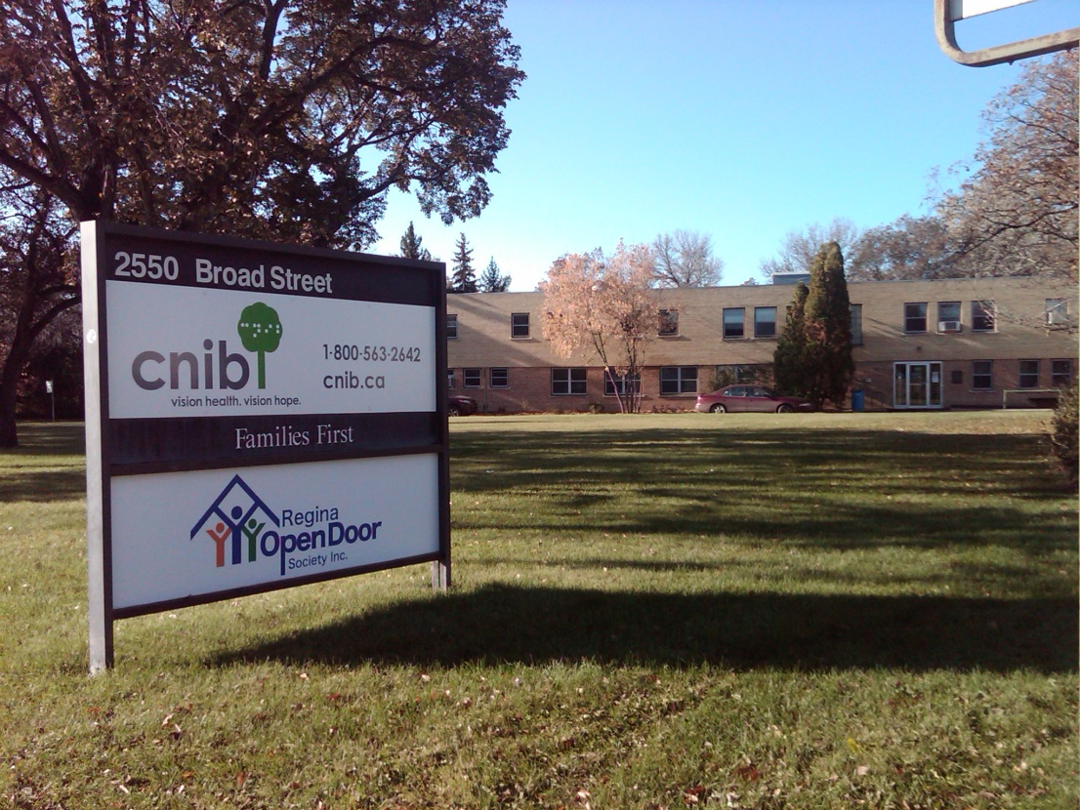
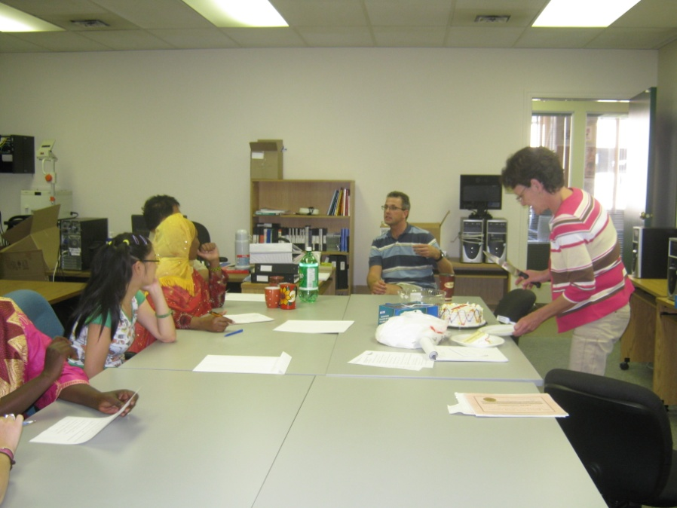
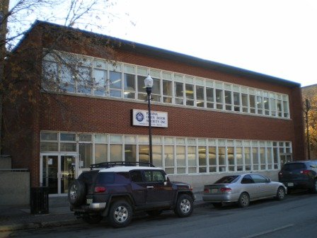
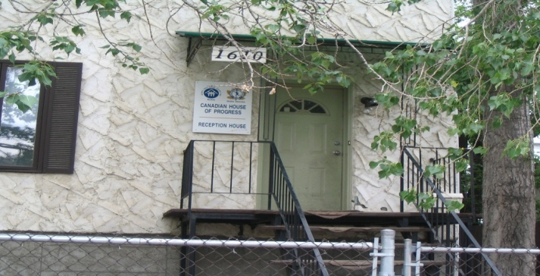

Slide 15

