Slide 1
Family caring for aging immigrants
Daniel W.L. Lai, PhD
Professor
Associate Dean (Research & Partnerships)
Faculty of Social Work, University of Calgary
PRAIRIE METROPOLIS CENTRE: A Centre of Excellence for Research on Immigration, Integration, and Diversity
Calgary Research Symposium University of Calgary - Olympic Volunteer Centre, October 27, 2009

Slide 2
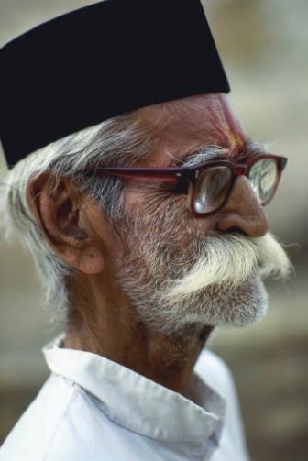
Context
Research, policies, and programs for immigrants often treat older adults as a homogeneous group
Aging immigrants are the minorities in minorities
Care for aging immigrants has become an emerging research focus, due to the increase of the aging population in culturally diverse and immigrant communities
Research on aging immigrants is closely linked with immigrant families – important role in family caring (caregiving)

Slide 3

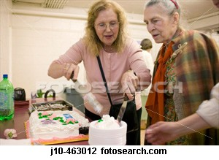
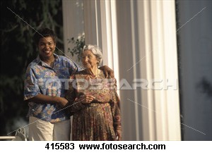
Trends in immigration rates and patterns raise new questions and research focuses about family/friend care because immigrant caregivers may face special challenges:
cultural expectations (Spitzer et al., 2003)
adjusting to the new care environment (Spitzer et al., 2003)
loss of social network due to immigration (Salaff & Greve, 2004)
lack of knowledge of health care system in the new country (Deri, 2005).
Notes:
Family and friend care continues to be an important issue in policy, practice and research, as population aging continues and the government has been emphasizing community-based care for seniors. However, at the same time the supply of family/friend care is less certain for several reasons. For example, increased women’s labor force participation, smaller families, more geographic mobility of family members could mean less capacity in the family/friend care sector. Geographic distance is especially challenging for immigrant families.
Canada receives over 200,000 immigrants each year, and both the number and diversity of immigrants are increasing.
Immigrants currently makes up about 20% of Canadian population, and this proportion is projected to increase. Trends in immigration rates and patterns raise new questions about family and friend care.
Immigrant caregivers are often faced with challenges to fulfill cultural expectations of care while adjusting to the new care environment including new health care system and public policy related to caregiving.
Also, lack of knowledge and information on health care, and language barrier may make it harder for them to access formal care services when caring for seniors.

Slide 4
How do the characteristics of older adults’ care networks vary across ethnic groups? (2002 GSS & 2001 CCHS 1.1) Yoshino, Fast, Dosman, Keating, & Lai (2008)
Ethnic groups | Size (mean) | Female (%) | Close kin (%) | Same household (%)
Canadian | 1.48 | 54.1 | 64.6 | 48.1
British | 1.51 | 53.3 | 62.6 | 42.6
French | 1.51 | 61.3 | 61.3 | 41.8
West European | 1.47 | 54.2 | 64.9 | 44.2
East European | 1.40 | 50.9 | 77.1 | 52.2
South Europe | 1.44 | 54.5 | 80.7 | 61.5
E & SE Asian | 1.45 | 74.2 | 84.7 | 83.8
Aboriginal | 1.70 | 55.1 | 53.7 | 59.0
2,407 respondents age 65+ who received help with one or more tasks in the previous year because of their long term health or physical limitations
Notes:
Most older adults, regardless of ethnicity, had small care networks. Mean size range from 1.4 to 1.7. We performed a test for significance for the size by ethnic groups, and it was not significant.
Small size may be related to the types of tasks that were included.
The tasks included are: Inside Home, Outside Home, Transportation, Personal Care. People who only provided emotional support, checking up, and care management were not includes as care network members.
So, we believe that the size of care networks in this data set is likely to be an underestimation of the actual size.
Next is the gender composition of care network members. This is % of female dominated networks in each ethnic groups. About 51% of East European older adults had female dominated networks, compared to 74% for East and Southeast Asian older adults.
The last one is about proximity composition. This is % of care networks with at least one member living with the older adult. About 42% of French older adults had one of the care network members living with them, compared to about 84% for E/SE Asians.

Slide 5
Types of Network (Relationship) by Ethnic Groups
*
*
* Includes number of other kin
Notes:
Next, we further looked at types of care networks by ethnic groups. Here, the type of care networks is based on relationship composition.
1: Network with only close kin members
2: with close kin and other kin members
3: also includes friends and neighbors
Before reading this graph, I need to inform you what the star means for the last two groups (E/SE Asian and Aboriginal groups). The blue section includes both orange and blue, and we are unable to disclose the specific numbers for the two categories due to small sample sizes.
You can see some patters in the graph, for South European and E/SE Asian groups over 80% of older adults had care networks consisted with only close kin members. Other groups had a little more diversity in the types of networks.
Test for significance for the networks types by ethnic groups was significant, but it might not be very reliable because the size some ethnic groups were fairly small.

Slide 6
Characteristics of Care Network by Immigrant Status
Networks size and characteristics | Canada-born | Immigrants 15 + | Recent Immigrants
Size (mean) | 1.49 | 1.55 | 1.58
Women (%) | 47 | 48 | 62
close kin (%) Other kin Friends/neighbors | 70 12 17 | 73 11 16 | 76 14 10
Employed (%) | 44 | 46 | 31
Notes:
Looking at the characteristics of care network, the proportion of female is much larger for recent immigrants (62%) compared to other two groups.
With respect to the relationship between care receivers and members of networks, slightly higher proportion of members in network for recent immigrant are made up by close kin (76% for recent immigrant as compared to 70% those who are born in Canada). This finding is consistent with the literature that associates immigrants with weaker social tie. Linking this point to social capital, perhaps, it takes time for them to build social capital.
For employment status, recent immigrant has lower rate of employed caregivers than other two groups. Only 31% of members in recent immigrants’ networks were employed.
Does it mean: 1) more recent immigrants are not able to find a job so that they are more likely to take up a caring role? 2) recent immigrants are holding on to stronger familial values regarding their obligations to provide care to the elderly in their family? Or more recent immigrant caregivers are women, probably wives of the (economic) immigrant and so not employed.

Slide 7
Predictors of types of care networks
Variables | Includes Other Kin | Includes Non-kin
Ethnic group (8)
Immigrant status (Yes or no*)
Age (65-74*, 75-84, 85+) |  | + (age 85+)
Gender (Male* or Female) | + | ++
Marital status (Married or unattached*) | + | +
Health status (4 levels)
Education (High school graduate or not*)
Living alone (Yes or no*) |  | +++
In the multinomial regression, close kin only was the reference group (+ p < .05, ++ p < .01, +++ p < .001)
Notes:
This is the results from multinomial regression. The reference group was close kin only group.
-Ethnic groups-----Living status were entered as IV.
-Canadian was the reference groups for ethnic groups.
-Health status was coded as 4 levels, and the healthiest level was the reference group.
-For other IV, coding are on the screen, and the group with star was the reference groups for each IV.
Gender and Marital status of older adults were significant predictors for both types of networks.
Female were more like to include other kin and non-kin in their care networks.
Also, married older adults were more likely to include other kin and non-kin in their care networks.
Those who are older than 85 and who are living alone were more likely to include non-kin members.
As you can see, ethnicity was not a significant determinants for care network types.

Slide 8
Care Provided by Care Network by Immigrant Status
 | Canada born | Immigrants +15 | Recent Immigrants
Family/friends Care (hour/wk) | 6.8 ^{a,b} | 9.5 ª | 14.6 ^{b}
Number of Tasks (fam/fri) | 2.58 ^{a,b} | 2.96 ^{a,c} | 4.58 ^{b,c}
Formal care (h/wk) | 1.9 | 2.0 | 1.3
Number of Tasks (formal) | 0.6 | 0.6 | 0.3
Significant mean differences between: a=Canadian born vs. Immigrants+15, b=Canadian born vs. Recent immigrant, c=Immigrant+15 vs. Recent Immigrant)
Notes:
This table includes results from ANOVA and shows means of care received by immigrant status.
Recent immigrants received the highest average hours of care the most number of tasks from their family and friends network (and fewer tasks from formal care networks) .
Are they less healthy??? –No, they are not
May be the care they required was related to instrumental? E.g. transportation, translation, adjustment to the new Canadian system??
For levels of access to formal care, recent immigrant received in average the least hours and number of tasks, but these differences were not significant.
How about the variable on either receiving or not receiving formal care (i.e. 0 or 1), any significant differences? If yes, what would be the reasons? _No change here.
We also performed Analysis of Covariance to control for care receivers’ level of disability.
Amount and number of tasks received by family/friend care network significantly varied by immigrant status even when level of disability was controlled for.

Slide 9

Lai, D.W.L. (2007). Cultural predictors of caregiving burden of Chinese-Canadian family caregivers. Canadian Journal on Aging, 26(suppl.1), 133-148.
Being an immigrant, having a Western and non-Western religion as compared to having no religion, and having a lower level of filial piety, were the significantly related to higher caregiving burden.
Caregivers who are younger and those who are less financially adequate reported a higher level of caregiving burden. Those who cared for care receivers reporting more health problems or more caring needs in ADL and IADL also reported being more burdened. All the predictors explained a total of 44.8 per cent of the variance in caregiving burden.

Slide 10
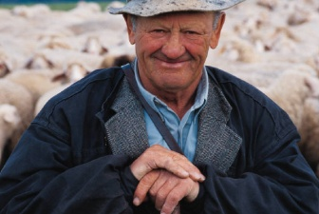
Lai, D.W.L., & Leonenko, W. (2007). Effects of caregiving on employment and economic costs of Chinese family caregivers in Canada. Journal of Family and Economic Issues, 28(2), 411-428.
Caregiver’s age, financial adequacy, employment, caring for an additional care receiver, and providing higher levels of assistance in activities of daily living (ADL), were the predictors for the high level economic costs perceived by Chinese family caregivers .
For Chinese family caregivers who were 45 to 65 years old, 2.9% reported having left their paid position due to their duties as a caregiver. This proportion is higher than the 2% reported by the general Canadian caregivers within the same age range in another national study (Decima, 2002).

Slide 11
Lai, D.W.L. (2007). Statesman Seniors’ Caregivers Survey: Executive Summary. Calgary, AB: Faculty of Social Work, University of Calgary.
In Calgary (i.e. Statesman Study), immigrant caregivers are younger in age, have a higher level of education, and have a larger household size than non-immigrant caregivers.
More immigrant caregivers (48.5%) were the primary caregiver than non-immigrant caregivers (35.3%).
More immigrant caregivers (18.3%) provided care to more than one senior than non-immigrant caregivers (8.7%).

Slide 12
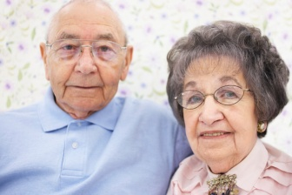
Immigrant caregivers vs non-immigrant caregivers:
Lower life satisfaction (3.91 vs. 4.10)
Higher life stress (2.89 vs. 2.68)
Higher economic costs of caregiving (1.69 vs. 1.47)
More barriers to accessing services (3.88 vs. 2.94)

Slide 13
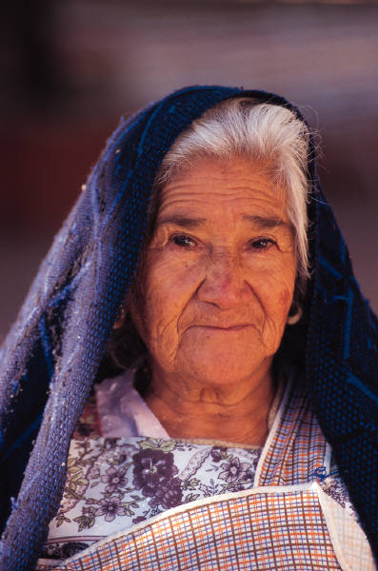
Lai, D.W.L. (2008, June). Ethno-cultural context of caregiving. A presentation at the Caregiving and Employment: Moving policy and practice forward. A policy workshop of Hidden Costs Invisible Contributions (HCIC) Research Program. Co-sponsored by Human Resources and Social Development Canada (HRSDC) and Policy Research Initiative (PRI). Ottawa, Crowne Plaza Ottawa, June 17.

Slide 14
Access Barriers | Immigrants | Non-immigrants
Not knowing existing services | 45.6% | 32.7%
Worry about being seen as having problems | 29.4% | 17.3%
Professionals do not understand caregivers’ culture | 26.5% | 8.1%
Professionals do not speak caregivers’ language | 30.9% | 9.2%
Not having the transportation to go using the service | 22.1% | 11.4%
Data Source: Lai, D.W.L. (2007). Statesman Seniors’ Caregivers Survey: Executive Summary. Calgary, AB: Faculty of Social Work, University of Calgary.

Slide 15
 | Immigrants | Non-immigrants
Provided 10 hours or more of care | 3.2% | 2.6%
Spending unpaid time looking after children | 57.6% | 53.3%
Not speaking either one official language | 4.8% | .1%
Working full time | 80.1% | 75.6%
Household income adjusted for household size | $20664 | $23293
Personal annual income | $28922 | $28012
Personal income < low income cut off | 17.4% | 11.9%
Data source: 2006 Census

Slide 16
 | Visible minority caregivers | Non-visible minority caregivers
Working full time | 78.8% | 76.1%
Spending unpaid time looking after children | 64.4% | 52.9%
Household income adjusted for household size | $17553 | $23444
Personal annual income | $22435 | $29305
Personal income < low income cut off | 21.5% | 11.9%
Not speaking one of the official languages | 6.6% | .3%
Data source: 2006 Census

Slide 17
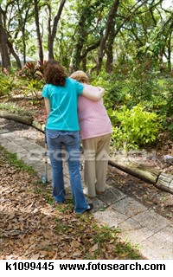
Implications
As the composition of the care network varies by immigrant status, there maybe different needs for support depending on immigrant status and gender.
There is a need to further examine the associations between immigration and care with bigger sample sizes.
Future study needs to consider heterogeneity among immigrants by incorporating the influence of cultural variables into the analysis.

Slide 18
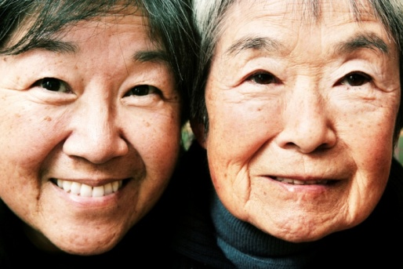
The disadvantaged socio-economic status and barriers that are often reported by immigrant and visible minority caregivers revealed the adjustment challenges, access barriers, and mental and physical health concerns (Wong & Tsang, 2004).
All these challenges result in a “double-jeopardy” phenomenon facing caregivers who are also immigrants, adding another layer of complications and burdens.

Slide 19
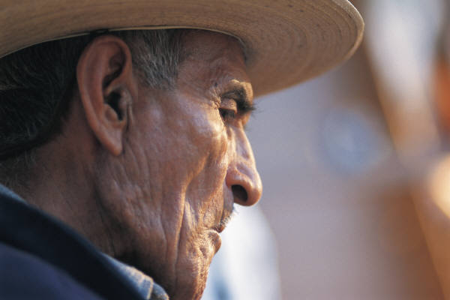
Structural circumstances such as family structure, living environment, housing, employment, and economy, often do not allow traditional filial piety to be nurtured.
Policies should consider the limitations and challenges that individual family caregivers face, particularly immigrant and visible minority caregivers, and should not take filial piety or obligations for granted.

Slide 20
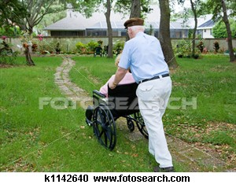
Financial support, employment policies, availability of support services for family caregivers should also attend to the unique socio-cultural circumstances of immigrant and visible minority family caregivers.

Slide 21
Immigration, Culture, and Caregiving: Research and Practice
Effects of Culture on Caregiving
Immigrant status, country of origin, languages, race, ethnic origin, ethnicity, cultural norms, cultural values and beliefs, religion/spirituality
Motivation and Rationales
Affection, love, intimacy
Reciprocity
Filial piety and obligation
Caregiving Outcomes
Stress and burden
Depression and mental health
Economic, financial, social
consequences
Family
Caregivers
Older Adults
Roles and Responsibilies
Daughters and sons
Wives
Daughters-in-law
Spousal roles
Use of Formal Services
Underutilization
Myths and misunderstandings
Access barriers
Availability of services
Systemic Discrimination and Challenges
Practice and Policy Implications
Cultural competence
Aware of structural issues
Access to informal and formal support and resources
Aging process and changes to older adults
Family caregivers’ other roles and responsibilities

