Slide 1
Patterned Interaction and Identity construction
Iranian Network
Kosar Karimi Pour
MA Sociology Candidate
University of Regina
Fall 2009

Slide 2
Ethnic identity
1- Theoretical side: Charles Tilly’s transactional model
2- Methodological side: Social Network as a methodology which is convergent with Tilly’s theory
3- Application
Notes:
Since March 2008 I have been to come up with an ontological, epistemological, and methodological standpoint. And these are what I’ve came up with up to now:
1- Theoretical side: Charles Tilly’s transactional model (my ontological and epistemological standpoint toward the issue of identity)
2- Methodological side: social network as a methodology which is convergent with Tilly’s theory
3- Application: I am going to apply this theory and method on Iranians and Francephones
I have divided my presentation into the above three parts.

Slide 3
1- Theoretical side: Charles Tilly’s transactional model
2- Methodological side: Social Network as a methodology which is convergent with Tilly’s theory
3- Application

Slide 4
The general explanation of social phenomena
Phenomenological individualism or dispositional explanations
Holism or systemic explanations
Alternative explanations
Notes:
The general explanation of social phenomena is divided into three types: phenomenological individualism or dispositional explanations, holism or systemic explanations, and what I call alternative explanations. The analysis of the first two types of explanations is founded on the concept of individual and structure respectively.
The core assumption of phenomenological individualism is that single individual parts determine the nature of wholes, and therefore sociology does not have an autonomous existence in their opinion and can be reduced to psychology.
But, holism assumes that a whole is more than the sum of its parts, and determines the nature of its parts. Wholes have independent needs, aims, and interests. Wholes “have their own self-sustaining logic” (Tilly, 1998, p. 40).
However, the alternative explanations such as mechanism explanation, transactional model, relational realism, methodological individualism, and structuration theory do not believe in the separation of individual and structure, and each of them develops a different way to integrate these two.
So, what I call alternative explanations are best understood as a response to the limitations of these two.

Slide 5
Transactional explanation
Charles Tilly’s alternative explanation
In transactional explanation “transactions, interactions, social ties, and conversations constitute the central stuff of social life”.
Tilly, 1998, p. 41

Slide 6
What does Tilly mean by transaction or interaction?
Dispositional and systematic explanation:
  A social actor first thinks something, and then interacts over that thing with another actor.
Transactional explanation:
  Social actors form each other in transactions
  Individual is an accumulation of the residue of numerous transactions
Notes:
What does Tilly mean by transaction?
Dispositional and systematic explanation perpetuates the idea that a social actor first thinks something, and then interacts over that thing with another actor.
Click: But in transactional explanation the point is that social actors form each other in transactions, and frequently actors do not know how transactions are going to end until they watch how the other responds. The transaction is the core element and transactional explanations build out interpretation from transaction to individuals, with the idea that the “individual is an accumulation of the residue of numerous transactions” (Tilly, 2007).

Slide 7
From single interaction to a pattern of interactions
An abstract a pattern of interaction from compounding particular interactions.
Notes:
Then, Tilly also talks about a shift from observing single interactions at a small scale to a pattern of interaction. It is possible to take an interaction at a small scale and to compound that particular interaction and other similar ones into descriptions of what Tilly calls performances. Tilly (2007) provides the example of a weaver shouting at a master in London. Similar interactions in this example mean all the interactions that occur when all the weavers are coming out and shouting at the masters, and when after a while another group of weavers from the same section of London appear and do something like a repeat performance, and this is when social scientists can start compounding: they can compound these performances into the picture of a whole pattern of interaction in a place like Great Britain over a long period of time. By analogy, among those individual interactions and relations which consist of a subordinate dissing the super-ordinate, it is perfectly possible to abstract a pattern of interaction.
Think about silent racism as a pattern of interaction and think about what is called low level of assimilation as a pattern of interactions.

Slide 8
Cause and effect analysis in transactional explanation
A standard story: individuals or collectives cause each others’ action
A transactional explanation story: the linear cause and effect chain cannot be seen, and individuals, and also collectives, are seen instead as changing products of interactions
  Indirect effects, unintended effects, cumulative effects, incremental effects, environmental effects, feedback, mistakes, repairs, and unanticipated consequences that result from interpersonal transactions
Notes:
Cause and effect analysis in relational realism differs from the common perception of it.
Tilly (1998) remarks that, for reasons which might lie in the early stages of the socialization process or in cultural immersion, people usually recognize and remember their own experiences as a ‘standard story’. What is a standard story? In a standard story individuals or collectives cause each others’ actions and outcomes.
Click: However, in relational realism the linear cause and effect chain cannot be seen, and individuals, and also collectives, are seen instead as changing products of interactions; as a result, there are a number of concepts which play a crucial part in transactional explanation stories but not in ‘standard stories’, including among others indirect effects, unintended effects, and cumulative effects. incremental effects, environmental effects, feedback, mistakes, repairs, and unanticipated consequences that result from interpersonal transactions” (Tilly, 2005, p. 7).

Slide 9
What does make up collective identity?
Boundaries
Cross-boundary relations
Within-boundary relations
Stories
Notes:
The concept of identity is based on the idea that there are boundaries which separate us from others. People have internal relations and external relations, and people make collective stories about boundaries, in-group relations and out-group relations. “Together, boundaries, cross-boundary relations, within-boundary relations, and stories make up collective identities” (Tilly, 2005, p. 8). Because of the public and relational nature of identity, each actor has multiple identities for each tie or network to which s/he is attached; racial or ethnic identity, gender identity, and socio-economic class identity are among the most famous examples.

Slide 10
1- Theoretical side: Charles Tilly’s transactional model
2- Methodological side: Social Network as a methodology which is convergent with Tilly’s theory
3- Application
Notes:
* Following Wasserman and Faust in their book Social Network Analysis, Methods and Applications, I have regarded social network as a research methodology

Slide 11
Social Network is the most appropriate research method when
The emphasis is on the relational variables rather than attributes
The structural relations play a more important role in the observed behavior, perceptions, and beliefs than attributes
The theoretical concepts are relationally defined and in the theoretical framework the processes are expressed as relational processes

Slide 12
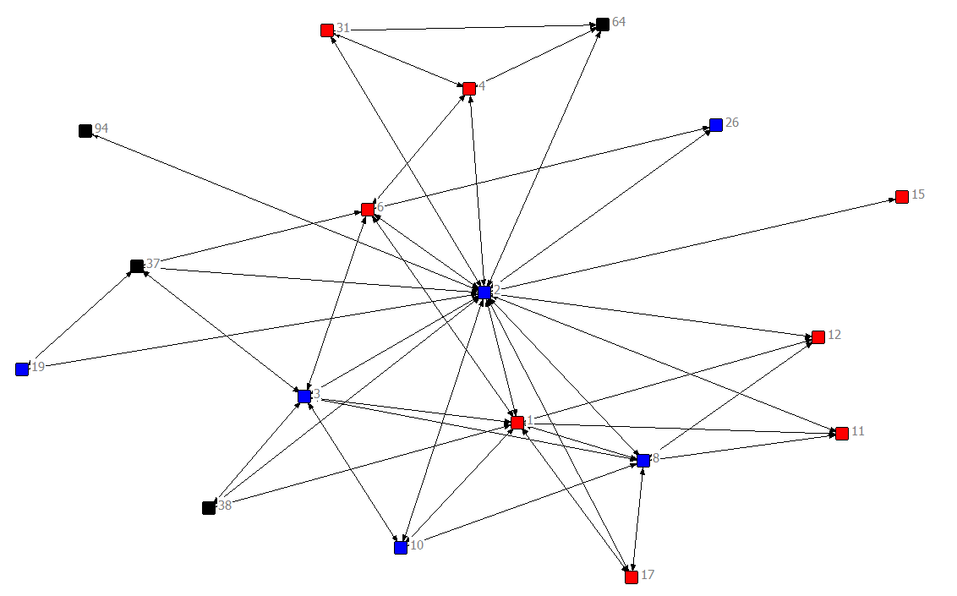
Your close friends are ones with whom you spend much of your spare time, for example, you regularly meet them for a drink, and you feel comfortable with them. Name your close friends.

Slide 13
The power of network analysis
“The ability to model the relationships among systems of actors”
Wasserman & Faust, 1994, p. 19
Notes:
Relational concepts, which are defined by the project’s theoretical framework, are mathematically defined as well by social network analysis tools. In other words, this method searches for the existence and characteristics of repeated and regular patterns in relationships. This is the power of network analysis: “the ability to model the relationships among systems of actors” (Wasserman & Faust, 1994, p. 19).

Slide 14
The convergence of Tilly’s thoughts with Social Network

Slide 15
1- Theoretical side: Charles Tilly’s transactional model
2- Methodological side: Social Network as a methodology which is convergent with Tilly’s theory
3- Application

Slide 16
What does make up collective identity?
Boundaries
Cross-boundary relations
Within-boundary relations
Stories
Notes:
Recall
Link to the next slide

Slide 17
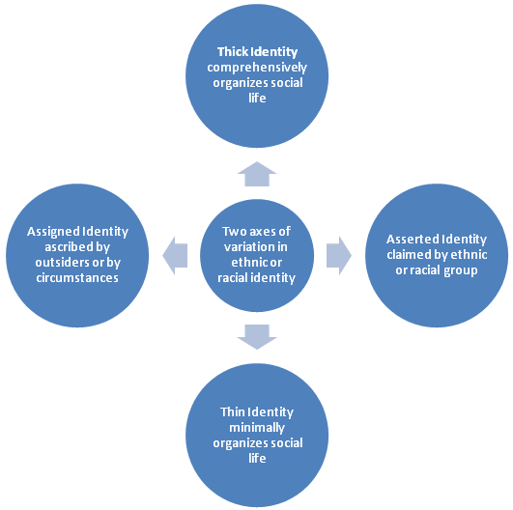

Slide 18
Two different stories:
  Early 1980s and before (Islamic Revolution: 1979)
  Early 1990s and
Notes:
The Iranians in Sheffield can be divided into two different groups based on the time that they left Iran. The first group left Iran in the late 1970s and early 1980s.
1980s the claims that “others” made about Iranians changed as a result of the revolution and the negative image which was made of Ayatollah Khomeini’s leadership => external factors had a big impact on the Iranians’ ethnic identification => Iranians accepted this new shape and tried to hide their ethnic identity => a clear boundary between English people and Iranians was formed => a thin ethnic identity which is more assigned than asserted
During the 1908s almost no one left Iran
The second group left the country later, after the 8-year war and during Rafsanjani’s and Khatami’s presidencies, in the very late 1980s and after that..
1990s: Changes in the political relationships between Iran and western countries during Rafsanjani’s and Khatami’s presidencies =>Iran’s political situation today is not as sensitive=> the role of “others” in shaping Iranian identity is less active => a thick identity which is more asserted than assigned

Slide 19
Your close friends are ones with whom you spend much of your spare time, for example, you regularly meet them for a drink, and you feel comfortable with them. Name your close friends.

Slide 20
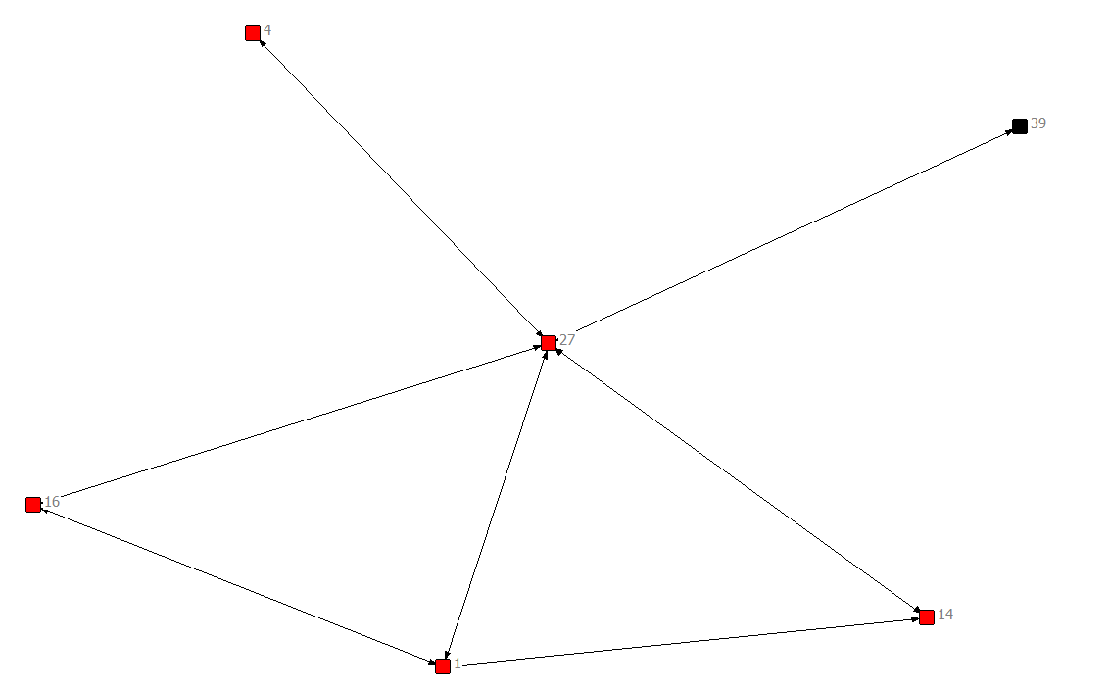
Your close friends are ones with whom you spend much of your spare time, for example, you regularly meet them for a drink, and you feel comfortable with them.

Slide 21
The question is
Is there any difference between the comprehensiveness of Iranian identity of the first and second group?
Notes:
The main research question is about the comprehensiveness of Iranian identity for the first and second group. For the first group of Iranians, those who left Iran in the 1980s and before, Iranian identity is assumed to be less important. Although people in both of the groups feel Iranian, the extent to which they are practically Iranian does not seem to be the same. It is expected that for those who have lived longest in the UK, those who have lived in the UK during Ayatollah Khomeini’s leadership in Iran, those who have lived with a non-Iranian partner, those who have half-Persian children, those who have been a part of the economic mainstream, and those who came to the UK alone and as individuals (not as a family), the experience of being Iranian should have been thin. This hypothesis considers the extent to which those different groups of Iranians, who left Iran earlier and later, are different in being Iranian practically (in their distinctive cultural practices) or the same in feeling Iranian (in their sense of ethnic distinction).
Social capital: The two groups are expected to have different dimensions of social capital: the first group, who have been in the UK for more than twenty years, are presumed to have different kinds of ties with other members of the network and with outsiders as a result of living in the UK for years and experiencing a period of thin and assigned identity. They are assumed to play an intermediary role between Iranians and non-Iranians. In contrast, the second group are presumed to have more dense friendship, work, and family ties within the network.
Local/cultural human capital: Local human capital refers to different skills which help people to interact with outsiders. The first group are supposed to have more developed local human capital in comparison with the second group.
The social capital of the first group is less developed than that of the second group (different kinds of ties);
The human capital of the first group is more developed than that of the second group

Slide 22
Bibliography
Cornell, S., & Hartmann, D. (2007). Ethnicity and race: making indentities in a changing world. Tousand Oaks: Pine Forge Press.
Diani, M. (2007). ‘The relational element in Charles Tilly’s recent (and not so recent) work’. Social Networks, 316-232.
Hughes, J., & Sharrock, W. (1997). The philosophy of Social Research. Essex: Longman.
Ritzer, G., & Douglas, J. G. (2003). Sociological Theory. New York: McGraw-Hill.
Scott, J. (2007). Social Network Analysis. London: Sage.
Senge, P. M. (1992). The fifth discipline: the art and practice of the learning organization. London: Century Business.
Tilly, C. (2005). Identities, boundaries, and social ties. Boulder: Paradigm Publishers.
Tilly, C. (1998). ‘Micro, Macro, or Megrim?’ In J. E. Schlumbohm, Mikrogeschichte, Makrogeschichte: komplementär oder inkommensurabel? (pp. 33-54). Göttingen : Wallstein Verlag.
Tilly, C. (2007, Sep 15). Paradigms and research programs in the social sciences. (D. Little, Interviewer). From http://www.youtube.com/watch?v=HjESyyQ16AI&feature=PlayList&p=73ABDF5D9781DF91&index=5 (Accessed: Sep 2009)
Wasserman, S., & Faust, K. (1994). Social network analysis, Methods and applications. Cambridge: Cambridge University Press.

