Slide 1

Recent Senior Immigrants’ Social Integration In Canada
Prairie Metropolis Centre Research Symposium
October 26th, 2009
Presenter: Adam Belton

Slide 2
Focus of Today’s Talk:
Main research focus is ‘social security’ of recent senior immigrants (OAS, CPP)
Today → Focusing on social integration
Demographic changes in immigration
Family Reunification Program → senior immigrants
Social Aspects
Knowledge of Official Languages
Overcrowded Housing

Slide 3
Demographics and Recent Changes
Canada receives ~250,000 immigrant/yr.
Family Class ~ 65,000
Parents and grandparents ~ 17,000
Historical European Source Countries:
U.K., Italy, and the U.S.
2007 Major Source Countries in Asia:
China & India (11%), Philippines (8%)
Citizenship and Immigration Canada, 2007, 2008

Slide 4
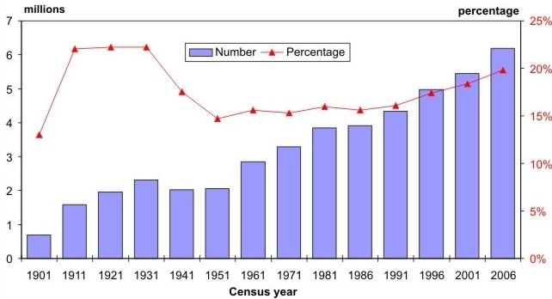
Canadian Immigration 1901-2006
Statistics Canada
Immigrant population proportion near pre-depression level

Slide 5
Family Reunification Program:
Intended to reunify non-spousal family members with those already immigrated
Problematic Rules:
10-year sponsorship period for family
Min. income for sponsorship ~ LICO
10-year min. residency for OAS/GIS
Canada does not have ISSAs with many of recent major source countries

Slide 6
Half Spoke Neither English or French
Less than half of recent senior immigrants arriving between 1996 and 2001 spoke either official language.
 | Age 65-74 | Age 75-84 | Age 25-34 | Age 35-44
Immigrated 1996-2001 | 53% | 54% | 4% | 7%

Slide 7
Familial Support
Reliance on family members for linguistic support (as well as financial, social, etc.) might be one of the reasons for the importance of reunification for family-class immigrants: “over 90% of who chose their final destinations based on where their spouse, partner or family members live”. (Statistics Canada 2003: Longitudinal Survey of Immigrants to Canada: process, progress and prospects, p. 16)

Slide 8
Seniors’ Primary Language At Home
 | Eng./Fr. | Chinese | Alt. Asian (A)/ Alt. Euro. (E)
Canadian-born | 88% | 7% | 6% (E)
Imm. Pre-1981 | 63% | 18% | 19% (E)
Imm. 1981-’90 | 26% | 26% | 18% (A)
Imm. 1991-’95 | 15% | 40% | 17% (A)
Imm. ’96-2001 | 16% | 30% | 22% (A)
Statistics Canada, 2001 Census

Slide 9
Housing Overcrowding
 | Age 55-64 | Age 65-74 | Age 75-84 | Age 85 or older
Canadian-born | 0.3% | 0.2% | 0.2% | 0.1%
Immigrated 1991 - 2001 | 16.7% | 14.3% | 9.8% | 15.7%
Immigrated 1996 - 2001 | 19.2% | 16.7% | 13.3% | 25.6%
Statistics Canada, 2001 Census

Slide 10
Where Now?
To conclude … demographic changes require we re-evaluate both policy and societal supports given the increasing levels of immigration to Canada
Thank you for listening.
Questions?

