Slide 1
Min-Cost Live Webcast under Joint Pricing of Data, Congestion and Virtualized Servers
Rui Zhu¹, Di Niu1, Baochun Li²
¹Department of Electrical and Computer Engineering
University of Alberta
²Department of Electrical and Computer Engineering
University of Toronto

Slide 2
Roadmap
Part 1 A joint pricing of data, congestion and virtualized servers
Part 2 Min-cost multicast as k-NWST
  The first PTAS proposed
Part 3 Trace-driven simulations
Part 1 A joint pricing of data, congestion and virtualized servers

Slide 3




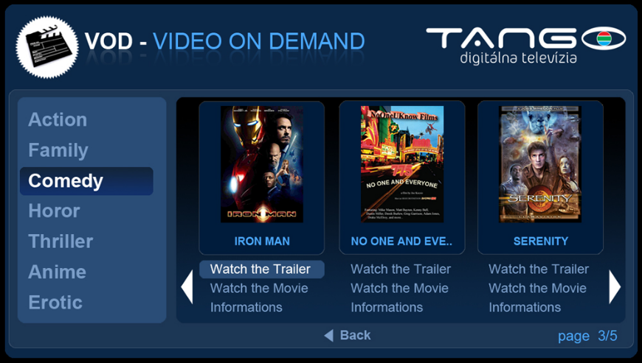



Live Webcast
Problem: Large amount of data transferring
Significantly contributing to traffic congestion
Engaging many server resources, etc.

Slide 4
Existing pricing policies
Charge end users – conventional
  Monthly flat rate/ Pay-as-you-go/Both
  Excessive burden on clients
Charge content/application provider
  Encourage customers to use more
  E.g. Telus: free six-month subscription of Rdio

Slide 5
How should webcast operators pay for the video delivery service?

Slide 6

A road pricing motivation
Distance traveled pricing
  Transferring data
Congestion specific pricing
  Congestion degree

Slide 7
Congestion pricing
Charge the webcast provider
  A per-minute price rate on each link
Pricing rate ∝ bandwidth-delay product
    Related with the media streaming topology
Encourage webcast operator minimize its “waiting data”
Notes:
Cloud is an expert in demand estimationPredictive autoscaling: prepare in advanceQuantitative risk management via statisticsLoad direction, fault toleranceCloud can multiplex the demand now, leading to reduced service cost and prices.

Slide 8








Cost of servers
Recoding and resending
Operation cost
Client
Download from source

Slide 9
Roadmap
Part 1 A joint pricing of data, congestion and virtualized servers
Part 2 Min-cost multicast as k-NWST
  The first PTAS proposed
Part 3 Trace-driven simulations

Slide 10
System model
Client
CDN Servers
Source

Slide 11
F
F
S
F
F
Objective: minimize the total cost including data transferring, congestion and server opening
Notes:
w_i is not necessarily 1

Slide 12
Formulating the problem
Server congestion
Service congestion

Slide 13
Formulating the problem
Opening cost

Slide 14
Formulating the problem
Optimal solution is a tree
Each client belongs to one server

Slide 15
The data cost
The total data transferred per unit time is proportional to the total number of selected edges
Given the video bit rate r, the total data transferred is
Since nr is a constant, this cost can be incorporated into the server opening cost

Slide 16
Unfortunately, it is a hard problem.

Slide 17
Let’s start by ignoring the opening cost
Then, f_{i}=0 for all relay servers.
Only congestion cost are considered.
Equivalent with an very famous hard problem, Steiner Tree. (NP-hard, even within 1.0105)
M. Chlebik, J. Chlebikova.
The Steiner Tree problem on graphs: Inapproximability results. Theoretical Computer Science, 2008

Slide 18
If we don’t consider the inter-server connection
Case 1: No cost for inter-server connections.
Case 2: No inter-server connections are permitted.
In both case, they are equivalent with Uncapacitated Facility Location problem, another NP-hard problem.

Slide 19
No server number constraint?
Well, it is called Node-Weighted Steiner Tree problem (NWST).

Slide 20
NWST – Existing Results
NP-hard to approximate within
C.Lund, M. Yannakakis
On the hardness of approximating minimization problems. Journal of the ACM, 1994
Currently best known ratio:
S. Guha, S. Khuller.
Improved methods for approximating node weighted Steiner trees and connected dominating sets. Information and Computation, 1999

Slide 21
The linear relaxation

Slide 22
A PTAS for k-NWST
Original problem
The Lagrangian relaxation

Slide 23
Lagrange multiplier λ as opening cost: f_{i}’ := fi + λ
Subroutine Algorithm¹:
A PTAS for NWST with additional opening cost
¹P. Klein, R. Ravi.
A nearly best-possible approximation algorithm for node-weighted Steiner trees. J. Algorithm, 1995

Slide 24
A PTAS for our problem
1
Searching for proper Lagrange multiplier λ
Convex combination of
P₁ and P₂
2
If μ₂>1/2, output P₂.
Otherwise, select some nodes in P₂ and add them in P₁
3

Slide 25
Step 1: find proper λ
For sufficiently large λ, the opening cost dominates
For sufficiently small λ, the cost depends on congestion, making more to open
The binary search can find two trees near the server constraint

Slide 26
Step 2: Convex combination
Convex combination of P₁ and P₂
where is the total opening cost
is the total congestion cost

Slide 27
Step 3: Merge P₁ and P₂

Slide 28
Target: select k-k₁ nodes from P₂
P₂
P₁

Slide 29
Double edges of P₂
P₂
P₁

Slide 30
Find the Euler tour and shortcut to tour
P₂
P₁

Slide 31
Find the Euler tour and shortcut to tour
P₂
P₁
Average cost:
Then, we have:

Slide 32
Connect P₁ to the cheapest path of tour
P₂
P₁

Slide 33
The total server cost

Slide 34
The upper bound for total cost
Since , we have

Slide 35
Conclusion (Approximation Ratio)
Our PTAS can approximate k-NWST with a ratio of

Slide 36
Roadmap
Part 1 A joint pricing of data, congestion and virtualized servers
Part 2 Min-cost multicast as k-NWST
  The first PTAS proposed
Part 3 Trace-driven simulations

Slide 37
Inter-server and server-client delay traces
Traces collected from PlanetLab and from the Seattle project
  Monitor the RTTs among 8 Planet nodes for a 15-day period
  Monitor the RTTs from the 8 Planet nodes to 19 Seattle nodes

Slide 38
Opening cost assignment
The opening costs (including data) for CDN edge nodes are from pricing policy by Amazon Web Service (Amazon CloudFront)

Slide 39
Baseline Algorithm
Randomly chooses a subset of servers to open
With no inter-server connections
Connects each client to its closet server.

Slide 40
The cost computed by our algorithm
Performance Ratio
Number of Servers

Slide 41
The cost computed by baseline algorithm
Performance Ratio
Number of Servers

Slide 42
Conclusions
A joint pricing policy of data, congestion and virtual servers for live webcasting application providers
Model the Min-cost multicast and provide the first PTAS for it
Future work:
  Only routing are considered, how about using network coding?

Slide 43
Thank you
Rui Zhu
Department of Electrical and Computer Engineering
University of Toronto

