Slide 1
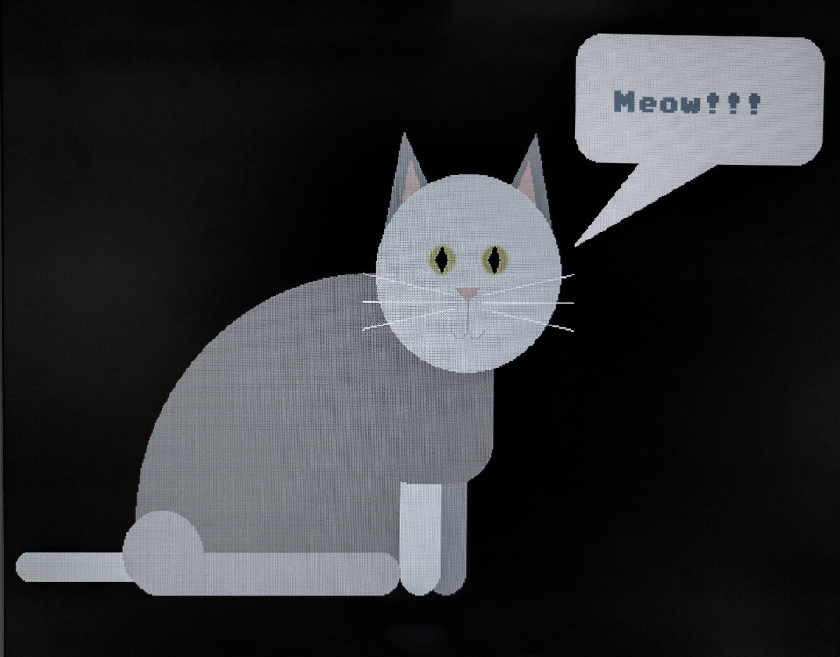
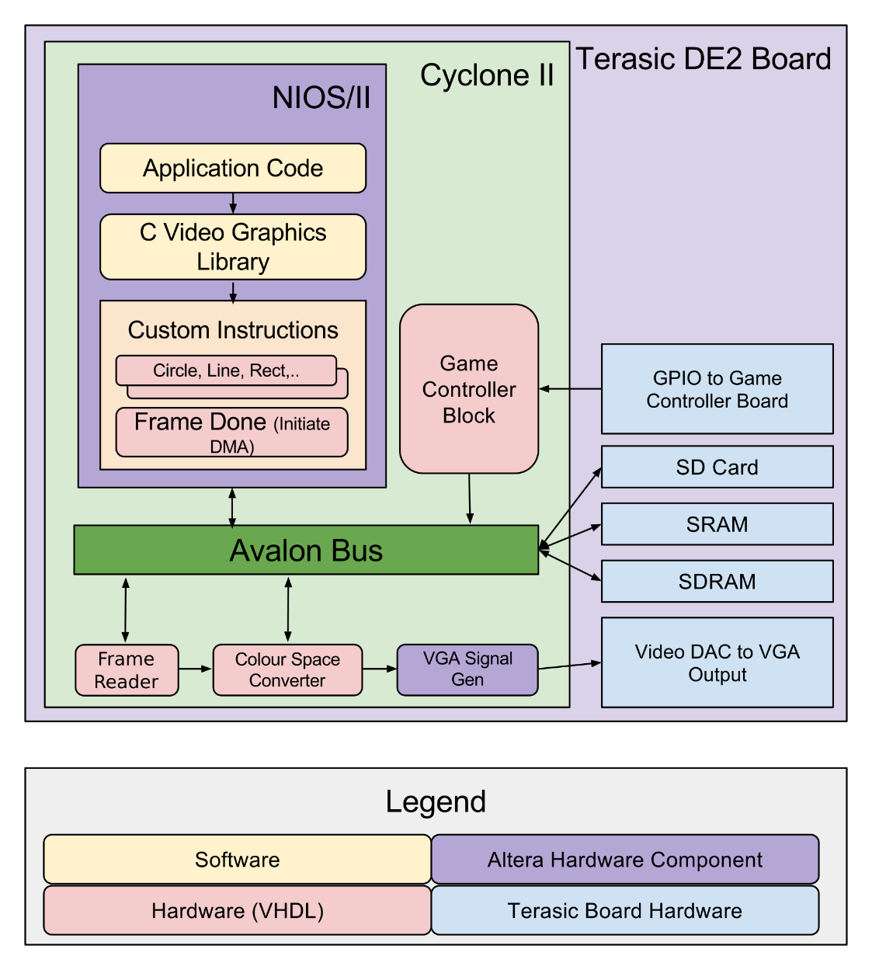
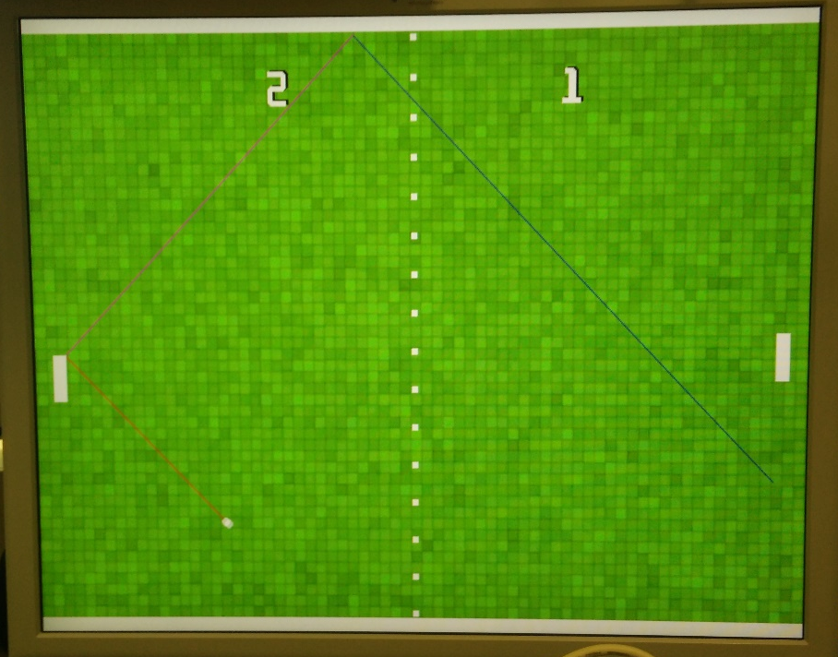
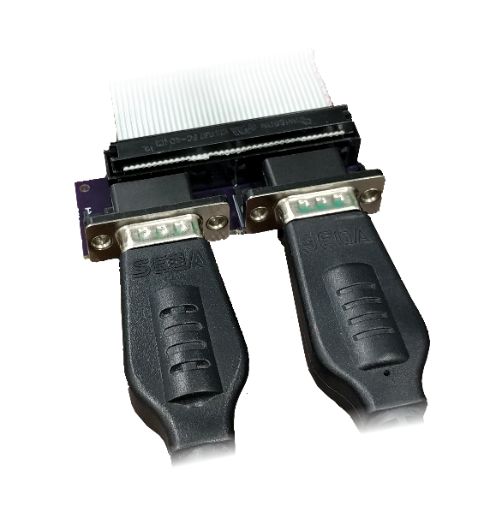
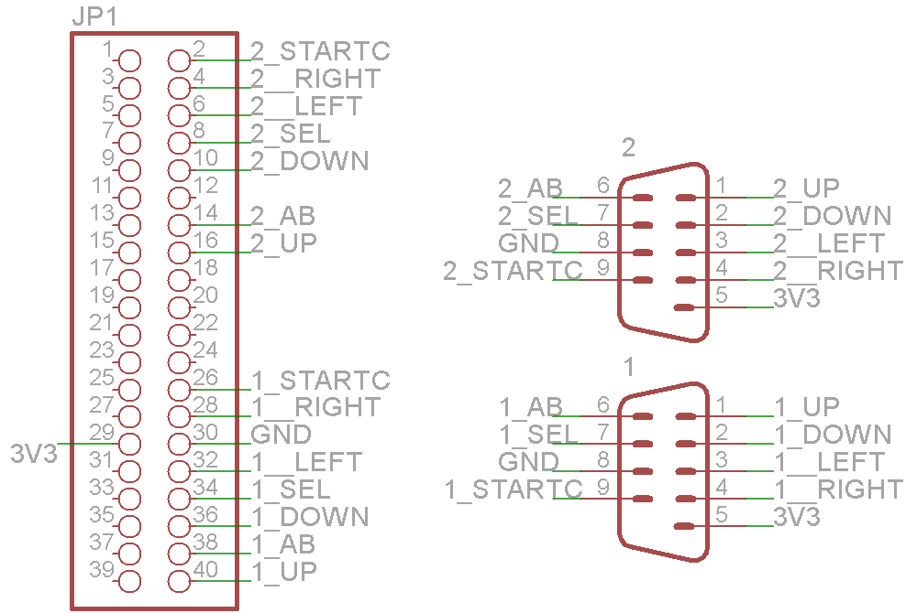
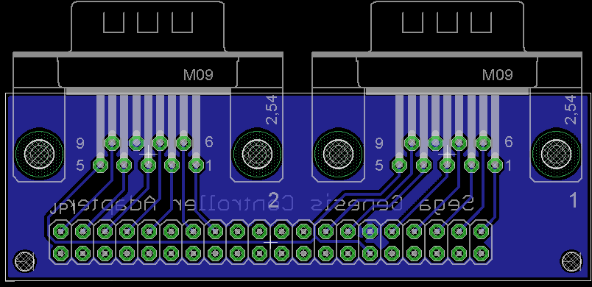

ECE 492 - Computer Engineering Design Project
2D GPU Platform with Hardware-Accelerated Features
Stephen Just, Mason Strong, Stefan Martynkiw | 2016
Use Case
To produce a comprehensive and performant graphics platform capable of outputting 640x480 video with a DE2 board. This video can have 256 on-screen colours and a maximum frame rate of 60fps.
By providing several operations in hardware, our platform achieves significantly faster performance than could be achieved in software alone.
The platform can be combined with other components to extend its capabilities.
Hardware Design
Each graphics primitive is implemented as a custom CPU instruction that operates on a framebuffer.
The 512KB SRAM stores a framebuffer that is continuously displayed through the VGA output stages. To eliminate tearing, each graphics primitive operates on a framebuffer in the SDRAM. When the “frame done” instruction is called, the hardware performs bursting DMA transfers from SDRAM to SRAM during the video blanking period. Layering and compositing are performed on the framebuffers in the SDRAM.
Software Design
Our custom hardware is exposed to the programmer through an easy-to-use C API.
Benchmarks/Performance
The performance of our hardware is related to the number of pixels written to a framebuffer. Displaying bitmaps is limited by SDRAM IO, and corresponding layer compositing.
Each plotted primitive is as large as will fit in the screen size. Our figures illustrate the performance benefits of utilizing the hardware accelerated capabilities on this platform.
#include <io.h>
#include <system.h>
#include <sys/alt_stdio.h>
#include "sys/alt_timestamp.h"
#include <string.h>
#include "graphics_commands.h"
#include "palettes.h"
int main()
{
graphics_init();
graphics_clear_screen();
switch_palette(&palette_ega);
graphics_draw_rectangle(graphics_get_final_buffer(), 0, 0, 640, 480, 15);
ALT_CI_CI_FRAME_DONE_0; //Draw the Frame
graphics_draw_circle(graphics_get_final_buffer(), 640/2, 480/2, 239, 3, 0);
graphics_draw_circle(graphics_get_final_buffer(), 640/2, 480/2, 239, 4, 1);
graphics_draw_line(graphics_get_final_buffer(), 0, 0, 640, 480, 5);
ALT_CI_CI_FRAME_DONE_0;
print2screen(graphics_get_final_buffer(), 20, 20, 6, 2, "Hello, World!");
graphics_draw_triangle(graphics_get_final_buffer(), 15, 112, 300, 112, 170, 240, 1, 9);
ALT_CI_CI_FRAME_DONE_0;
return 0;
}
Primitive | Time (ms)
Hardware Filled Rectangle | 2.21
Software Filled Rectangle | 130.31
Unfilled Circle | 0.29
Software-Filled Circle | 14.86
Two Software Triangles | 66.44
Diagonal Line | 0.075
Horizontal Line | 0.017
“Hello, World!” font (average) | 7.73
Layer Copy | 5.91
Layer Copy with Transparency | 5.91
Palette Switch | 0.50
Processing Deadline for 60fps | 13.16
Processing Deadline for 30fps | 29.83
Fig. 3. API Usage Example
Fig. 1. Static graphical demonstration showing hardware primitives.
Pong
To demonstrate the features and capabilities of our graphics platform, we built a version of Pong. This version of Pong uses both controllers, the line-drawing hardware, rectangles, fonts, and bitmaps.
Several “undocumented features” are available by pressing the controller buttons. Discovering all of the features is up to the player.
Graphical Features
Hardware-Accelerated Features:
Multiple Layer Compositing (via DMA)
SD Card Reading & Bitmap Drawing
Game Controller Input
Color Palette Shifting (256 color→16-bit RGB)
Lines, Circles, Rectangles, Triangles, Rounded Rectangles [1]
Partially Hardware-Accelerated Features:
Filled Circles, Filled Triangles, Fonts
Fig. 5. Performance Figures.
Future Work
Our platform is designed to be extended. Future work can include: creating different applications using the platform, adding support for higher resolutions, adding audio output support, or expanding the capabilities of our graphics primitives .
References
[1] J. Bresenham, "Pixel-processing fundamentals," in IEEE Computer Graphics and Applications, vol. 16, no. 1, pp. 74-82, Jan 1996.
[2]C. Rosenberg, "Sega Six Button Controller Hardware Info", Cs.cmu.edu, 1996. [Online]. Available: https://www.cs.cmu.edu/~chuck/infopg/segasix.txt. [Accessed: 18- Jan- 2016].
Fig. 2. System Block Diagram
User input consists of two Sega Genesis controllers, chosen for their interfacing simplicity. [2] A custom hardware block polls the controllers’ state frequently via the GPIO pins. Controllers can be plugged in via a custom adapter board.
Fig. 4. Pong Game Demonstration
Department of Electrical & Computer Engineering
Notes:
For colour ideas, University Visual Identity Guidelines can be found here: http://www.toolkit.ualberta.ca/VisualIdentityGuidelines.aspx

