Slide 1
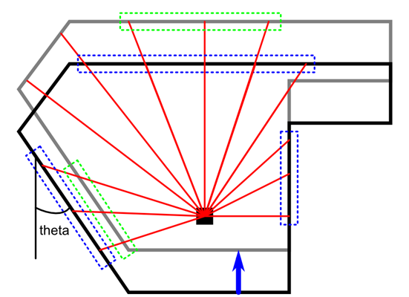
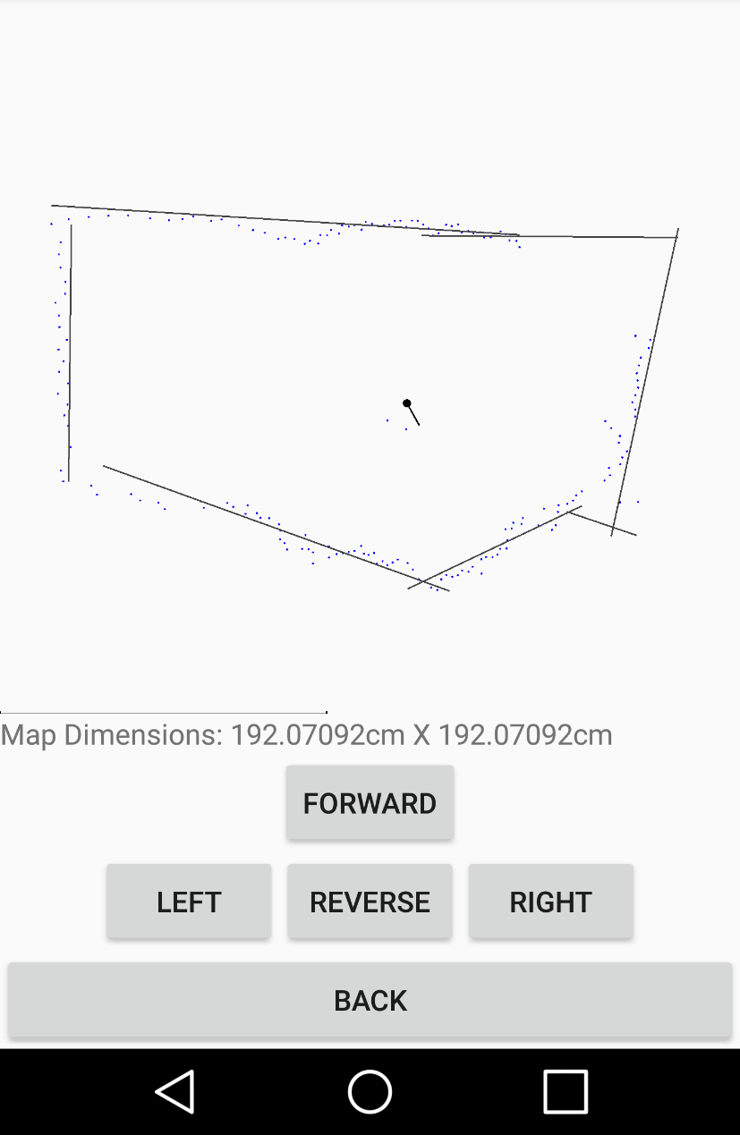
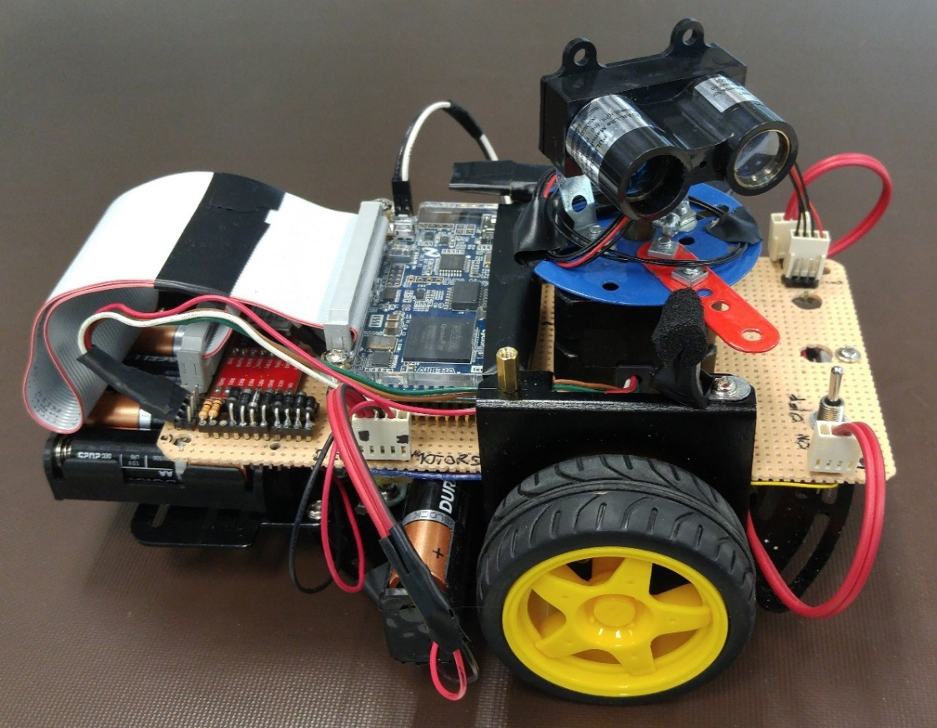
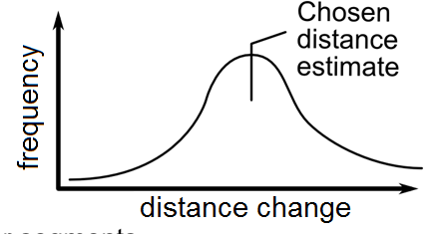

ECE 492 - Computer Engineering Design Project
Mapping Robot
Group 3: Corey Jamison, Mark Langen, Joel Keeling | 2016
Overview
The skid-steer driven Mapping Robot drives around a room generating a 2D map of it. A LIDAR sensor mounted on a stepper motor gathers the range data the map is based on. An Android application is used to control the robot as well as generate and display the map.
The UART core allows for communication between the CPU and an external Bluetooth chip which is done over GPIO lines. This Bluetooth chip is also used to connect to Android devices using the Bluetooth wireless protocol. These connections provide a link between our Android application and the CPU of the robot.
When the app receives new angle and distance measurements from the robot it sends this information to the mapping algorithm which processes it into a movement of the robot and updates the map.
Fig. 3 – Screenshot of the Android Application
Fig. 4 – Matchable Co-linear Segments
The SLAM algorithm created for the project uses a histogram based approach to estimate motion. For linear motion, position deltas are calculated between line segments in the scan and the existing map that have similar rotations. Then the peak of a histogram of those position deltas is chosen as the true delta for the move. Rotational motion is similar but using rotation deltas of lines with similar perpendicular distances to the robot instead.
When merging the new data into the map after a move, line segments which are close to collinear are merged together.
Fig. 1 – Mapping Robot Picture
Hardware Design
As shown in figure 2 the robot is composed of many hardware components. The core of the device is an Altera DE0 Nano development board. The DE0 Nano board provides power and general purpose I/O(GPIO) connections to an Altera Cyclone IV FPGA. This FPGA is loaded with 5 main cores, one for each of our hardware components and one for a NIOS II CPU.
The CPU sends digital commands to the DC motor driver over GPIO lines to control the DC motors for skid-steer driving of the robot.
The I2C core handles communication between the LIDAR unit (laser range finder) and the CPU via the I2C protocol over GPIO lines. The CPU may request distance measurements using this core.
The CPU controls the stepper motor via GPIO lines through the stepper driver core. This allows the CPU to aim the LIDAR device between measurements.
Fig. 2 – Hardware Overview
The CPU core is a soft processor that runs the uC Operating System. This OS controls the motors and LIDAR device and is also responsible for fulfilling requests made by the Android application. These requests include: move commands and data transfers.
Android Application
The Android application has three functions: communicate with the robot, generate/update the map using a mapping algorithm and display the current map. See Figure 3.
Communications between phone and robot happen: A) When the user presses or releases a movement button in the app. B) When the robot finishes a scan of the surroundings, sending the angle and distance measurements to the app (A scan is done whenever a movement completes).
Mapping Algorithm
The mapping algorithm converts data from the robot (ranges and angles) into line segments that can be used to build an updatable map. Figure 4 shows how segments are used to keep track of the robot’s movement between scans.
First co-linear groups of points are found using linear regressions on the LIDAR scan data. The collection of line segments is then compared to the existing map to compute the new position and rotation post move. Only one of rotation or linear motion is allowed in each move, allowing a comparatively simple SLAM (Simultaneous Location and Mapping) algorithm to be used. With an updated position and rotation, the line segments can be used to extend and refine the map.
Fig. 5 – Calculating Rotation / Position Delta using Histograms
Acknowledgments
Thank you to Duncan Elliot, Nancy Minderman, Michael Wong and Rick McGregor for your support throughout the semester.
Department of Electrical & Computer Engineering
Notes:
For colour ideas, University Visual Identity Guidelines can be found here: http://www.toolkit.ualberta.ca/VisualIdentityGuidelines.aspx

