Slide 1
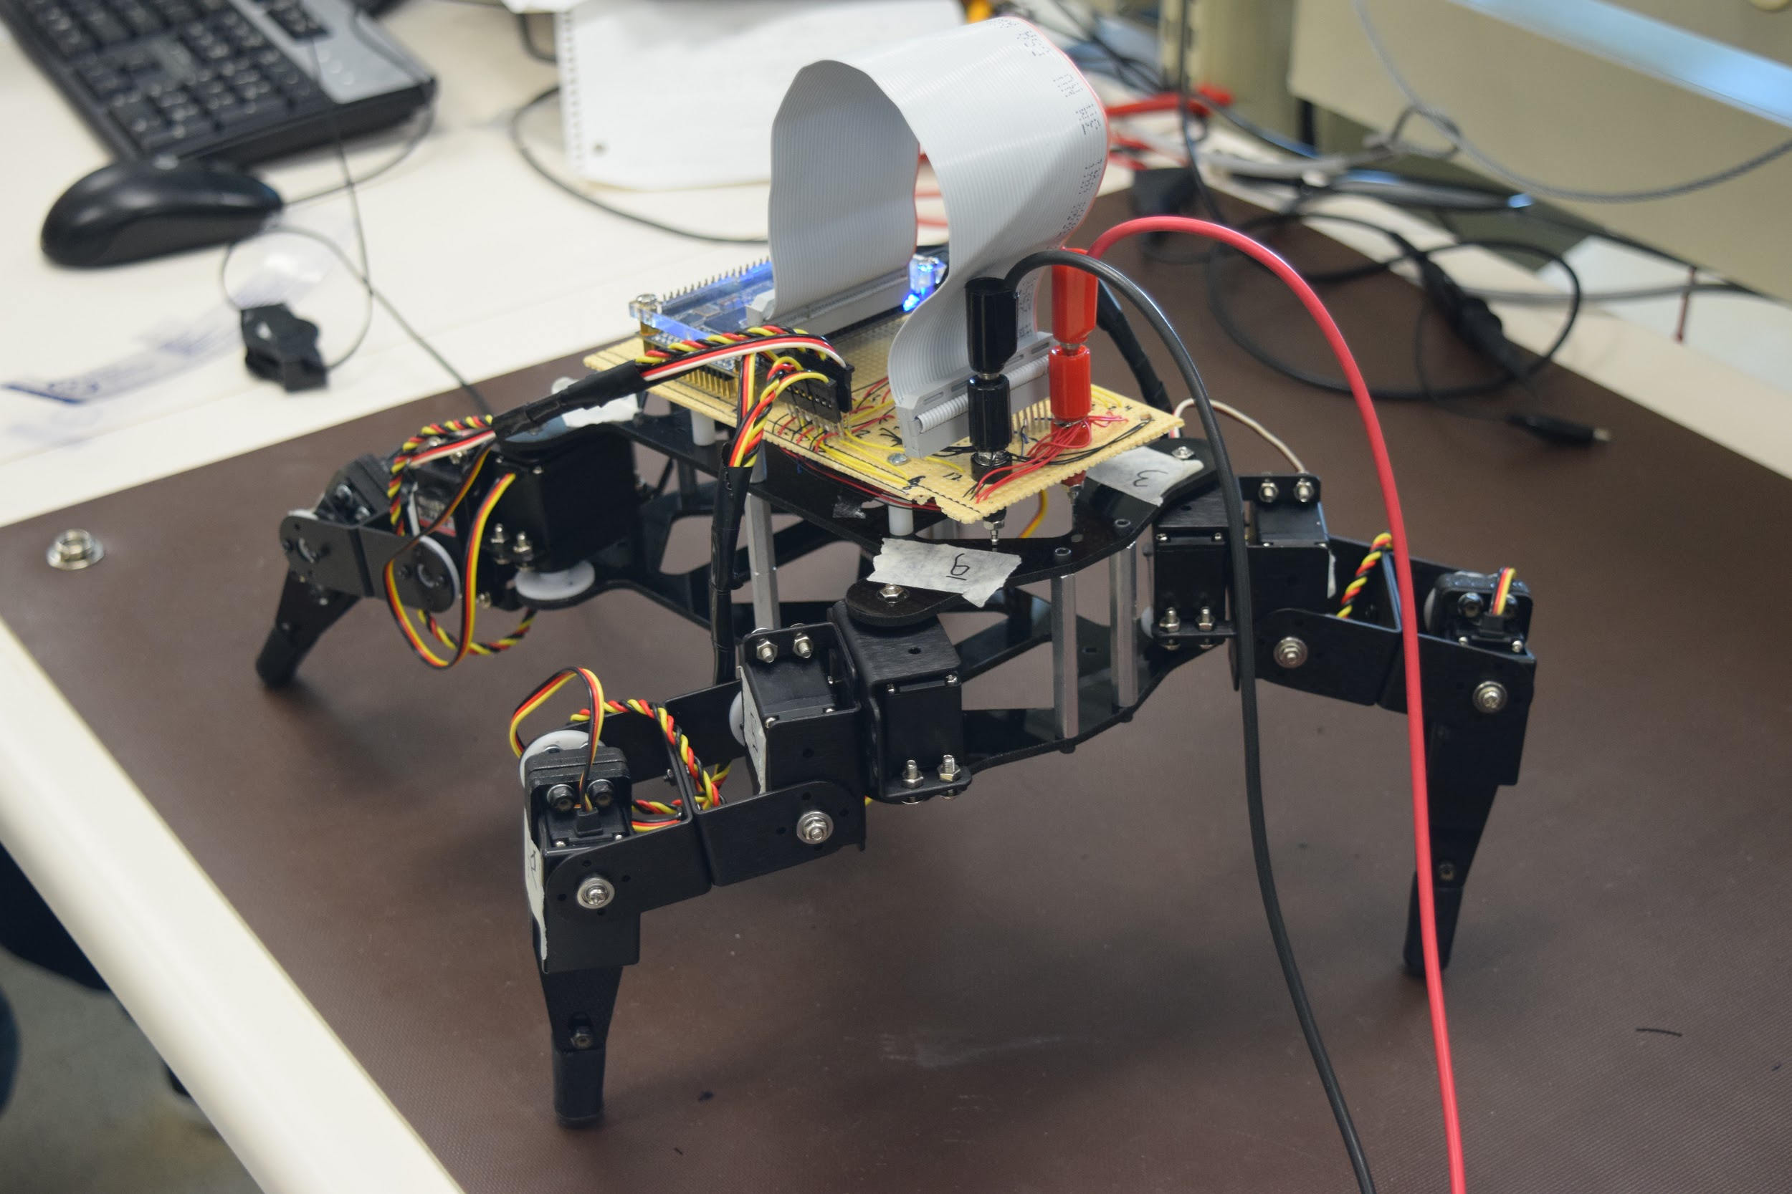
Smart Robotic Quadruped
Brittany Lamorie
Duncan Prance
Cody Otto
With Special Guest:
Bob the Robot
Notes:
Introductions + introduce Bob

Slide 2
Motivation
Goals
Interest in robotics and machine learning
Walking is an interesting challenge
ECE 449 Intelligent Systems
Build working robot
Create accurate simulation of physical robot
Convert simulation output to pulse width signals
Hard-code basic motions
Learned walking motion
On board adjustments
Notes:
Motivation: Cody
Goals: Duncan

Slide 3

Overview
Design Plan
Simulation is run; All learning done on PC
Simulation outputs are converted to pulse width signals
Pulse widths are saved in memory
On board program reads pulse widths
Notes:
How does it work?
Brittany

Slide 4
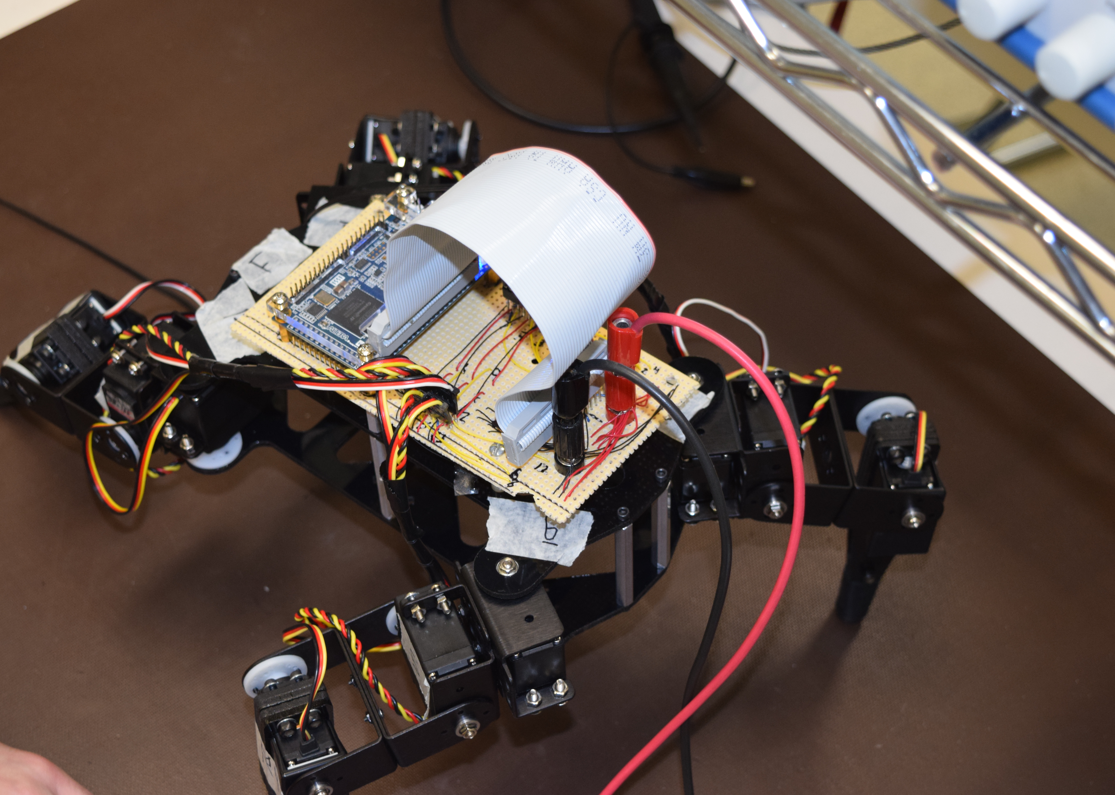
Overview
Current Functionality
Hardcoded Modes
- Walk
- Dance
- Weight Shift
- Simulation
Simulation output conversion
Battery powered tether
Notes:
How does it work?

Slide 5
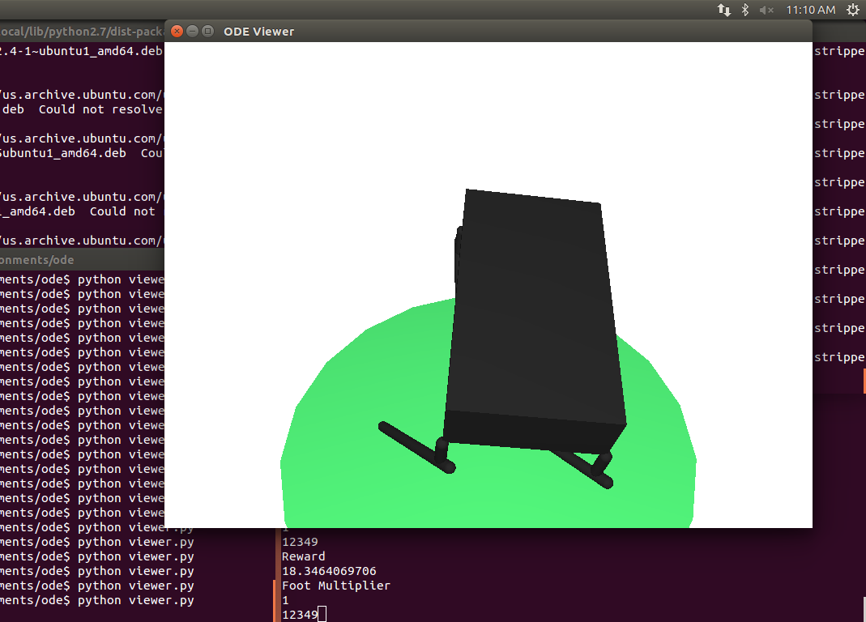
Simulation
Simulation used a combination of ODE and OpenGL for physics simulating, and PyBrain for the machine learning aspect
The machine learning uses a reward based system, allowing for fine tuned control over learned motion
The simulation is taught through a combination of neural networks and reinforcement learning

Slide 6
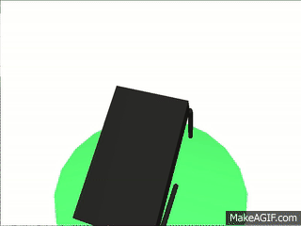
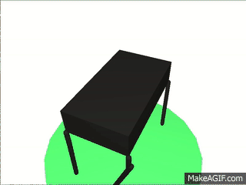
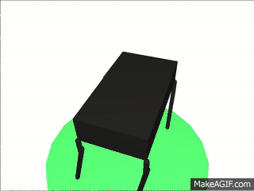
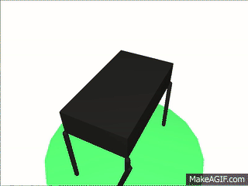
Simulation
Trial 1
Trial 740
Trial 10500
Trial 20000

Slide 7
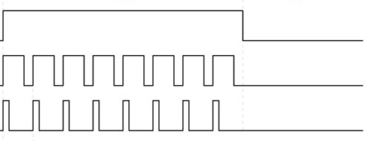
Pulse Width Modulation
Square wave form
Defines the angle of the servo motor

Slide 8
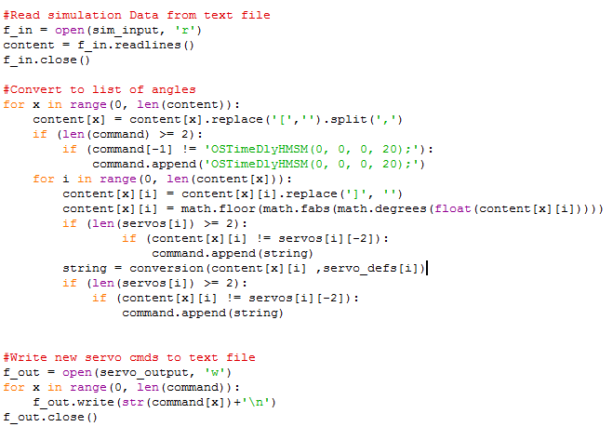
Converting from Simulation to Real World
Slippage between gears
Varying pulse width ranges
Rotation around differing points
Degree conversion for ease of use
Notes:
Issues with sim and servos

Slide 9

Robot motion versus simulation motion

Slide 10
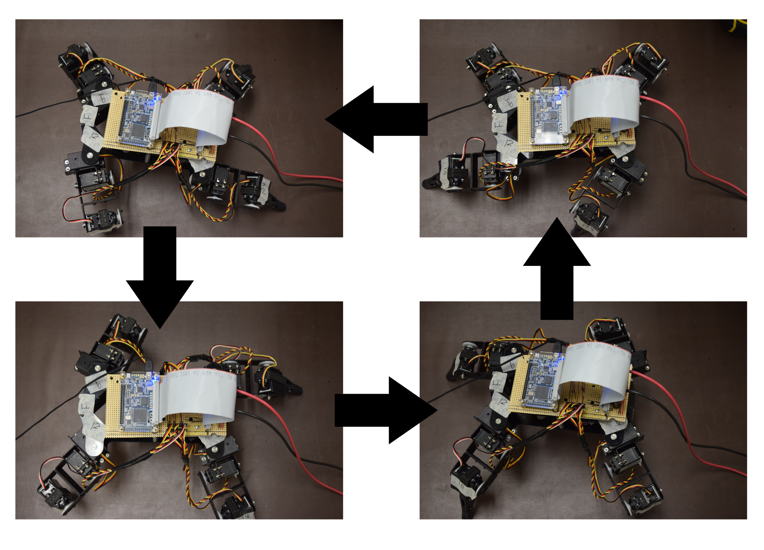
Learning to Walk Again…..
The stances shown allow for a total weight shift from front to back legs and back again
3 point balance allows for a large safety margin for the torque of our servos

Slide 11
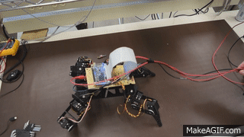
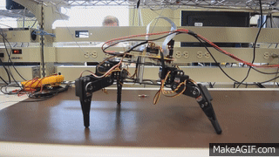
Learning to Walk Again…..
Simulated and exaggerated weight shifting was necessary to allow for balance during steps
Notes:
Hardcoded walking

Slide 12
DEMO

Slide 13
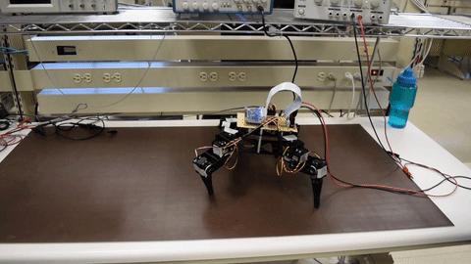
Challenges
Physical calibration
Math and precision
Simulation reward system to achieve a proper forward motion

Slide 14
Questions?

