Slide 1
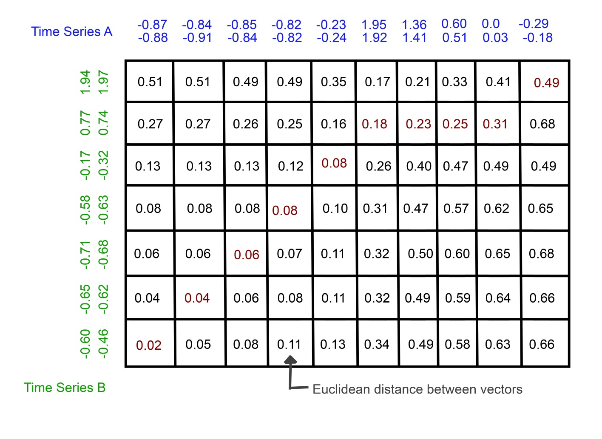
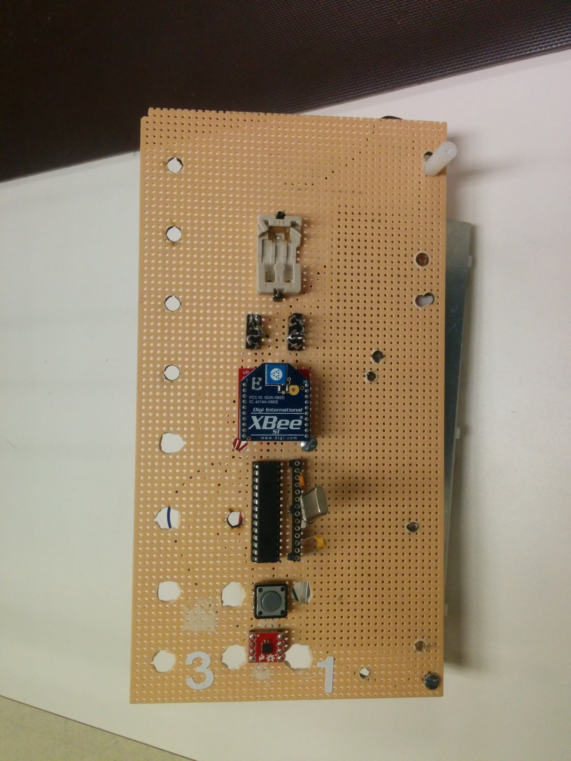
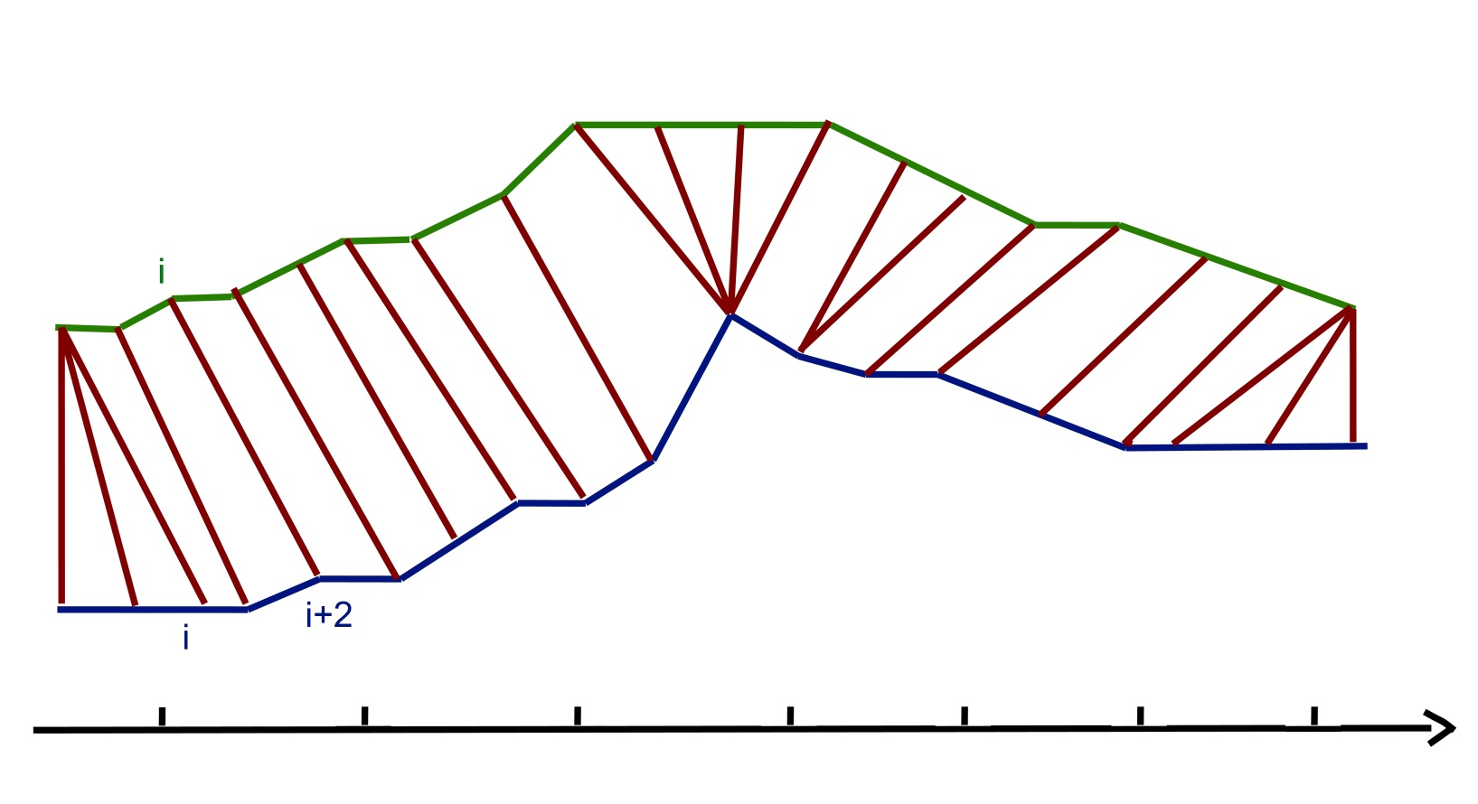
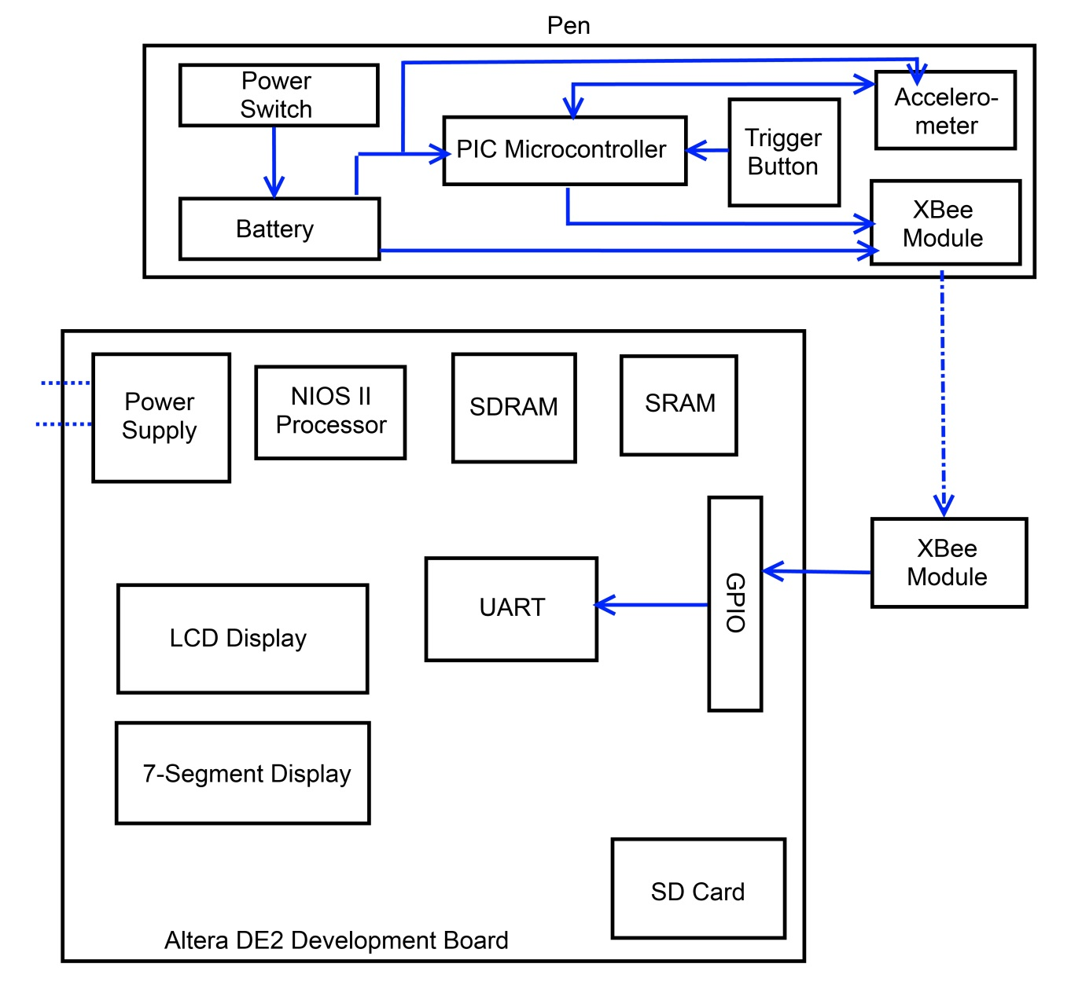

ECE 492 - Computer Engineering Design Project
Accelerometer-Based Character Recognition Pen
Kyle Buchanan Theodore Pham James Chang | 2014
Project Overview
Our aim was to create a pen that could interpret written input for handwriting or gesture recognition. The pen utilizes an accelerometer to track and provide acceleration values for multiple axes. The pen compares acceleration patterns against templates that are stored in memory and determines the character it most closely matches.
Pattern Matching Algorithm
To match characters based on acceleration patterns, we use an algorithm called Dynamic Time Warping (DTW). Dynamic Time Warping is a general pattern matching algorithm that has been used successfully in the past in other applications such as voice or image recognition.
The idea behind DTW is to take two acceleration patterns, one from the input of the pen and one from a template we are trying to match, and find their similarity using euclidean distance. We can do this by constructing a matrix where the width and length of the matrix are the size of each acceleration pattern respectively. In the first cell of the matrix we calculate the euclidean distance from one point in one acceleration pattern to the corresponding point in the other pattern. The lower the distance the closer the two patterns match. We then find euclidean distances for adjacent cells and add the minimum distance cell to our score. We continue this process using dynamic programming to find an optimal path in the matrix as determined by the algorithm.
XBee Wireless Series 1 Modules
Transmits all acceleration data from the pen to the board. The XBee Wireless Series 1 modules were chosen because they are among the easiest to work with, especially when dealing with strictly point-to-point communications. The XBee is what transfers data, sent from the microcontroller, to the UART on the DE2 board.
PIC 16F873A Microcontroller
Handles reading data from the accelerometer. Controls sending of data using switch signals. Sends all data to the XBee Module so that it gets sent to the board. Since the pen is external from the Altera DE2, a microcontroller is necessary to retrieve the data from the accelerometer.
SD Card
Contains the acceleration pattern templates for 0 through 9. These are the patterns that all pen input patterns are compared against. The SD Card memory was chosen over the other forms of memory simply because it had the sufficient space and was easy to implement on the DE2 board.
When the algorithm reaches the end of the matrix, the total summation gives us our score for the comparison. We repeat this process for all of our templates and the lowest total score will tell us which pattern our input matches.
Components
Altera DE2 Board
Provided to us for the base of this project. Handles the storage and processing of all acceleration patterns as well as analysis and matching for character recognition. The DE2 board uses a NIOS II processor. Many internal components such as SRAM, UART, SDRAM, LCD screen, and 7-Segment Display were quickly decided on implementing internally to meet our processing and display needs.
ADXL362 Tri-Axis Accelerometer
Reads the acceleration data that is used for analysis. Capable of reading values from ±4g. This accelerometer was chosen because it had the capability of using SPI communications. Acceleration data is able to be sent directly back to the microcontroller.
Department of Electrical & Computer Engineering

