Slide 1
G1 Duckhunt Alarm Clock
Jesse Larson (jrlarson@ualberta.ca) IR Communication
Jing Lu (jlu9@ualberta.ca) Stepper Motors
Qingqing Liu (qliu6@ualberta.ca) C code

Slide 2
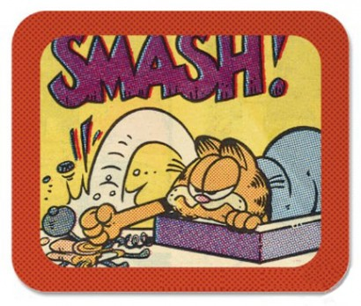
The Motivation
Imagine this:
It’s EARLY in the morning, and your alarm sounds.
How many of us secretly wish we could do this to our alarm clock
Our Functionality Goal:
To build an alarm clock that is capable of waking you up, and is fun to turn off. Making it somewhat nicer to wake up.
The Idea:
Make a sleeper perform simple and fun game to shut off the alarm clock

Slide 3
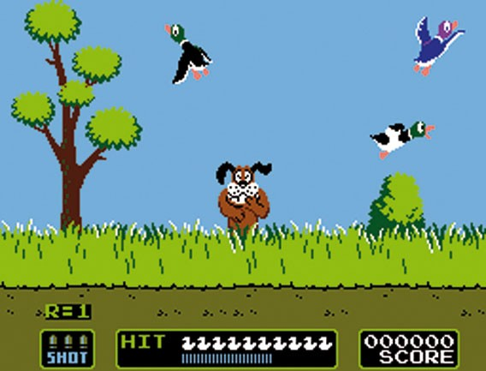
What our simple game is loosely based on
If any of you remember this one…
We hope to achieve a more realistic version

Slide 4
Design: General Structure of the Alarm clock
Stepper motor
Ceiling of the room
Stepper motor
2 x 4
DE2 Board
and
Pulley
Infrared receiver
and
Pulley
Speaker
Strong fishing line
Infrared Transmitter
What you will use to shut off the alarm
Sensor bar. cleverly disguised as a duck
Infrared Receiver
Infrared Shotgun Transmitters

Slide 5
Design: General Behavior & Functionality
Functions like a normal alarm clock except…
The only way to shut off the alarm is to shoot the sensor bar 3 times.
The reason for 3 hits is to break ties as we plan on having a “his” and “hers” gun for the alarm, encouraging a sense of competition and fun as the alarm clock can distinguish between the two guns announcing the winner after the alarm is shut off.
Once the sensor bar has been shot down by the infrared guns, the sensor bar is safely retracted to its resting place on the roof where it will enter a low power state.

Slide 6
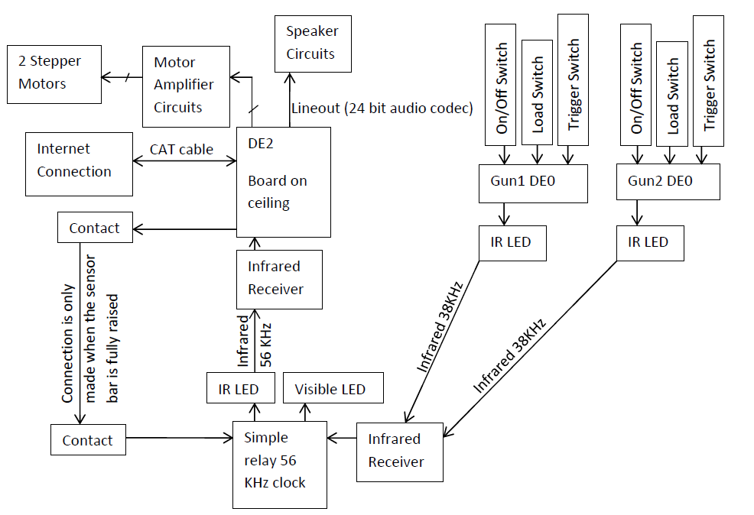
Design: Top Level Hardware Diagram

Slide 7
Design: The Sensor bar (duck) diagram
38 kHz IR signal
38 kHz active low IR receiver
NAND gate
IR LED
56 kHz clock
56 kHz IR signal

Slide 8
Design: The Gun (DE0) Diagram
On/Off switch
Load switch
Trigger switch
ID switch
Send_Burst_Component
Send_1_component
Send_0_component
IR LED
38 KHz Clock

Slide 9
Design: DE2 diagram
SDRA
ON-CHIP MEMORY
LCD
Screen
Nios_II
Seven Segment
RESET
2bit
Avalon MM Slave
Motor
Controller
Signal decoder
PWM Generator Peripheral
Motors
IR Receiver

Slide 10
Software Diagram:
C Project
-record and calculate the position of “duck” on x axis and y axis
-generate acceleration for x axis and y axis
-test whether the acceleration is safe
-when a reset signal is received, bring up “duck” to original position
SPEAKER
VHDL
-send a signal to turn on/off the speaker
STEP MOTOR
DE2 BOARD
VHDL
-realize the controlling of step motors
VHDL
-process signal and send gun ID
RECEIVER

Slide 11
Design Calculation
Variables: acceleration a_x, a_y
current position x_curr, y_curr
safe distance: 0.9-x_curr, 0.4-y_curr
Moving range
(2.0m*1.0m)
y
Safe area
(1.8m*0.8m)
Safe distance
(x_curr, y_curr)
0
x

Slide 12
Design Calculation
Generated random acceleration:
a_x_generated, a_y_generated
Saft acceleration:
a_x, a_y
Function to test the generated acceleration
a_x=2((0.9-x_curr)-Vx)/t^2
a_y=2((0.9-y_curr)-Vy)/t^2
If((a_x<=a_x_generated)||
(a_y<=a_y_generated))
{ a_x==a_x, a_y==a_y}
else
{ regenerated new accelerations }
y
0
x

Slide 13
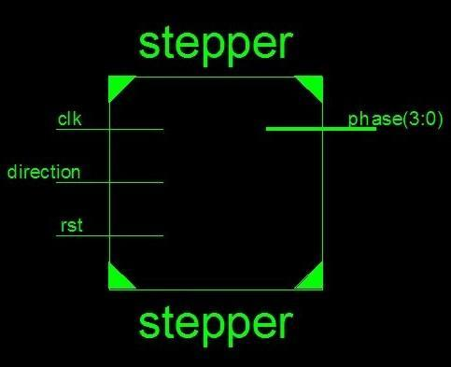
Sample code
Define a motor controller:
entity stepper_motor is
port
( phase : out std_logic_vector (3 downto 0); direction : in std_logic;
clk : in std_logic;
reset_n : in std_logic;
);
end stepper_motor;

Slide 14
Sample code
architecture st of stepper is signal step_count :std_logic_vector
( 2 downto 0);
begin process (rst,clk)
begin if rst = '0' then step_count <= "000"; else if clk'event and clk = '1' then if direction = '1' then step_count <= step_count +1 ; elsif direction = '0' then step_count <= step_count -1 ; end if; end if; end if; -- end if; end process;
process (step_count) begin case ( step_count) is when "000" => phase <= "0001"; -- 0 when "001" => phase <= "0011"; -- 1 when "010" => phase <= "0010"; -- 2 when "011" => phase <= "0110"; -- 3 when "100" => phase <= "0100"; -- 4 when "101" => phase <= "1100"; -- 5 when "110" => phase <= "1000"; -- 6 when "111" => phase <= "1001"; -- 7 when others => phase <= "0000"; end case; end process; end;

Slide 15
Challenges:
1. Deciding on the “best way” to implement the IR game aspect of the clock
2. Finding useable parts:
- IR receivers need to have a significant range and must be feasible to connect to, only the most common frequency modulation (38kHz) is available on break out boards. We need two IR links with no cross talk if the sensor bar is to remain a simple relay. very few in stock available receivers meet this requirement.
3. Verifying that the “duck” is actually in the safe communication area

Slide 16
Test Plan
Confirm the area of the IR communication links, adjust the safe area size if needed.
Motor and Duck: limit the roaming area to inside the safe communication area.
Test that all voltage suppliers have proper output, especially for the battery powered sensor bar.
Test that the speaker is loud enough to wake someone up.
Test the ranges and bounds of the functions.

Slide 17
Future Application Notes
How to program a DS1077 as a stand alone oscillator (133 kHz down to 16.2 kHz)
How to implement a custom IR communication protocol.

Slide 18
Features to Add/Remove
Possible options to remove:
1. Remove the alarm clock function; it can just be a simple game.
2. Remove the two player aspect of the game, make only one shotgun.
Possible options to add:
1. Create a friends flight server for the pattern of the duck. Meaning that your alarm clock will fly the same path as your friends duck hunt alarm clock at a different house. Both yours and your friends’ alarm clock will record the time it took each of you to shoot your alarm clock. Fastest times can then be posted at the end of each day encouraging a sense of competition amongst friends to wake up and shoot the clock faster than your friends.
2. Add a third stepper motor to make the sensor bars movement more stable.
3. Add a magnetic contact to dock the sensor bar, so it can enter a low power state.
4. Add a web interface to set alarms for convenience.

Slide 19
Questions?

