Slide 1
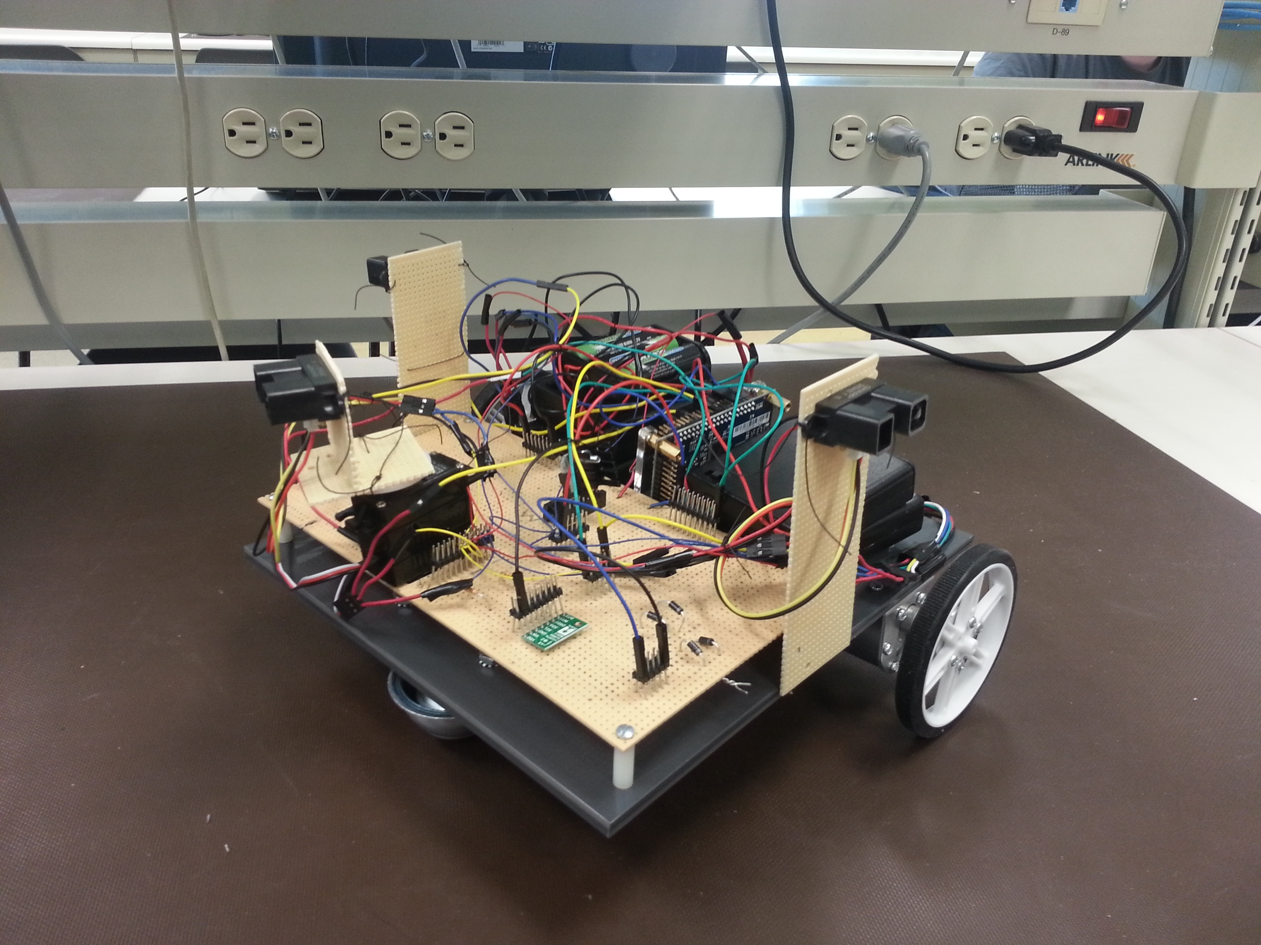
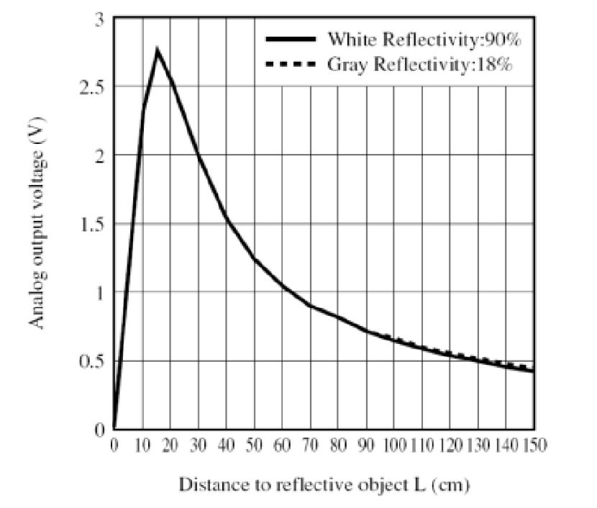
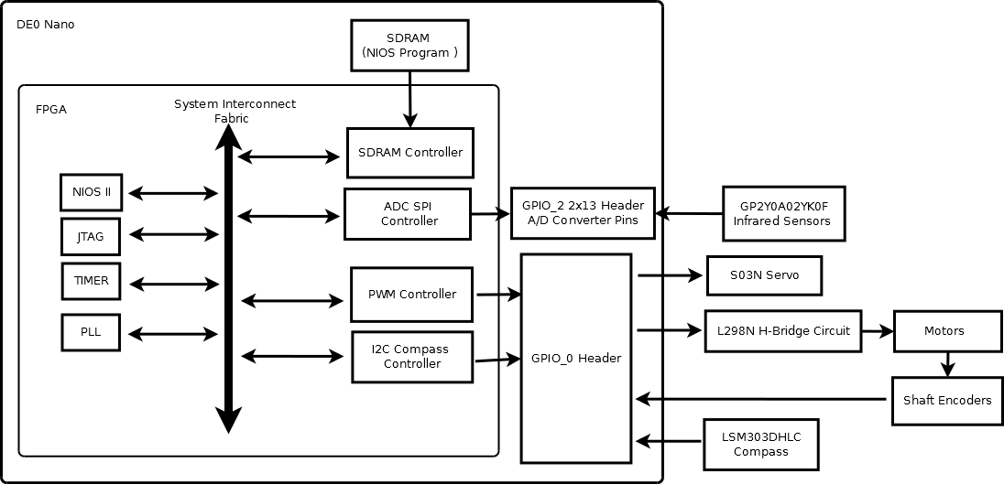
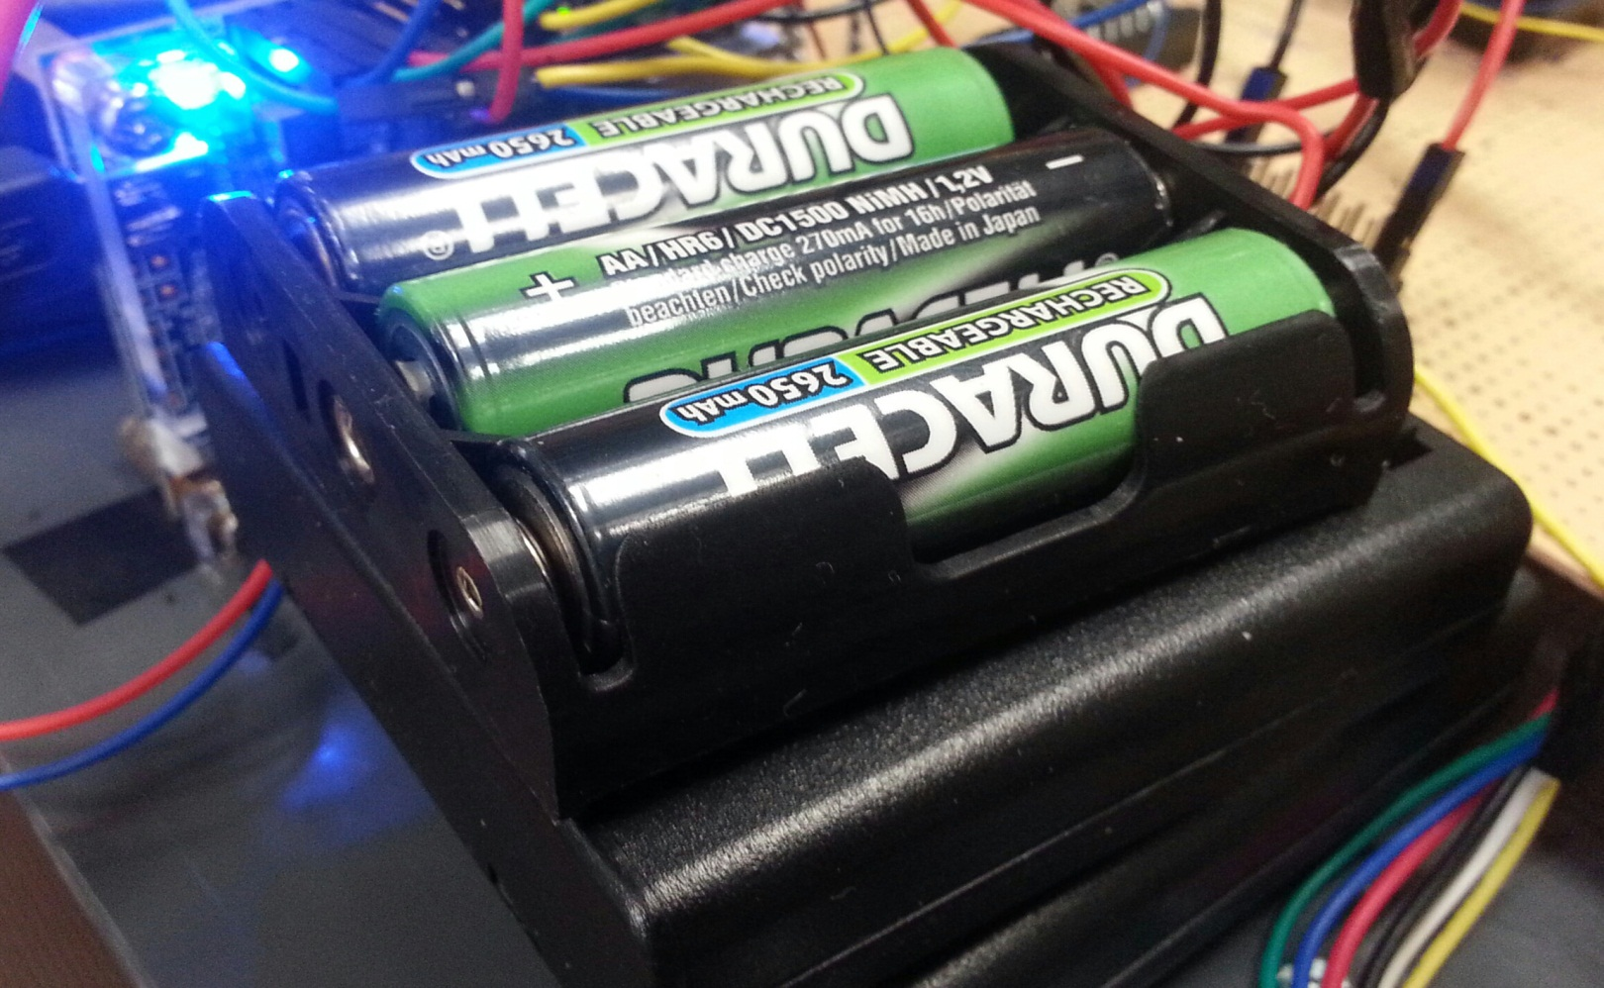
ECE 492 - Computer Engineering Design Project
Three-Wheeled Rover
Group Members:
Mikael Rouhiainen, Peter Hu
Year:
2013
Overview
Our robot runs with two motors. Three infrared mounted on the robot help to detect and avoid collision with obstacles. The goal of the robot is to successfully navigate through an obstacle course.
Motor Control
Our motors are controlled using PWM signals
sent from the DE0-Nano and through the L298N IC chip. Increasing the duty cycle of the signal increases the speed of the motors. Each motor has two signal wires. Figure 3 shows the signal logic sent to the motors. The L298N chip is considered a “full-H-bridge” IC. However, the chip doesn't protect the circuit from current spikes caused by turning the motors on and off. To protect the circuit, 4 diodes are arranged near each of the motors. Capacitors near the voltage source pins further stabilize the circuit.
Navigation
The rover moves forward until the front sensor detects an object. When this occurs, both side sensors are checked, and the side returning the lowest voltage is the direction the robot turns. After turning, the robot remembers it's initial direction, and will attempt to return to this initial direction, and properly proceed through the course. In the situation of a dead end (all sensors are blocked), the robot will go in reverse, then perform a 180 degree turn, and continue forwards.
Hardware
DE0-Nano FPGA board
Two 12V motors with built=in encoders
L298N motor driver IC
LSM303DHLC compass
3 Sharp GP2Y0A02YK0F Infrared Sensors
S03N Servo
Fig. 3 Motor Logic Table
Power Supply
The rover uses a total of 19 AA NiMH batteries.
Eleven batteries are in series to power the motors,
four in series are used for the sensors, the servo,
the L298N and the encoders. The last four batteries
in series power the DE0-Nano board, and the compass.
Infrared Sensors
The figure on the right shows the voltage returned by the sensors based on the distance away from an object. ADC pins on the DE0-Nano reads this data and the software controls the robot accordingly. The servo oscillates the front sensor in increase the field of view. The range of detection used is between 20-40cm.
Fig. 1 Hardware Diagram
Fig. 2 IR Range Diagram
Fig. 4 Battery Packs
Department of Electrical & Computer Engineering
Notes:
For colour ideas, University Visual Identity Guidelines can be found here: http://www.toolkit.ualberta.ca/VisualIdentityGuidelines.aspx
<number>

