Slide 1
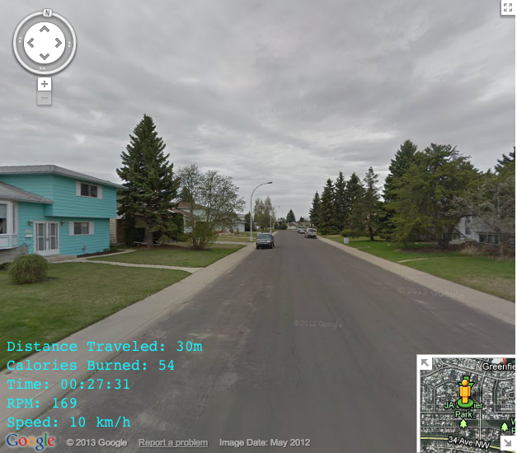
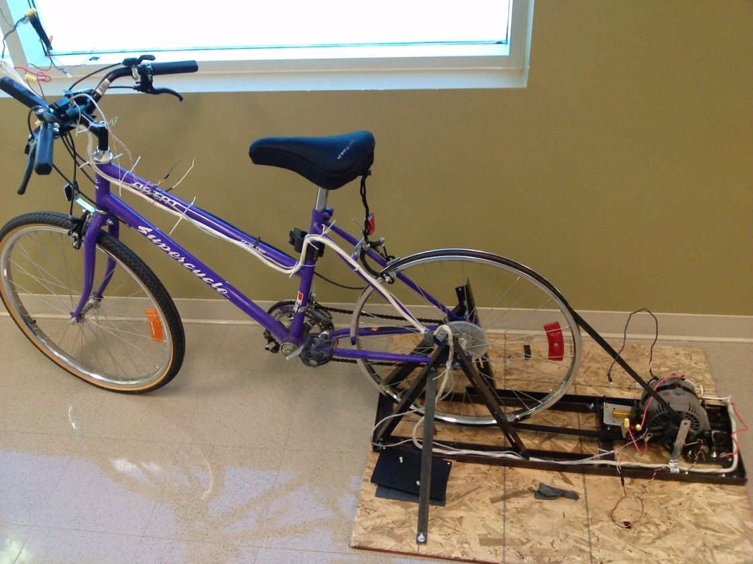
Virtual Exercise Bike
© 2012 Google Inc. All rights reserved. Google and the Google Logo are registered trademarks of Google Inc.
Robert Miller
Adam Eliason
Notes:
Our project is to create an Interactive Virtual Exercise Bike. The general idea is that the user will pedal a stationary bicycle and as they pedal a monitor will take them through Google Street View.

Slide 2
Motivation
Exercise is boring
Hard to bike outside during Winter
See the world
Going green
Challenging project
Notes:
Our motivation for this project was that exercising is boring, especially during the winter when it is dangerous to bike outside so you’re stuck inside pedalling but not going anywhere. We wanted to make it fun, this way you can explore anywhere in the world that has been mapped by Google Street View which currently is 39 countries and over 3000 cities. You can ride the tour de France or through the streets of Italy without having to pay for a plane ticket. Since the world is “going green” we didn’t want to be like other exercise bikes that just have a belt tighten against a wheel, we wanted to DO something with the energy we were exerting, so our bike involves some power generation. We also chose this project because it’s going to be difficult, it involves everything from low level circuit design and power generation, to VHDL coding, to integrating with Linux and websites.

Slide 3
Functionality
Traverse through Google Street View™
Record user stats to database (usernames, calories burned, total distance travelled, speed)
Generate power (light bulbs)
Variable resistance for your workout
Google, the Google logo, and Google Street View are registered trademarks of Google Inc., used with permission
Notes:
So as we said, as you pedal you will traverse through Google Street View. You’re going to be able to log in and a database on the DE2 board will record your stats. Our bike is hooked up to a generator which will power some light bulbs, but could be changed to power almost anything as long as you’re willing to pedal hard enough. And since Google provides elevation data, we’ll be able to determine if you are going uphill or downhill, and change the resistance of the bicycle accordingly.

Slide 4
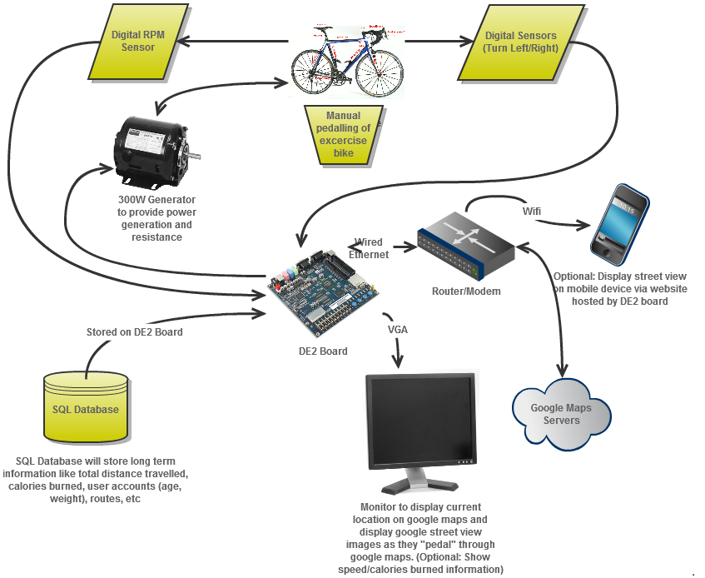
Overall Design
Notes:
Here is the overall design of our project. It shows how we plan to connect everything.
We have the sensors counting the RPMs of the bike to see how fast you are going.
We have the other digital sensors to sense if you want the bike to turn left or right. Those go straight into the DE2 board.
Some of you have seen the bicycle in the lab, it is connected to a generator, and that generator is going to be connected to some light bulbs which will light up as you pedal. If you want to increase resistance, you add more light bulbs, and if you want to decrease, you disconnect more bulbs, we’ll go into the circuit design of that later.
The DE2 board has an Ethernet port which will connect to the internet to get the Google Street View data. You can also see one of our optional items which is displaying the Google Street View images and exercise statistics to a smartphone.
The DE2 board also has a VGA port which is where we will be sending the Google Street View images to display to the rider as well as an overlay with information like how many calories they have burned, how fast they are going, and how far they have travelled.
Finally all of that data will be stored on a database which is also on the DE2 board. You will be able to save your workouts, log in, and see all time stats.
<<lots of talking so people can digest>>
<<add light bulbs to image>>

Slide 5
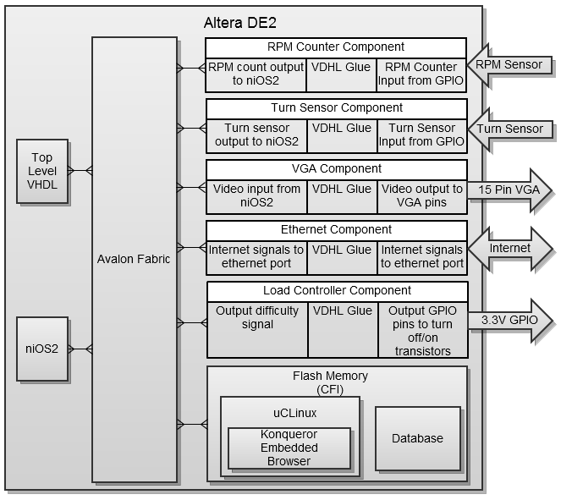
Hardware Design – Components
Notes:
This is the hardware design of our components. You can see things like our turn detectors, RPM sensor, the Ethernet, VGA, and we’ll also use some of the GPIO pins to control the resistance which we will show in the next slide. A few of these have application notes already written for them like the VGA, and we hope to write the application notes for any parts that don’t yet have any. This is similar to the assignments we’ve done in the labs already.

Slide 6
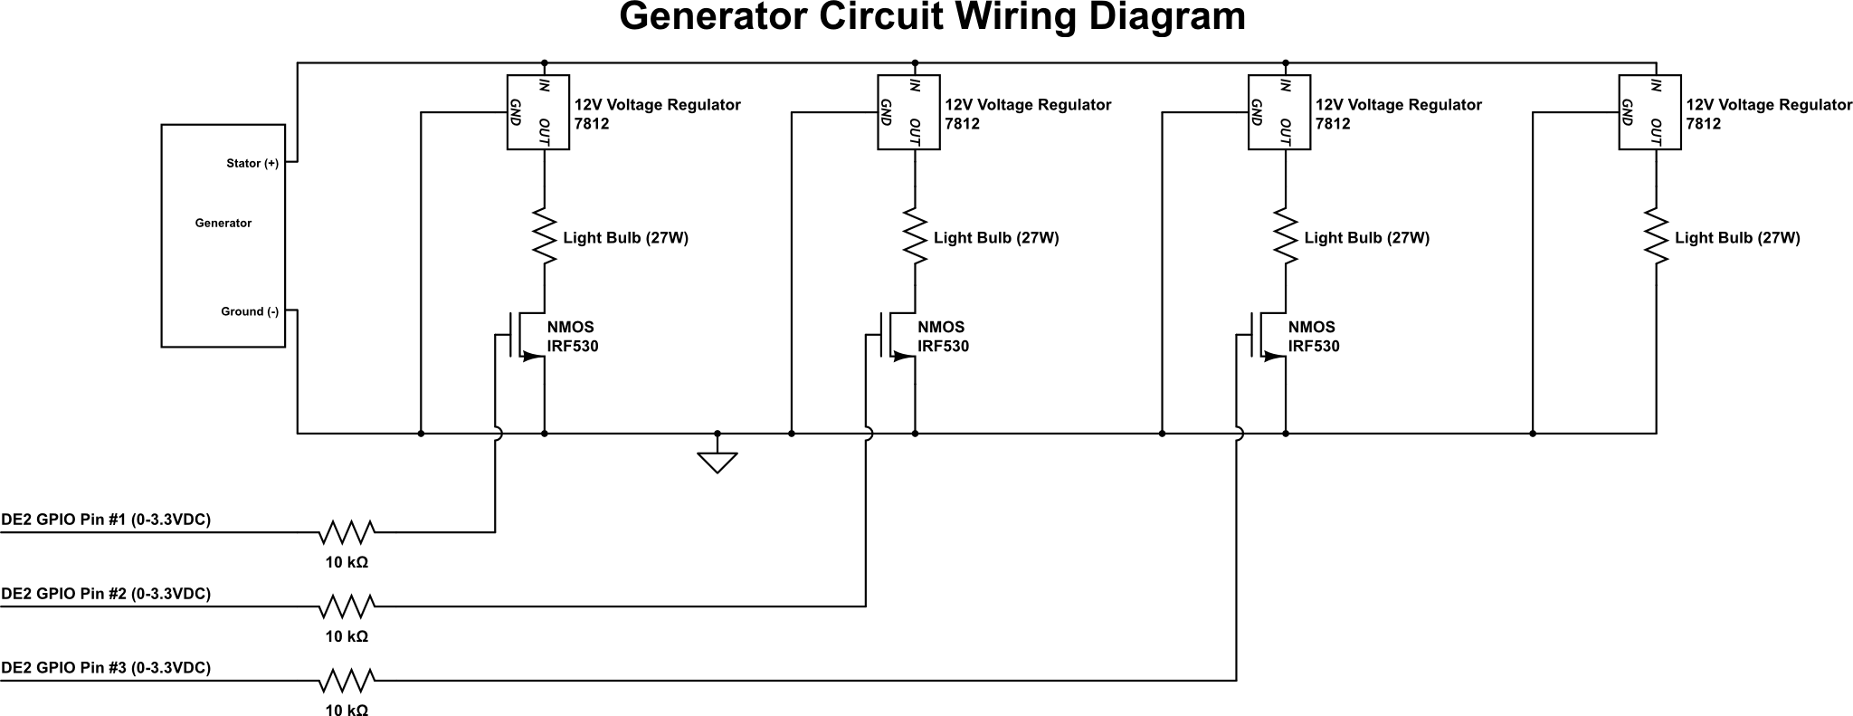
Hardware Design – Power Generation
Notes:
This is the hardware design for our generator circuit. The generator on the left is spun by the bicycle tire, this generates a voltage. Since this voltage varies depending on the load and how fast you pedal, we use a voltage regulator to get a constant 12V. And since the current we will be producing will be around 10-20Amps, we had to use multiple voltage regulators, one for each light.
So our light bulbs will act as the load for the generator, and they will be turned on by these NMOS transistors connected to the GPIO pins on the DE2 board. One thing that we thought was counter intuitive at first was
Unintuitive parallel

Slide 7
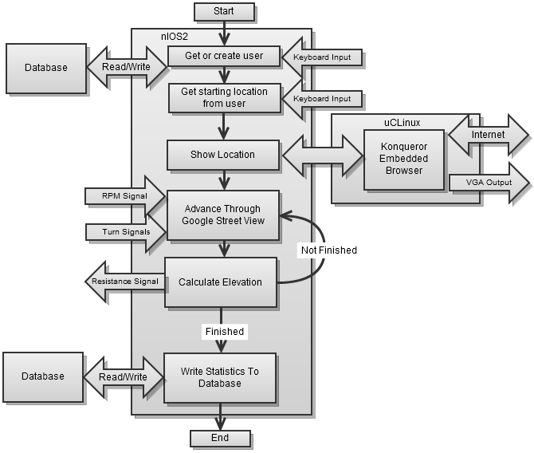
Software Design

Slide 8
Code Example
(Pseudo code to change resistance)
//Calculate Elevation & Resistance
set lastElevation
get currentElevation
elevationDifference = currentElevation - lastElevation
Case based on elevationDifference
Case > 100
call to change resistance “turn on all lights” //going uphill Lance Armstrong
Case > 75
call to change resistance “turn on three lights” //going uphill hard
Case > 50
call to change resistance “turn on two lights” //going uphill medium
Case > 25
call to change resistance “turn on one light” // flat to slight uphill
Case < 0
call to change resistance ”no resistance” //going downhill
Default
no change call
End Case

Slide 9
Potential Problems
Linux – µCLinux Proven to work on Altera forums
Database – SQLite
Browser – Konqueror Embedded
Street View API – Up to 24,000 images/24 hours
Generator – Already powers static loads (light bulbs)
Board features (Ethernet, keyboard, VGA) – Application notes
Loading – C code is very light

Slide 10
Test Plan
Unit Testing
  Hardware
    Power test circuit with generator (Complete)
    Finish test circuit with transistors and retest
  Interfacing
    Control transistors with DE2 board
    Read RPMs (accurately) and turn signal inputs
    Display test images to VGA
    Ping Google servers to test Ethernet connection
    Receive keyboard input and write to console
  Software
    Install Linux
    Install Konqueror browser and read website
    Install SQLite database, read and write to it
Integration Testing
  Hardware
    Give sample elevations and see resistance change
    Test processor loading
  Software
    Download Google Street View Images and display to monitor
    Turn left/right (when valid and not valid)

Slide 11
Optional Features
Competition Mode: Race your friends or old lap times
Power Generation: Charge your electrical devices instead of light bulbs
Post your scores to a website
Display Google Street View™ to mobile iOS device
Google, the Google logo, and Google Street View are registered trademarks of Google Inc., used with permission

Slide 12
Questions?

