Slide 1
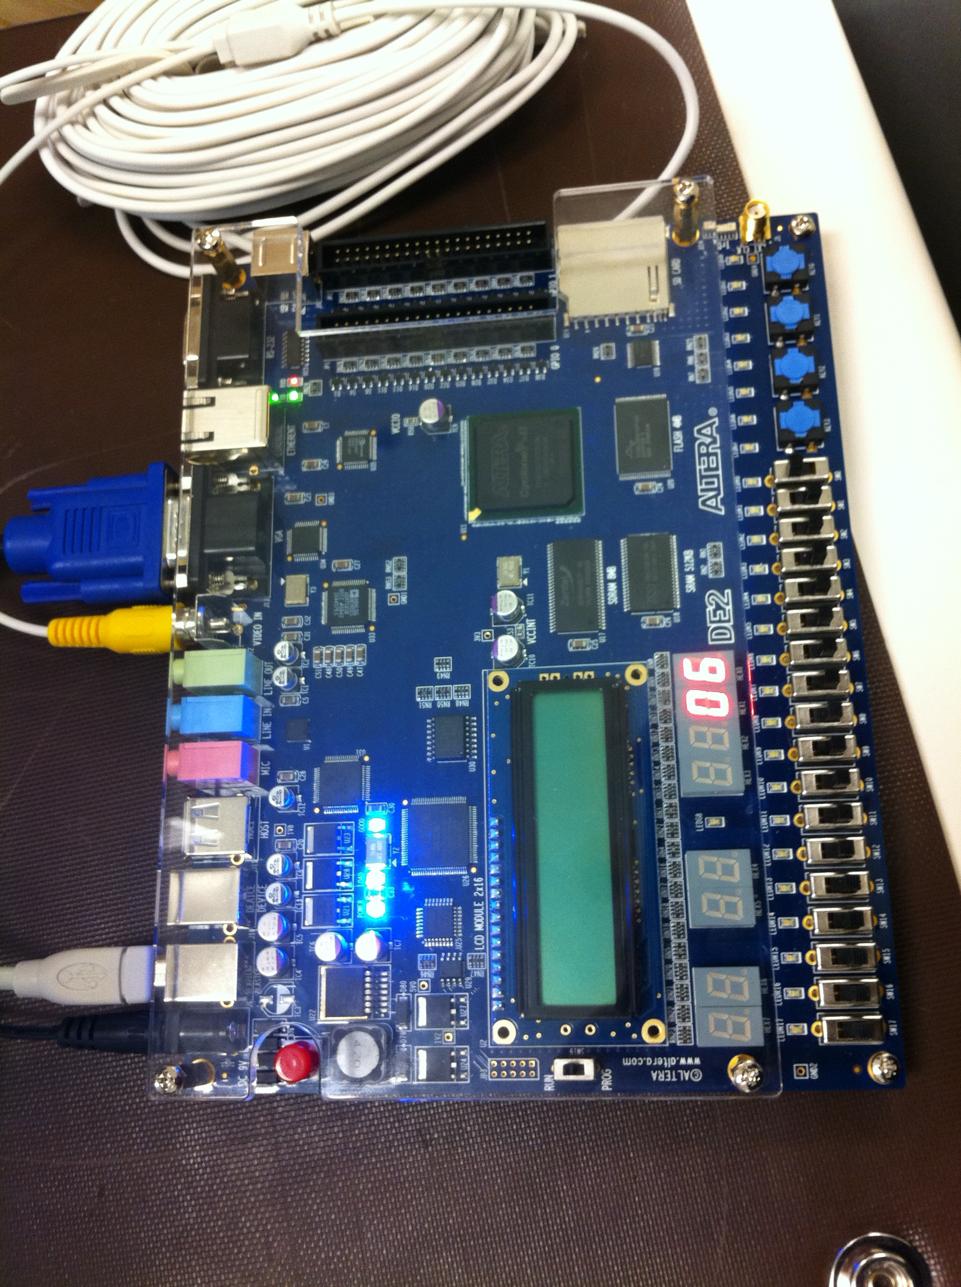
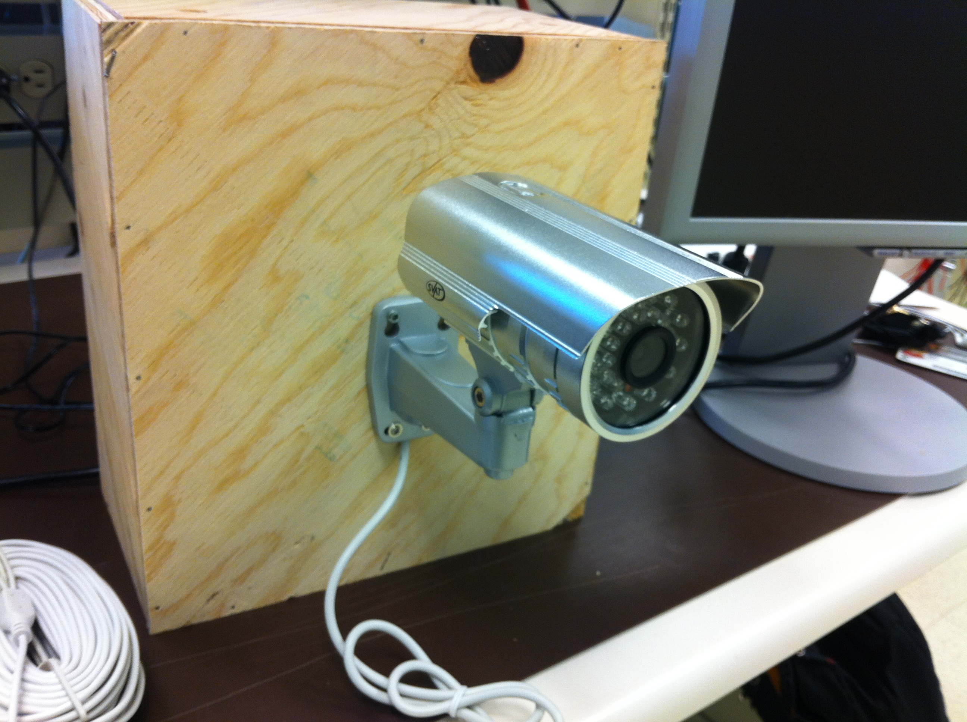
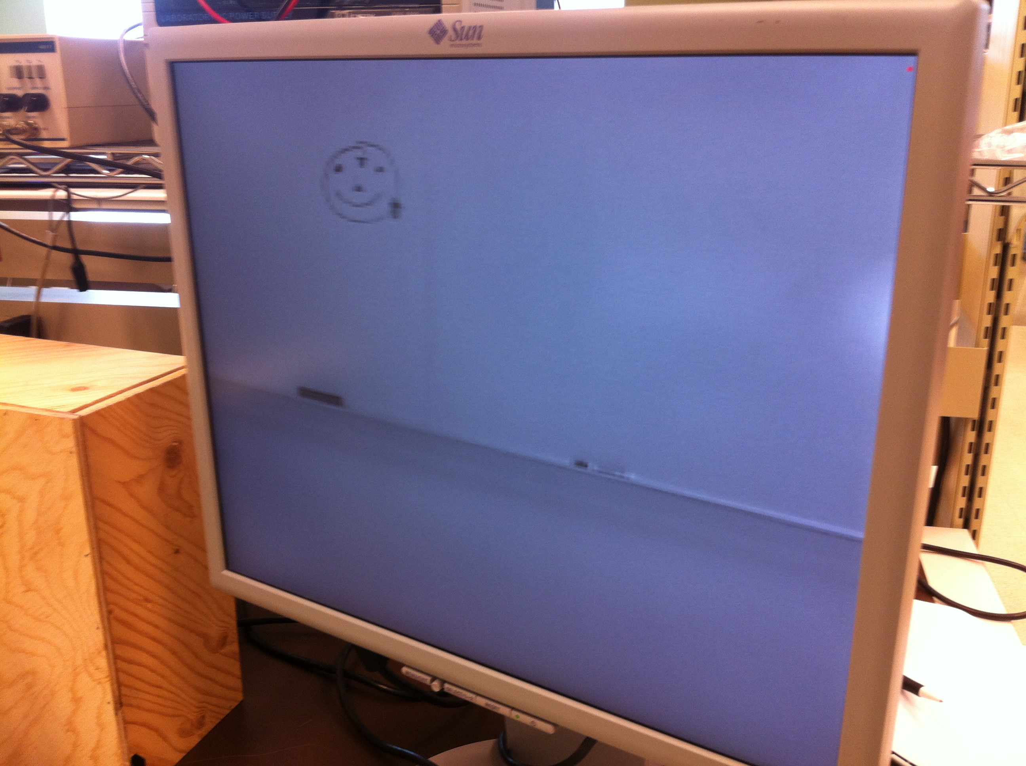
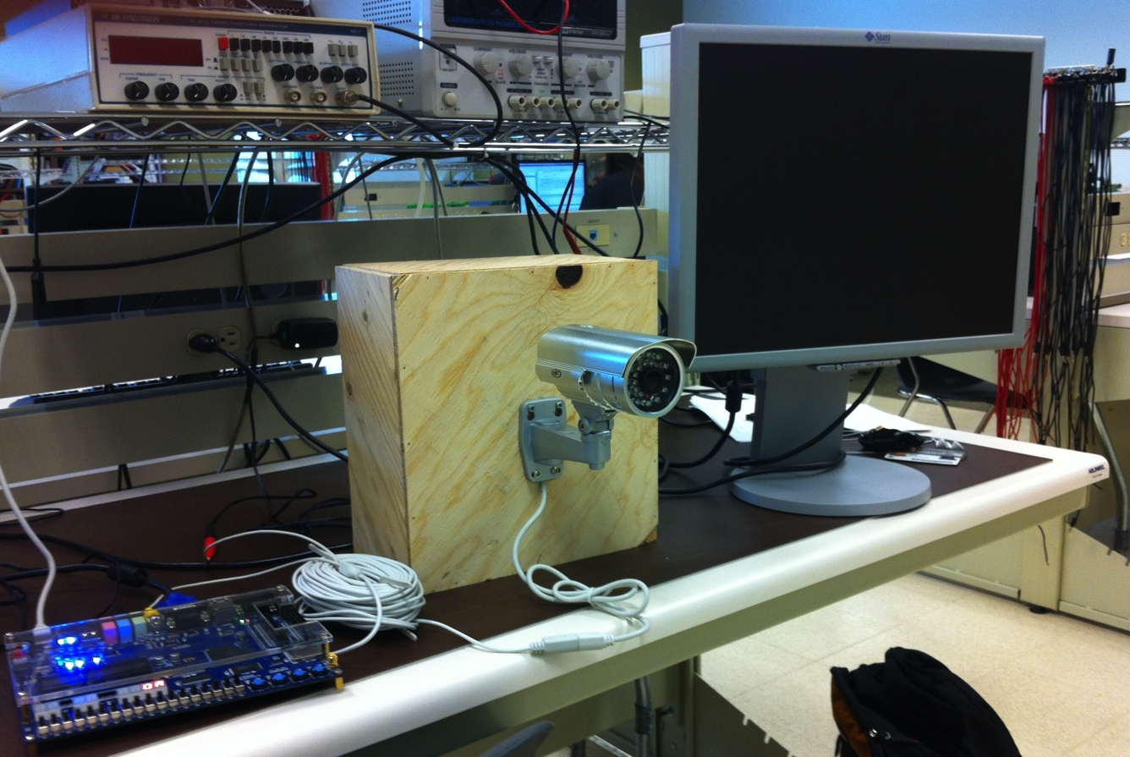
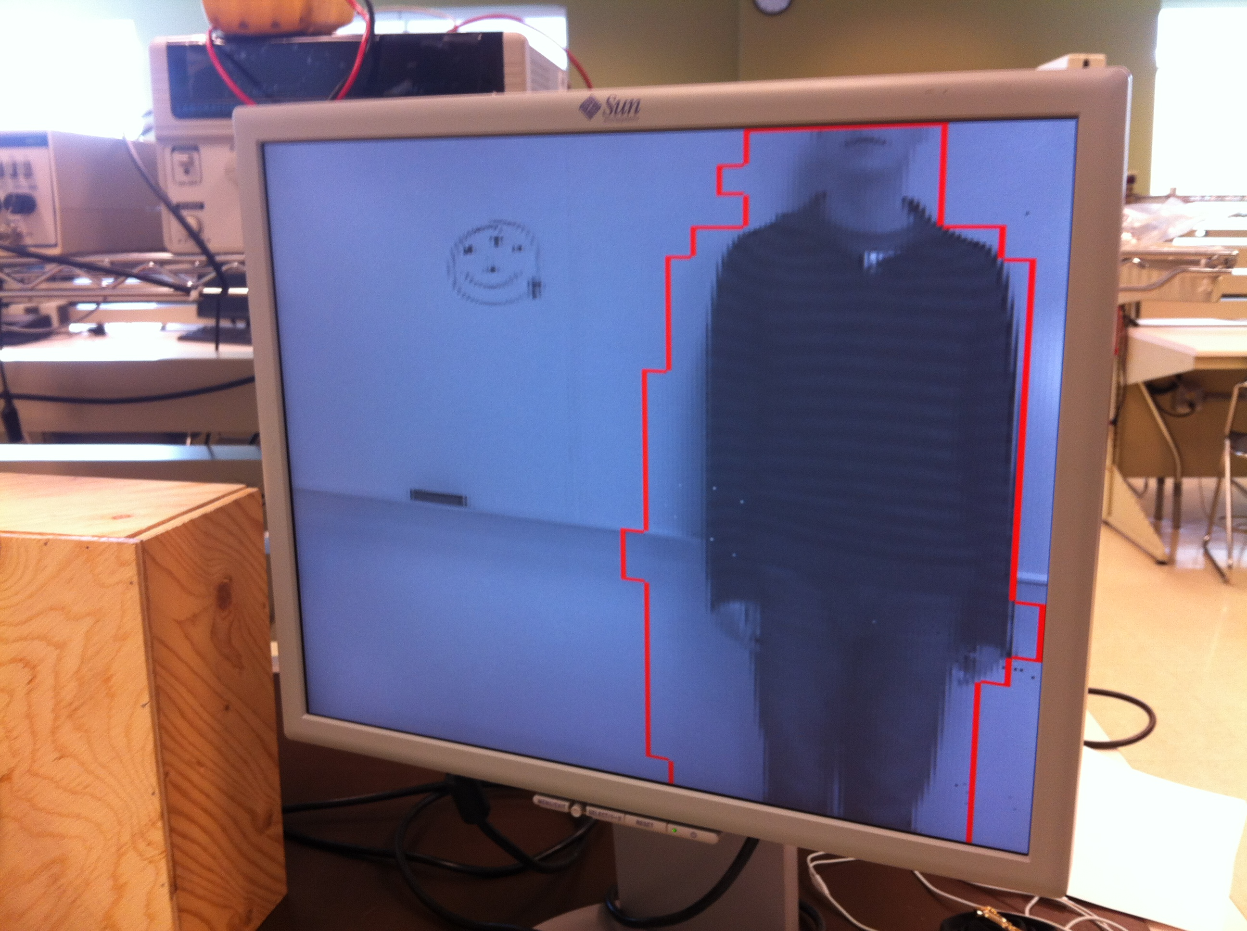
CMPE 450/490 Capstone Design Project
Intruder Alert System
Group Member I Group Member II Course | Year
Jordan Tymburski Rachita Bhatia CMPE 450/490 | 2012
Introduction
This project involves the creation of an Intruder Alert System. The idea behind the system is to capture consecutive video frames, analyze them for detecting motion, and output the final result.
The three major components used in the project include a Camera, a TV Decoder chip on the Altera DE2 board, and a VGA screen to output the resulting video highlighting any detected motion.
Input: Camera
Video Input was decoded from ITU-R 656 Standard
The resolution was cut in half to 320 x 240.
The deinterlacer only saved the even lines of the ITU standard
Frame was pushed onto a circular frame buffer that stored it on the SDRAM.
Output: VGA
VGA read frame data from the same circular frame buffer that stored on the SDRAM.
The data was decoded to RGB (from greyscale) where the special value of 0xFF signaled a red (flagged) pixel.
The RGB data was then pushed to the VGA DAC onboard of Altera.
Testing
The Intruder Alert System was tested initially in blocks for software and hardware:
Software testing was done using simulated data
Hardware testing was done simply by pushing data from the camera to the screen
Finally, integration testing was done to ensure that the system works as a whole.
Conclusion
The project met all its requirements and specifications and provided the expected results during testing. Such a system can further be built upon to provide additional features such as setting up of a web server to monitor the video feed.
Fig. 2 Altera FPGA DE2 board
Fig. 3 Camera for capturing video feed
Fig. 1 The Components Involved
Motion Detection
The background frame and the current frame are both read in from the camera.
The current frame image is divided into smaller equal sized slots.
Pixel values of the current frame and the background frame are then compared
If the absolute difference between the pixel values is higher than a certain threshold, then the slot containing that pixel is flagged
Once all the pixels have been compared, the flagged slots are checked for adjacency. If two or more slots are adjacent to each other, only their non-shared boundaries are outlined with a red box.
Once all moving subjects are outlined, the final frame is sent to the VGA screen.
Objectives:
Camera: Records the video and sends it to the TV Decoder chip for analysis.
TV Decoder Chip: Reads the frames from the camera and converts them to grayscale, then compares the pixel values of each frame to a static background frame to detect motion. All detected movement is outlined with a red box. The resulting frames are sent to the VGA.
VGA: Outputs the final video with a resolution of 320x240 pixels on the screen.
Fig. 3 Results during testing
Department of Electrical & Computer Engineering
Notes:
For colour ideas, University Visual Identity Guidelines can be found here: http://www.toolkit.ualberta.ca/VisualIdentityGuidelines.aspx

