Slide 1
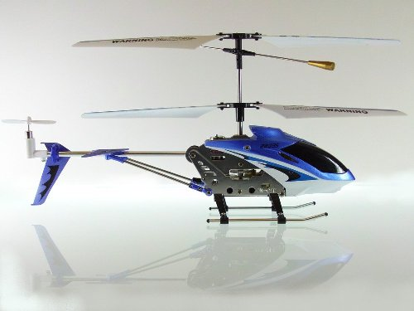
Voice Controlled Helicopter
Team Members: Jonathan Lam, Mian Zhu

Slide 2
Outline
Introduction
Software Implementation
IO Circuit Design
Photos of System
Demo Video
Live Demo

Slide 3
Introduction
Purpose:
Designing a system such that individuals could control a radio-controlled helicopter via voice commands.
Motivation:
Fun and Unique
Accomplishments:
Helicopter responds to certain voice commands
Helicopter moves Up and Down, as well as, Start and Land when such commands are spoken into the mic.

Slide 4
Software Design
Read values from both channels and store them in buffers.
Infomation of the sound and the system is displayed through LCD, LEDs and seven segment displays.
System is controlled by the slide switches.
Safety control is implemented using the pushbuttons.
The sound values are fed back into the CoDec, then outputted through the line out.

Slide 5
Manual Control
A slide switch to control the power to the system.
3 pushbuttons added as safety control.
One for raising the helicopter
One for lowering the helicopter
One for emergency shutdown, which cuts all power to everything in the system.

Slide 6
Display
LEDs
8 red LEDs for left channel
8 green LEDs for right channel
The LEDs shows the amplitude of the sound
LCD
Display prompt messages
Seven Segments
Display the current state of the program

Slide 7
Recognition Algorithm
We match the words based on 3 criteria
Length of the word
The maximum positive amplitude of the word
The maximum negative amplitude of the word
The matching range of the 3 criteria is obtained through testing.
If 2 out of the 3 criteria fall in the matching range, we decide we have a match.

Slide 8
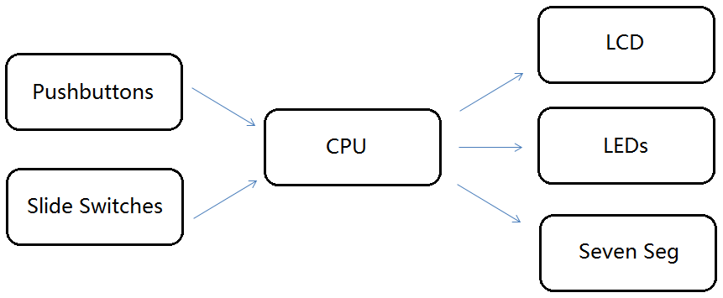
Software Diagram

Slide 9
Software Testing
Valid Commands | # Trials | # Success Match | Accuracy
UP | 10 | 9 | 90%
DOWN | 10 | 10 | 100%
Invalid Commands | # Trials | # False Match | Error Rate
LEFT | 10 | 0 | 0%
Right | 10 | 0 | 0%

Slide 10
Hardware Components
NpN Transistor (2N3691)
Microphone
Digital-to-Analog Converter (DAC0832LAN)
Helicopter
Op-Amp (LM324N)
Infrared Controller

Slide 11
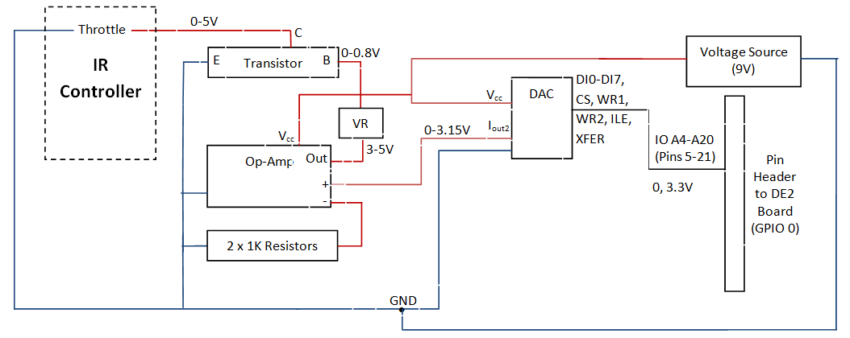
IO Circuit Schematic

Slide 12
IO Circuit Test Results
Mode of Operation | NpN Transistor Collector-Emitter Voltages (V)
Helicopter Motor ON | >3.5
Full Speed | 5.0
Helicopter Motor OFF | 0
32-bit Hex Address | NpN Transistor Collector-Emitter Voltages (V)
0x00013802 | 3.5
0x00013BD2 | 5.0
0x00011002 | 0

Slide 13
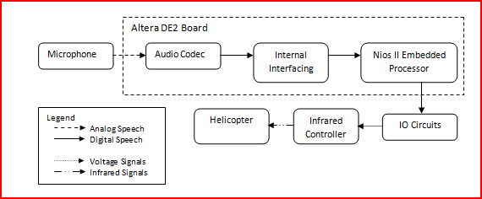
Block Diagram of Operation

Slide 14
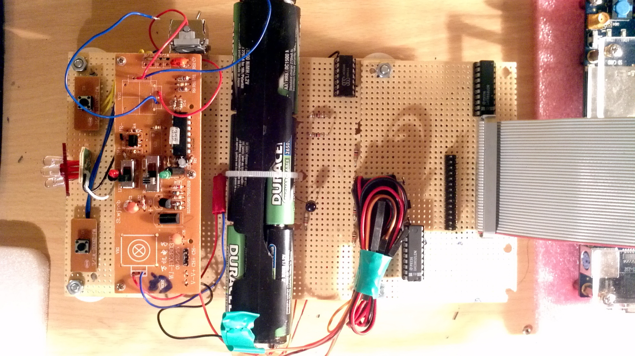
Photos of System

Slide 15
Photos of System Cont’d

Slide 16
Demo Video

Slide 17
Questions?

Slide 18
Thank You

