Slide 1
Mapping Robot
Group 3: Corey Jamison, Joel Keeling, Mark Langen

Slide 2
The Problem
  S
  L
  A
  M
  Simultaneous
  Localization
  And
  Mapping
  “Where am I?” (Localization)
  “What does the world look like?” (Mapping)

Slide 3
Why?
Fundamental problem for autonomous robots’ navigation
  Roomba, Google self-driving car
Alternatives:
  Dead reckoning unreliable
  GPS not accurate enough (4 meter RMS accuracy)
  External sensors – robot only works in prepared areas

Slide 4
The Project
Two-dimensional SLAM
Robot is manually controlled by a human
Simplify the problem by alternating between movement & scanning

Slide 5
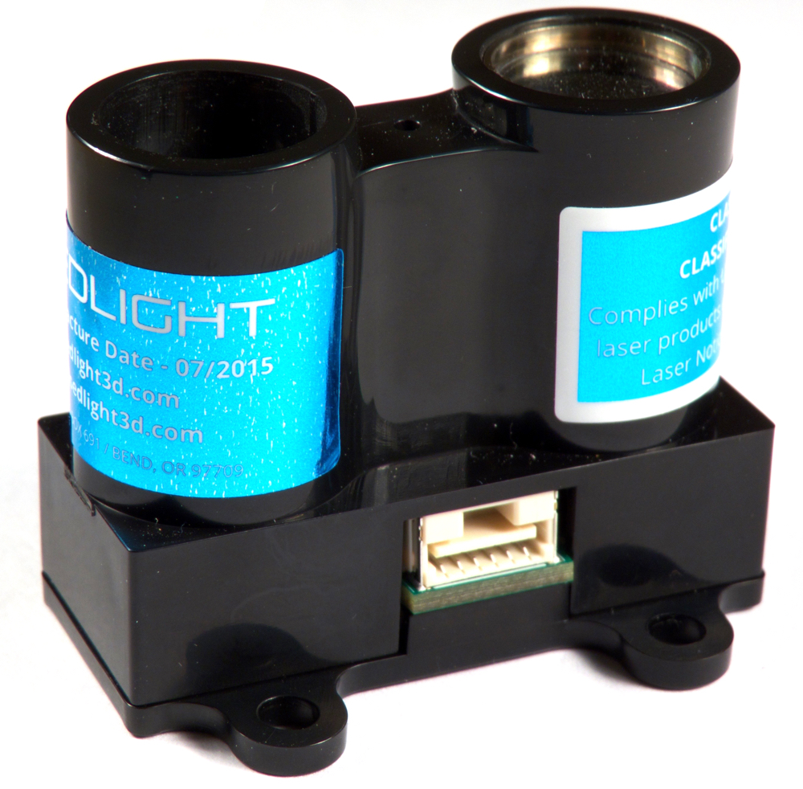
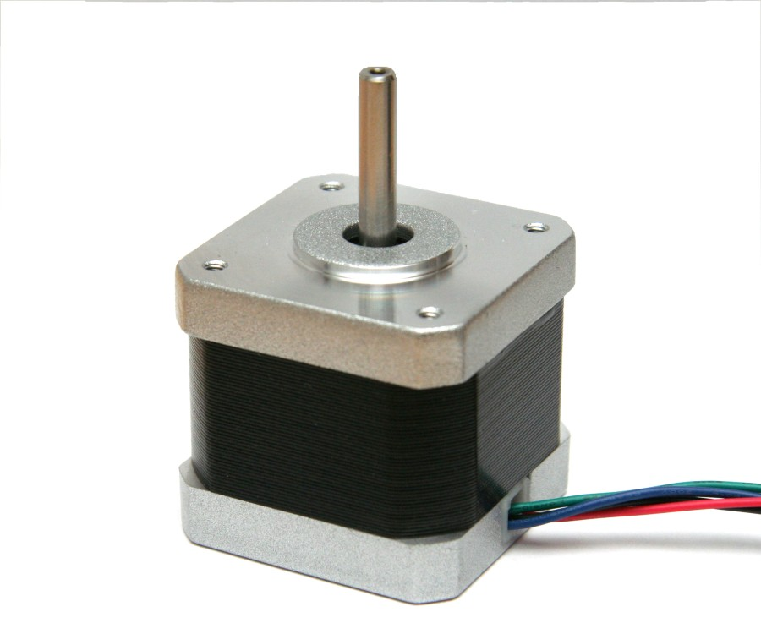
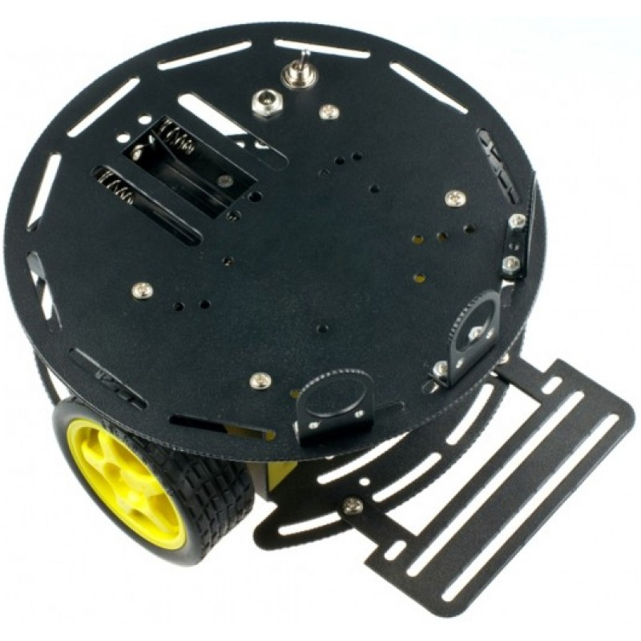
The Project
Use an accurate LIDAR sensor to measure distance
  PulsedLight’s LIDAR lite unit
Mount it on top of a rotating motor
  Stepper motor
Mount the rotating sensor on a mobile platform
  DFRobot Turtle 2WD platform

Slide 6

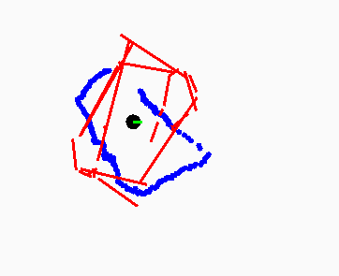
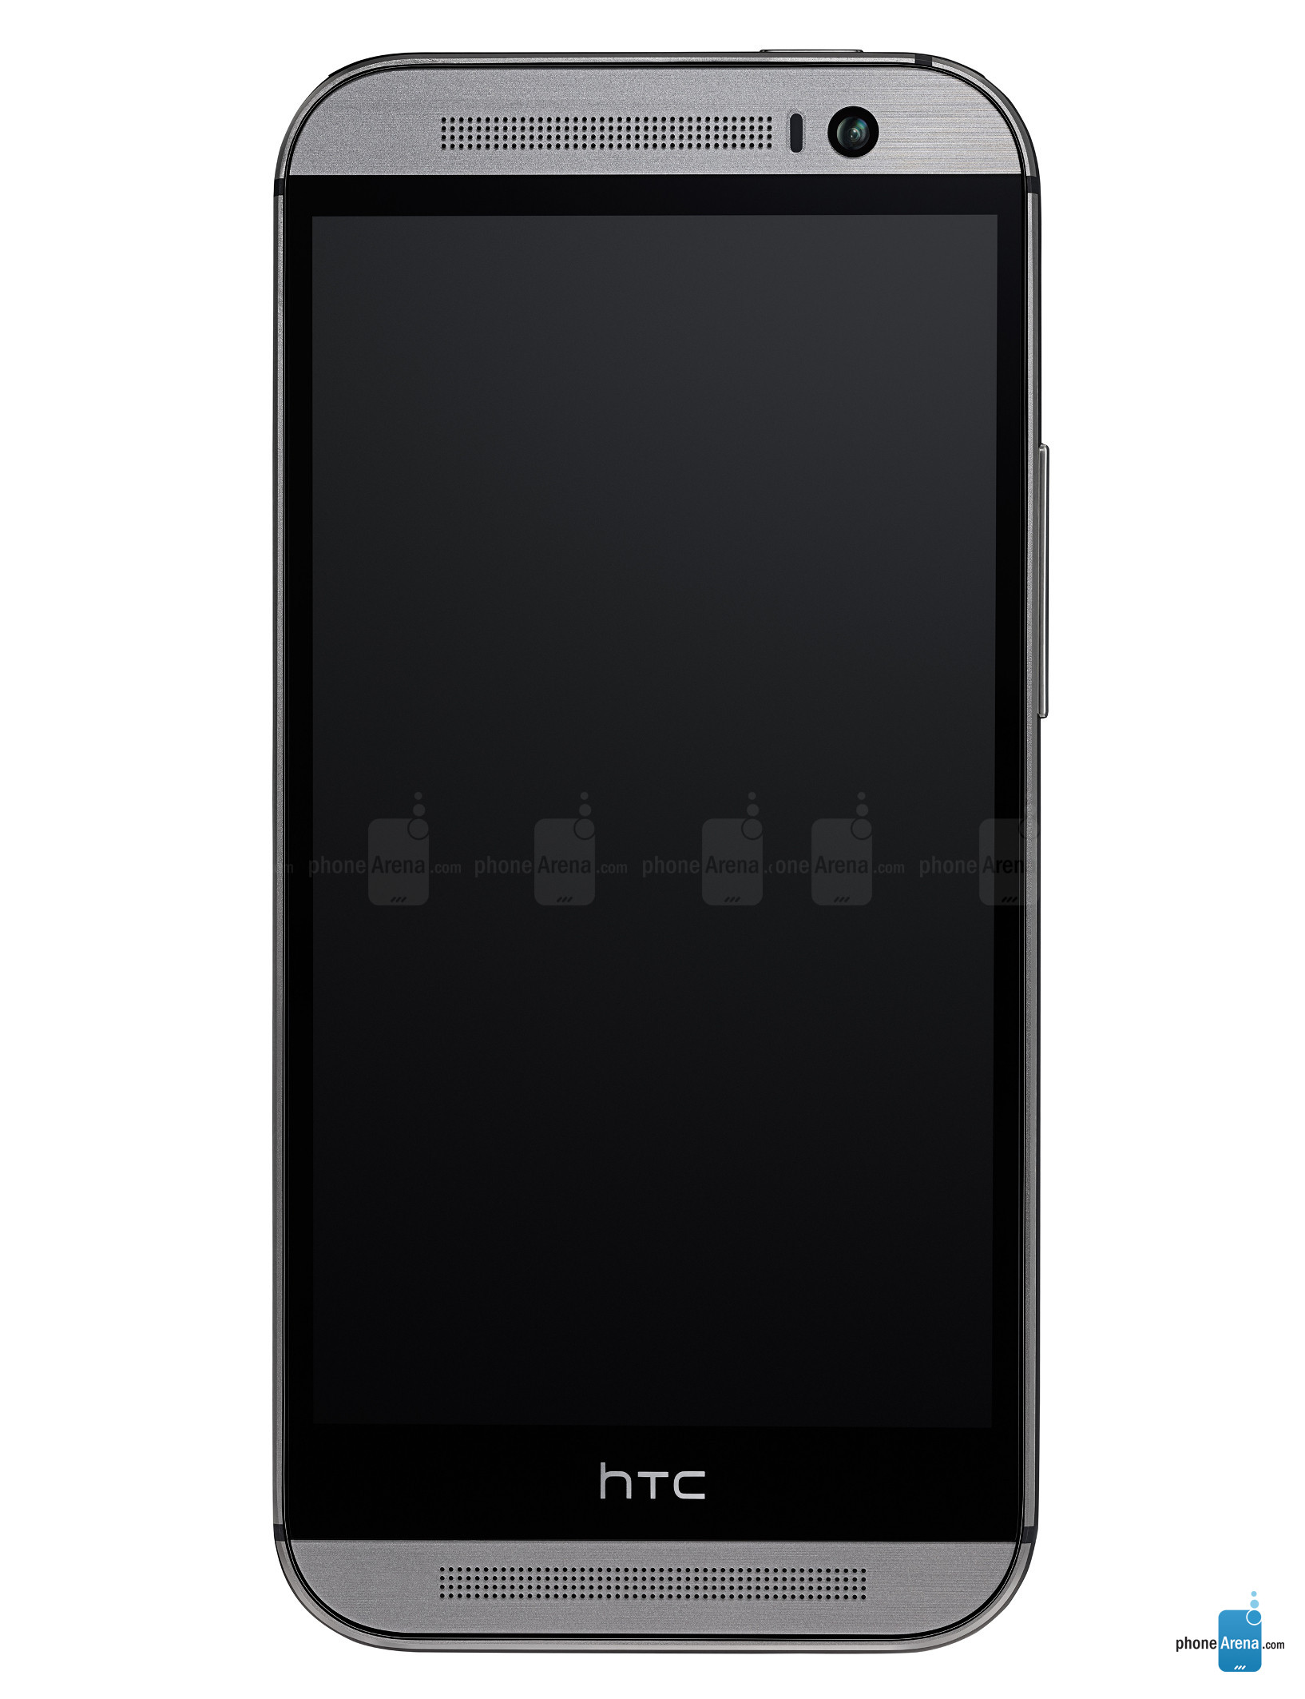
The Project
Two-way communication via Bluetooth with a mobile
application (data and commands)
Feed raw data into SLAM algorithm
Display resulting map and position on mobile application,
send user’s commands back to robot

Slide 7
Algorithm Design
After each movement, do a full 360° sweep
Convert array of distance/angle measurements into line segments
  Co-linear points found by linear regression
Compare new line segments to existing map to determine new position & orientation
After adjusting position & orientation, use array of measurements to refine the map

Slide 8
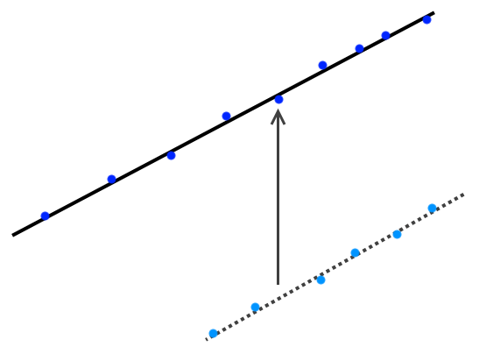
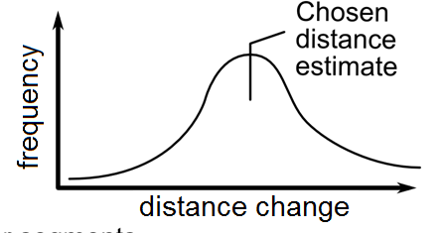
Algorithm Design
New Line
Histogram approach:
  Determine position deltas between new data and old map
  Collect position deltas into histogram
  Choose the peak of the histogram as the true delta
  Similar approach used for rotation
Direction of movement
Old Line

Slide 9
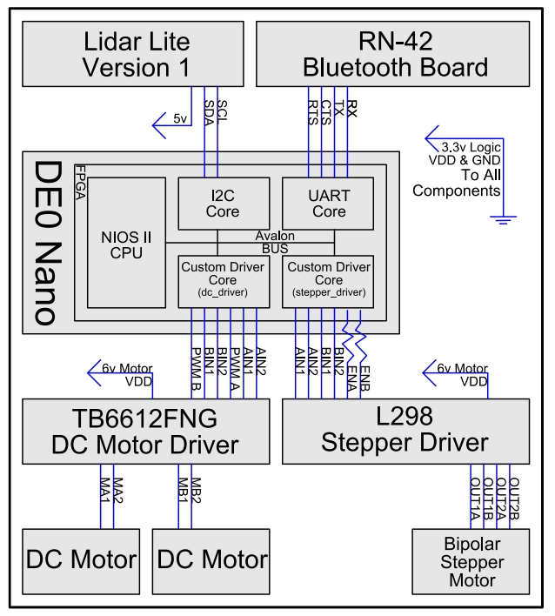
Hardware Design

Slide 10
Challenges Faced
Bluetooth packet loss
  Triple redundancy error checking with checksum
  Watchdog timer to stop motors
DC motor imbalances
  Doesn’t drive in straight lines
  Increased algorithm complexity
Found the last LIDAR lite sensor in existence

Slide 11
Postmortem
What would we do differently?
  More accurate simulations & more iteration time on algorithm
  Better parts – in particular DC motors and chassis ball bearing “wheel”
Future work / extensions:
  Autonomous mapping
  Optimize mapping algorithm to run on board
  Scan while moving

Slide 12
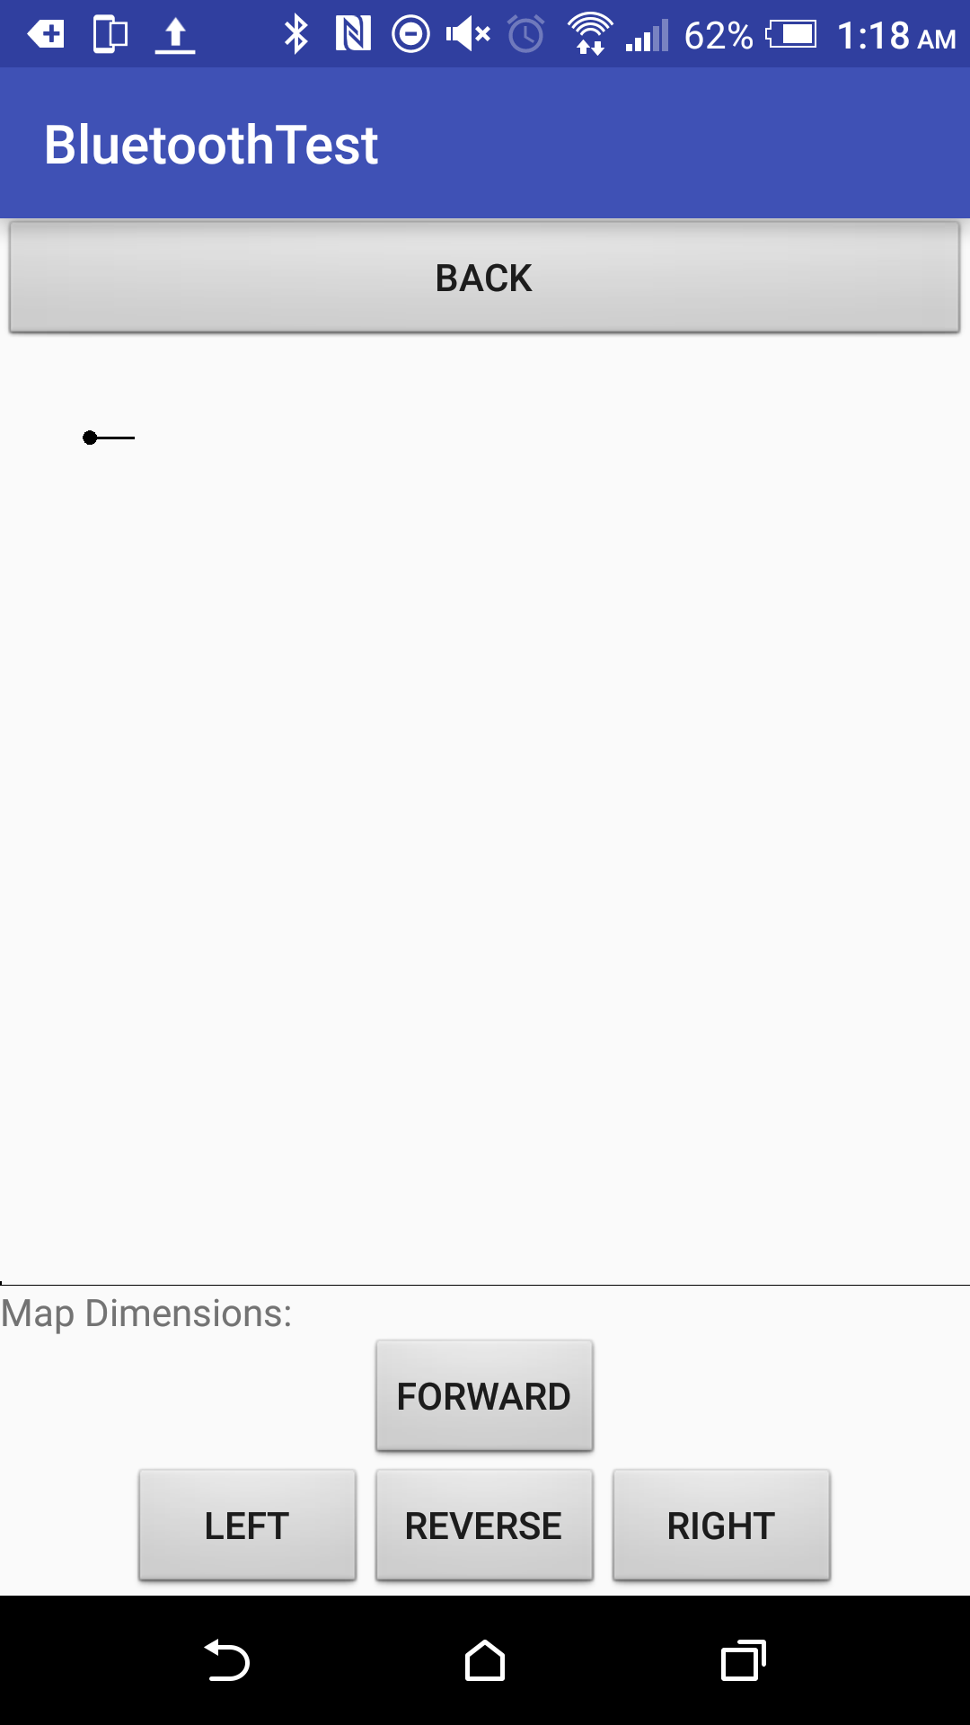
How to read the map
Black circle: current position
Black line: orientation

Slide 13
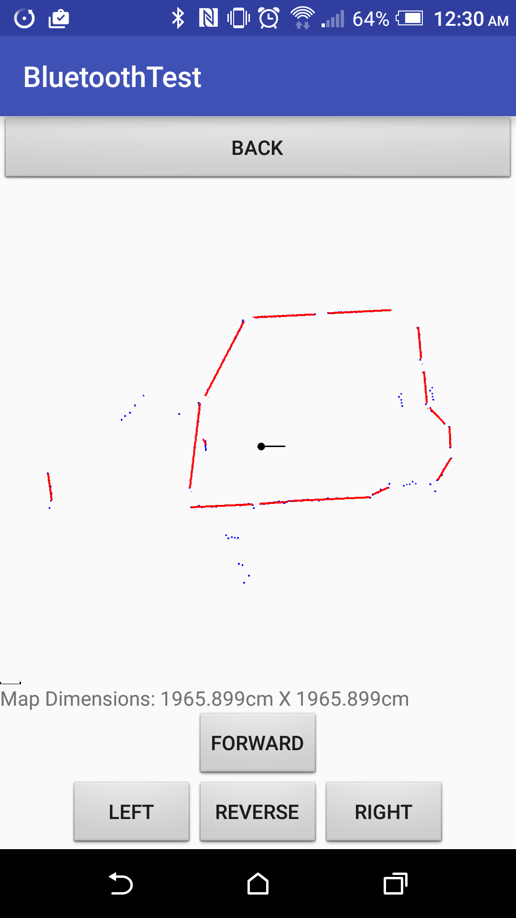
How to read the map
Blue dots: newest LIDAR measurement array
Red lines: new line segments from latest data

Slide 14
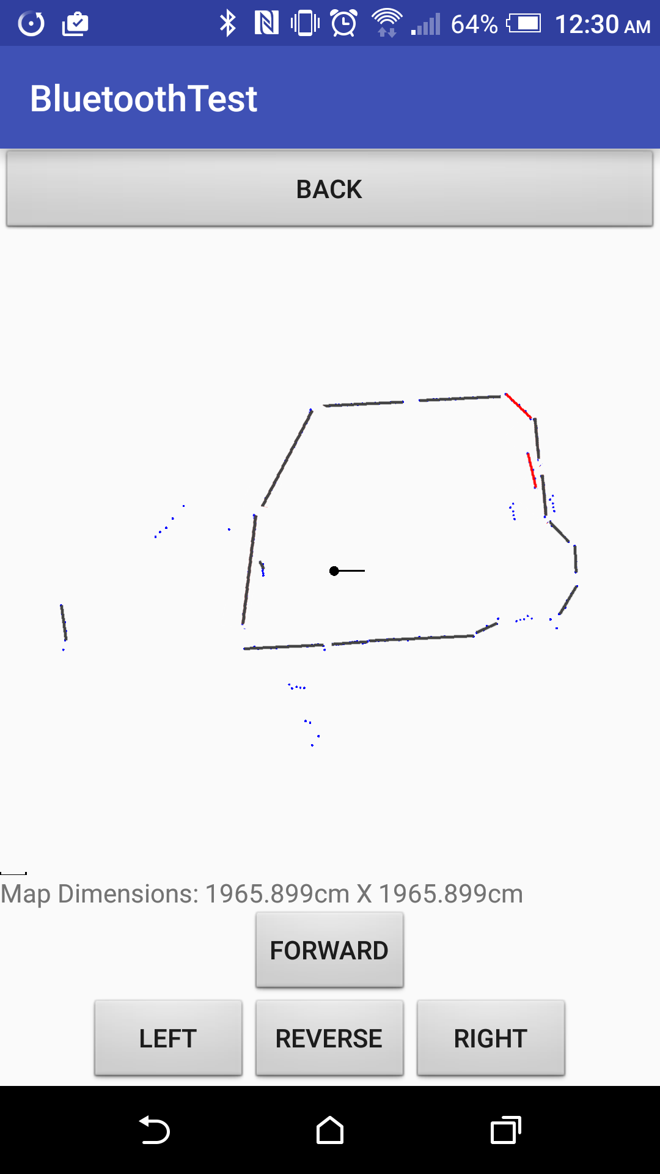
How to read the map
Grey lines: previously existing line segments

Slide 15
Demo & Questions

