Slide 1
Smart Robotic Quadruped:
Using Machine Learning to Optimize Parameters and Control
Brittany Lamorie, Cody Otto, Duncan Prance

Slide 2
General Information
Functionality:
Taught from computer - Milestones
Adjusts on the fly
Motivations:
Machine Learning
Building a robot
Inspiration:
Bipedal Simulations done in 2013
Proof of Concept:
https://youtu.be/M8YjvHYbZ9w?t=15
Notes:
Brittany

Slide 3
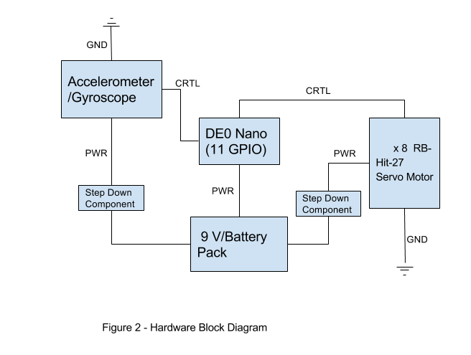
Hardware
Block
Diagram
Notes:
Duncan

Slide 4
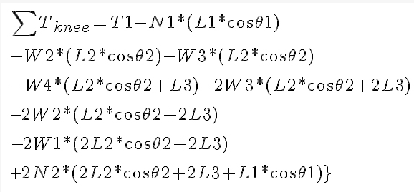
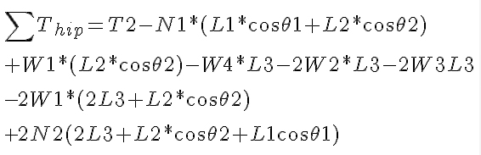
Hardware
Challenges:
Voltage
Power
Torque
Backup Plans:
Tethered
Higher torque/cost servos
Notes:
Dunca

Slide 5
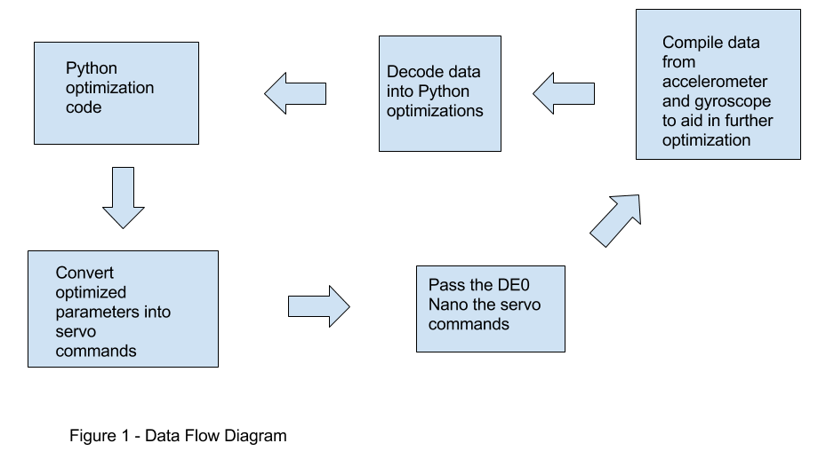
Data
Flow
Diagram
Notes:
Cody

Slide 6
Software
Challenges:
Need to run large amounts of simulations for learning
Making sure that our code is redundant and fault tolerant
Not killing the fragile hardware
Backup Plans:
Not using machine learning
Confining movement to a set boundary
Physical tethering for power requirements
Notes:
Cody

Slide 7
Test Plan
Hardware:
Test servo motion
Test single leg
Test weight with full setup
Software:
Test robot fully in simulation software (pre-recorded)
Using working robot to test simulation results for accuracy
Setup learning algorithm and test that the parameters fall inside set boundaries

Slide 8
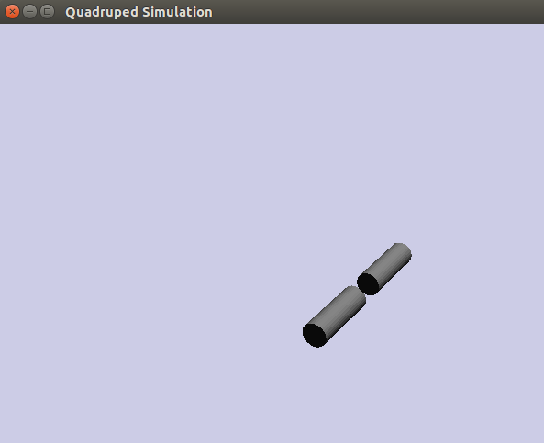
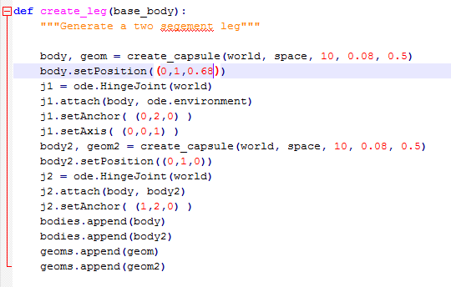
Code Example

Slide 9
Questions?

