Slide 1
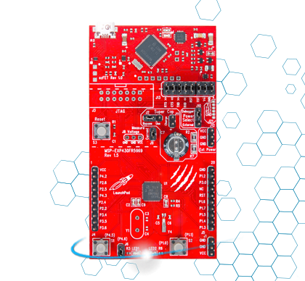
NFC Sensor System
Texas Instruments MSP-430FR5969
ECE 492 - Winter 2015
Notes:
Eric

Slide 2
Group Members
Mike Pappas
Sensor connections to MCU and NFC
Nigel Himmelreich
NFC connection to DE0 and Bluetooth
Eric Anderson
Bluetooth-Android communication, data logging and sensor display application
Notes:
Everyone reads their own

Slide 3
Functionality
Inspired by a disposable ‘Smart Bandage’
Transmits real time sensor data over NFC
Inductively powered via NFC
Transfers NFC data to Bluetooth for constant monitoring via DE0
Data logging/display on Android
Notes:
Eric

Slide 4
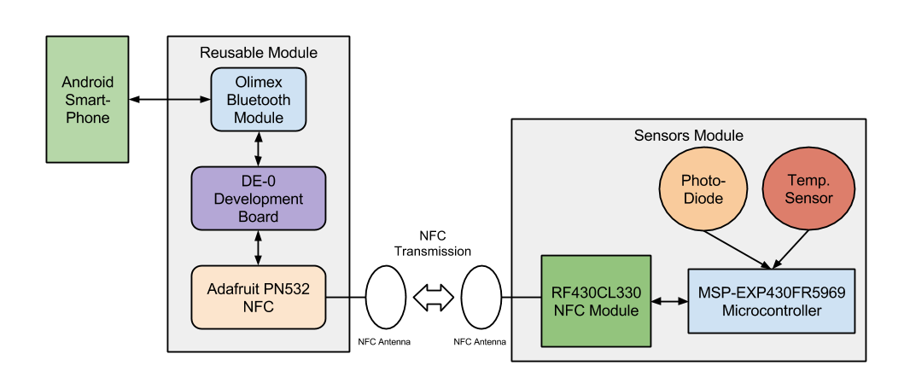
Design - Hardware
Notes:
Nigel

Slide 5
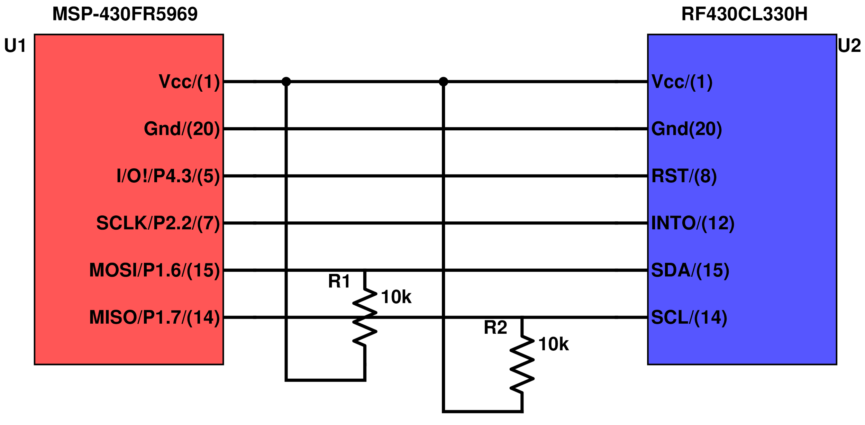
Design - Sensor Connections
As of Feb 8, 2015
Notes:
Mike

Slide 6
Design - Software
MCU
Gather sensor data
Package into NDEF (NFC data format) and send
DE0
Read from NFC and log
Send data over Bluetooth
Smartphone
Read current sensor data
Display current and past data graphically
Notes:
Eric

Slide 7
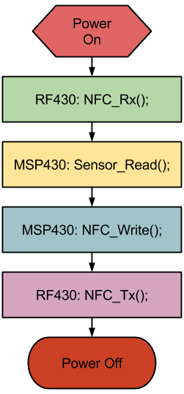
Design - Sensor Software Flow Diagram
Induction power does not allow for idling
Power on -> Initialize -> Perform Read -> Power Off (lose power)
Notes:
Mike

Slide 8
Design - Challenges
Induction power - difficult to operate on 100μA.
Challenging antenna implementation (≃1mm x 1.8mm Schottky diodes with < 0.4V forward voltage)
NFC to DE0 communication - minimal resources available
Notes:
Nigel

Slide 9
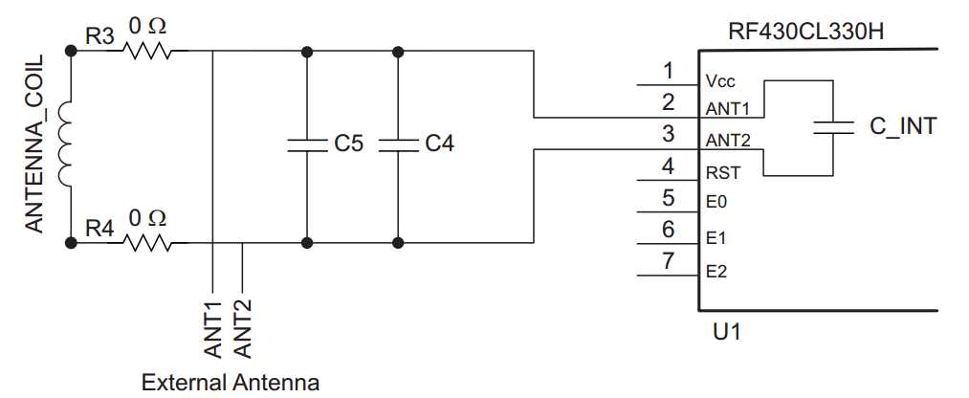
Design - Calculations
Antenna Design
where
a = (ri + ro)/2
b = ro – ri
ri = Inner radius of the spiral
ro = Outer radius of the spiral
N = number of turns
Antenna Inductance (f_{res}~ 13.7MHz)
Min | Typical | Max
3.57 µH (@ Cint = 38.5 pF) | 3.85 µH (@ Cint = 35 pF) | 4.28 µH (@ Cint = 31.5 pF)
Notes:
Mike

Slide 10
Design - Components
Thermal sensor and light diode
TI MSP430FR5969 MCU
TI RF430CL330H NFC Module
PN532 NFC Shield
DE0 Nano
MOD-BT Bluetooth Module
Android Device
Notes:
Eric

Slide 11
Code Example - RF430 Read
unsigned int Read_Register(unsigned int reg_addr)
{
TxAddr[0] = reg_addr >> 8; // MSB of address
TxAddr[1] = reg_addr & 0xFF; // LSB of address
UCB0CTLW1 = UCASTP_1; // USCI Automatic stop condition
UCB0TBCNT = 0x0002; // UFCI Byte Counter threshold
UCB0CTL1 &= ~UCSWRST; // Software reset
UCB0CTL1 |= UCTXSTT + UCTR; // Start i2c write operation
while(!(UCB0IFG & UCTXIFG0)); // Wait for TX
UCB0TXBUF = TxAddr[0]; // Assign Buffer To MSB of Address
while(!(UCB0IFG & UCTXIFG0)); // Wait for TX
UCB0TXBUF = TxAddr[1]; // Assign Buffer to LSB of Address
while(!(UCB0IFG & UCBCNTIFG)); // Wait for biyte counter of interupt
UCB0CTL1 &= ~UCTR; // I2C read operation
UCB0CTL1 |= UCTXSTT; // Repeated start
while(!(UCB0IFG & UCRXIFG0)); // Wait for RX
RxData[0] = UCB0RXBUF; // Assign MSB
UCB0CTLW0 |= UCTXSTP; // Send stop after next RX
while(!(UCB0IFG & UCRXIFG0)); // Wait for RX
RxData[1] = UCB0RXBUF; // Assign LSB
while (!(UCB0IFG & UCSTPIFG)); // Ensure stop condition got sent
UCB0CTL1 |= UCSWRST; // Software Reset
return RxData[1] << 8 | RxData[0];
}
Notes:
Mike

Slide 12
Test Plans
Unit Testing
Test sensor data being read to MCU
Test NFC data is being sent from MCU to DE0
Test Bluetooth data from DE0 to smartphone
Verify logging ability of DE0 and smartphone
Test smartphone app and functionality
Integration Testing
Test overval data from sensors to smartphone
Verify correct data logged
Notes:
Nigel

Slide 13
Optional features
Inductively power the NFC, MCU, & sensors via power from the NFC antenna when communicating with the receiving board
Add additional sensors
Join the NFC, MCU, & sensors all on one single circuit board with integrated antenna
Notes:
Eric

