Slide 1
Multi-touch Table
Group 4
Alix Krahn
Denis Lachance
Adam Thomsen
Notes:
Introduce group members and any parts of project each person has led
Adam – physical set-up done and a bit of hardware
Alix – vhdl and physical set-up
Denis – software drivers and image processing (camera)

Slide 2
What does it do?
Multi-touch interface to control software and applications
Intuitive, natural gestures and natural interface to use computer
Useful for collaboration and learning, particularly with children and people who are disabled
IT’S COOL, YO

Slide 3
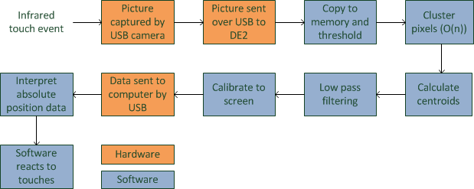
How does it do it?

Slide 4
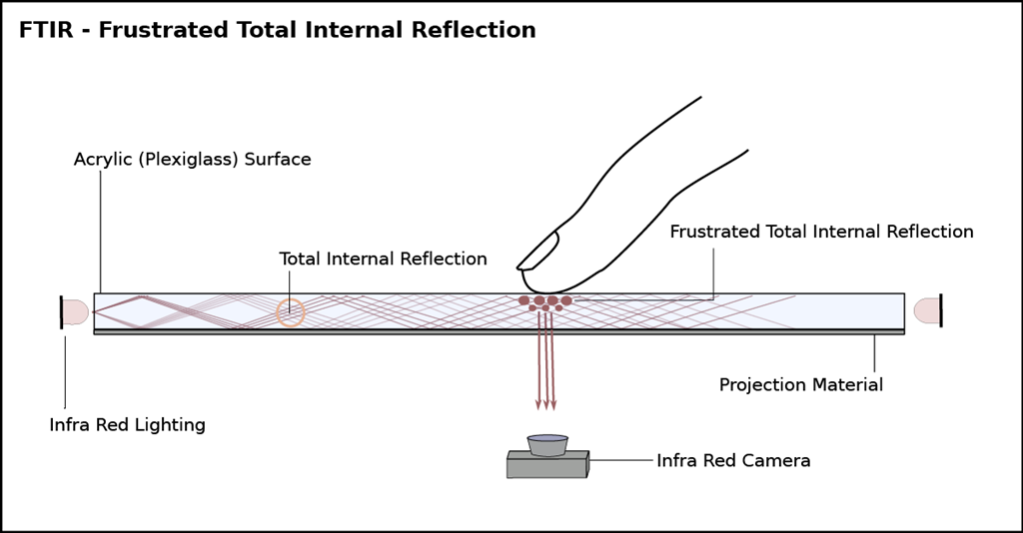
Infrared Touch Event

Slide 5
How does it do it?

Slide 6
Picture Captured by USB Camera

Slide 7
How does it do it?

Slide 8
Picture sent over USB to DE2

Slide 9
Picture sent over USB to DE2
Webcam to Board Data Rate
Data rate (measured on computer) ~0.7MB/s
Below the data rate max for the USB (1.5MB/s)

Slide 10
How does it do it?

Slide 11
Can it do it?
Copy and threshold | 1 comparison per pixel
Cluster pixels | 5 comparisons per pixel for first pass 2 comparisons per pixel for second pass
Calculate centroids | 2 divisions and 0.25%*pixels additions for each of up to 10 clusters
Low-pass filter | Two multiplication and two additions for each of 10 points
Calibrate | Two multiplications for each of 10 points
Total: 19,525,498 (comparison, addition, subtraction) calc/s
1,440 (multiplications, divisions)/s

Slide 12
How does it do it?

Slide 13
Data sent to computer by USB
Board to Computer Data Rate
For each frame sent by the webcam, data for ten touch points is sent to the computer.
Each touch point contains three integers: an x location, a y location, and the size of the touch point. Therefore, the data rate is:
24Hz * (3*10*4Bytes + 4Byte header) = 2976B/s

Slide 14
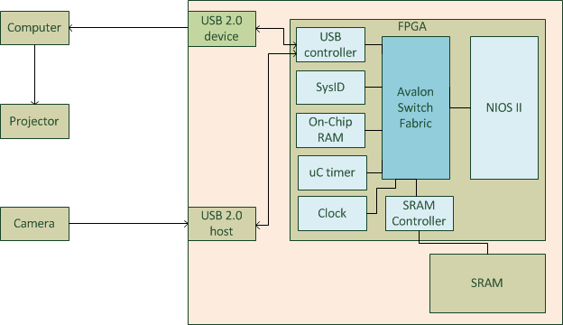
Hardware Diagram

Slide 15
Test Plan
Software
Unit tests
Integration tests
Test image frames and real image frames to test image processing
Testing FIFO buffer overrun and underrun
Maximum performance using fake data sources
Memory leaks
Webcam Infrared Tracking
Ability to visually track touches
Hardware controllers
Testbench
Basic functionality
Integration and functional testing
Testing strict functionality, upper and lower bounds
Performance and calibration
Response time
Pressure of touch required
Any noise
Recognition of gestures
Resolution
Calibration: spatial and pressure required

Slide 16
What’s special?
Unique peripherals
Using common I/O – USB
Debug and calibration modes
Digital Signal Processing

