Slide 1
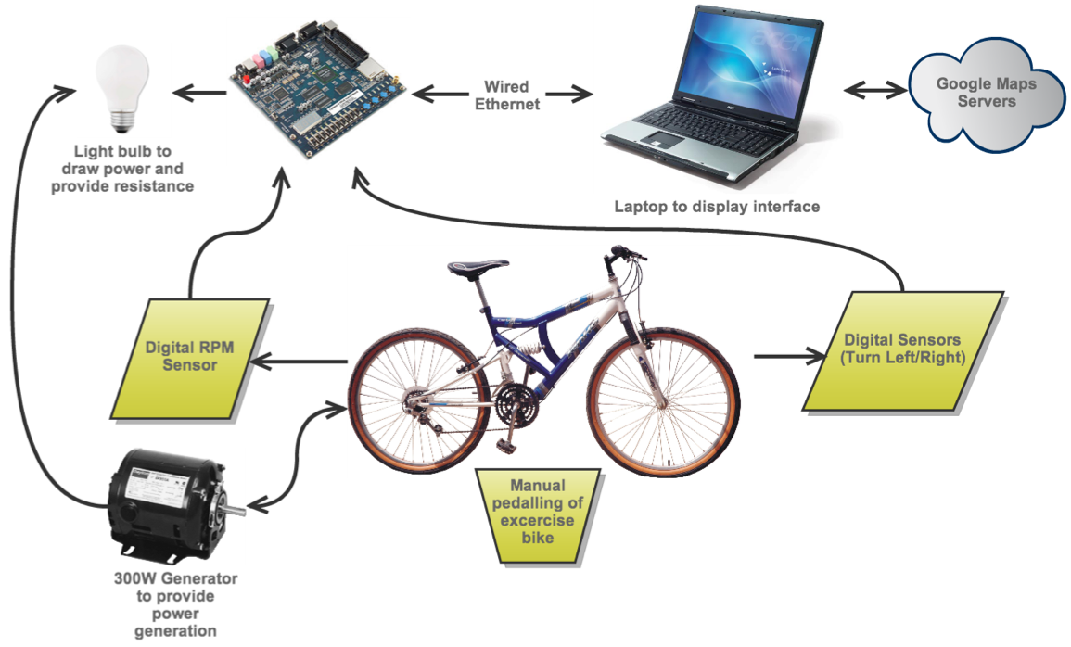
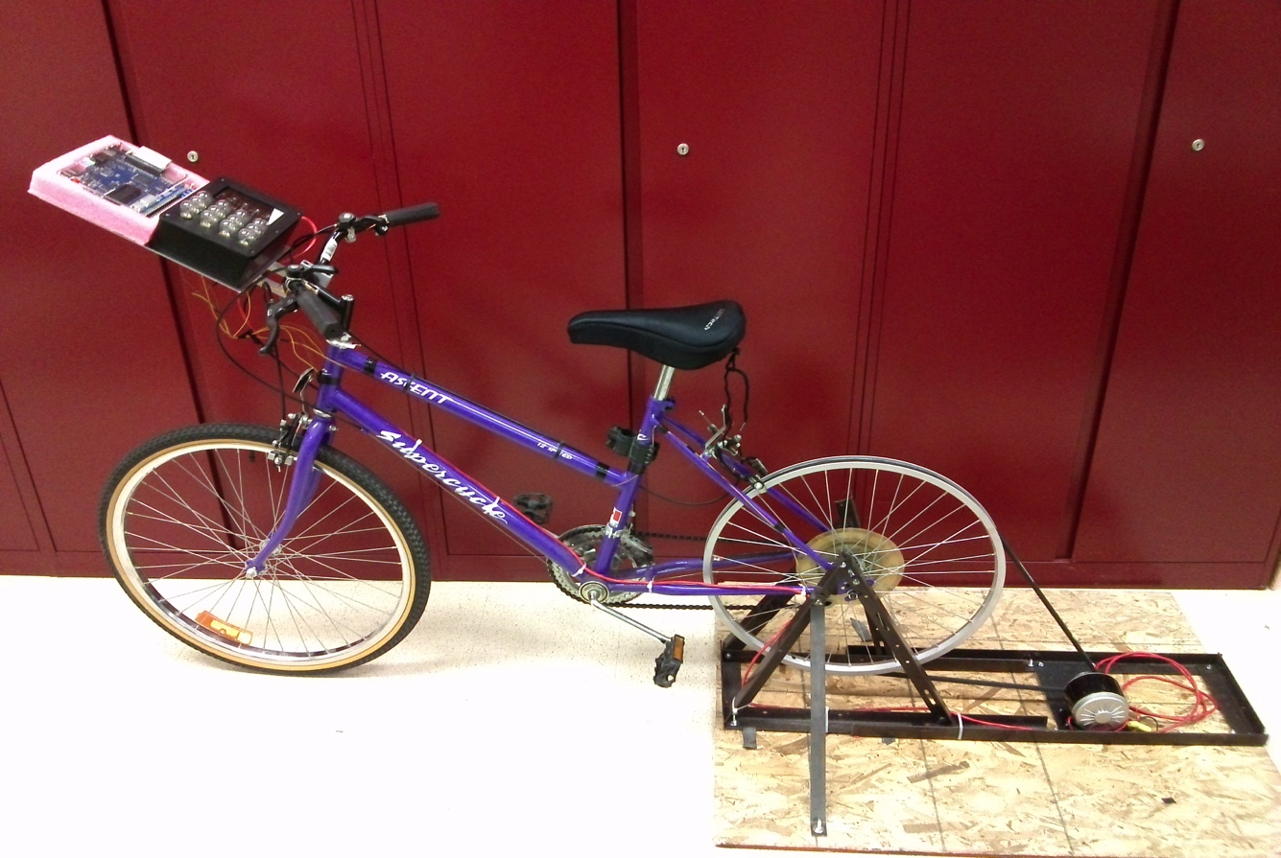
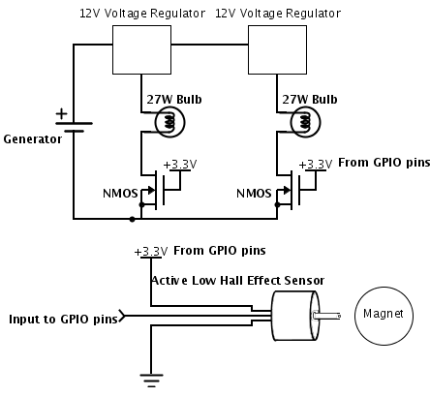
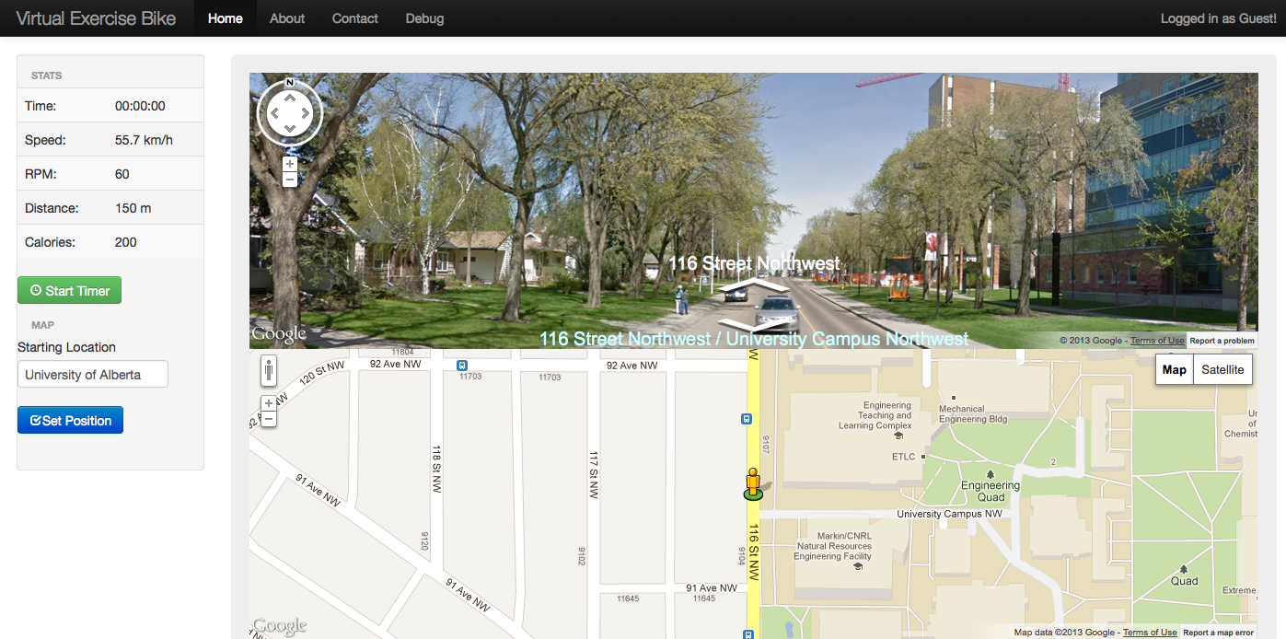
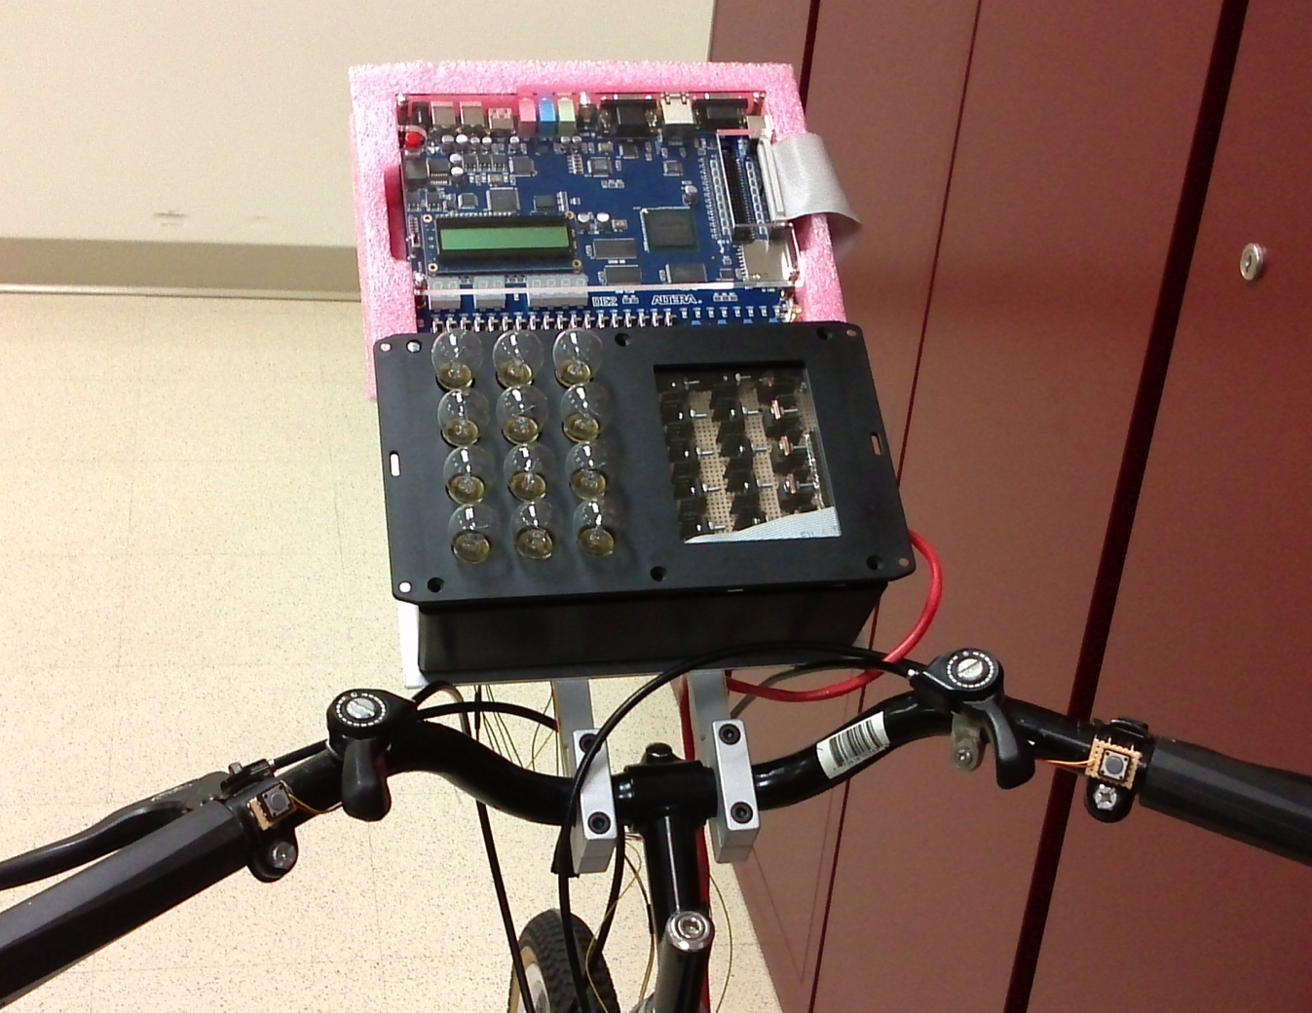
ECE 492 - Computer Engineering Design Project
Virtual Exercise Bike
TitleRobert Miller, Adam Eliason | 2013
Introduction
The interactive virtual exercise bike allows users to enjoy a simulated bicycle tour in Google Street View while exercising. Users can choose from any starting location available in Google Street View and choose their own route as they pedal along. Resistance for the bicycle is provided by a 300W electric generator powering a series of 27W bulbs for varying resistance. The users workout statistics such as distance and time are calculated and displayed in real time via a web server application running on the Altera DE2 development board.
Dynamic Resistance
By controlling a circuit of 27W bulbs, the bicycle is able to provide 12 levels of resistance. As more light bulbs are turned on, resistance seen by the generator increases, making the bicycle harder to pedal. Resistance can be controlled by the user manually via buttons mounted on the handlebars, or automatically based on the elevation data returned from Google Street View. The light bulbs are controlled by NMOS transistors connected to the GPIO pins on the Altera DE2 development board. Since the generator can supply over 35VDC, the voltage is regulated down to 12V by an array of 12V regulators.
Webserver
The Altera DE2 development board is running a webserver to provide the user interface for the exercise bike. The page displays statistics such as speed, RPM, distance, and calories burned. Using the Google Maps JavaScript API V3, the webserver is able to render both maps and street view images to simulate a real riding experience. The frames that contain the street view and map advance through the route in response to rpm feedback provided by the digital Hall effect sensor mounted on the rear wheel. Hall effect sensors are also mounted to the front fork to detect when the user has turned the handlebars. This data is used to update the heading in Google Street View, allowing the user to turn left or right.
Department of Electrical & Computer Engineering
Notes:
For colour ideas, University Visual Identity Guidelines can be found here: http://www.toolkit.ualberta.ca/VisualIdentityGuidelines.aspx

