Slide 1
G14 Autonomous Rover
Wall Avoiding Robot
Mikael Rouhiainen
Peter Hu

Slide 2
Why we decided on a robot?
- Building a robot requires a general knowledge of software, electrical/hardware, and mechanics; good challenge
- We both have a great interest in robotics
- Builds on experience that could be beneficial in a digital world

Slide 3
Functionality
- 3 IR sensors to aid in navigation
- Digital compass for rover direction awareness
- After maze completion, the robot uses its memory to return to the beginning of the maze
- Option for manual control, robot controlled via keyboard and WiFi connection

Slide 4
Maze types

Slide 5
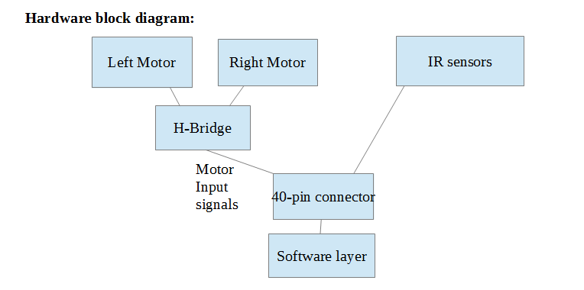
Hardware Block diagram
w/ Encoder
w/Encoder
Compass
Module
WiFi
Module

Slide 6
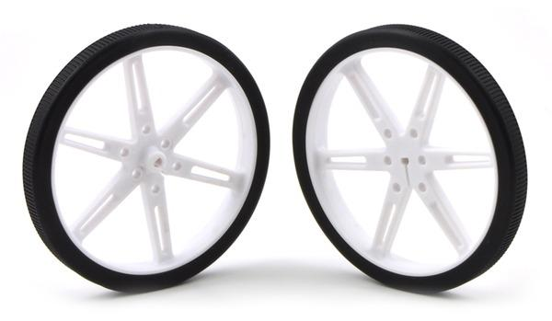
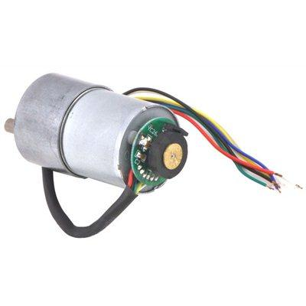
Motor Requirements
Estimated mass: m = (2.27 kg)/2 motors
Desired acceleration: a = 0.5 m/s^2
Wheel radius = 0.04m
μk ~ 0.1
T – μk*N= m*a
(T = torque force, N = normal force)
T = 1.8N --> t = 1.8N*(0.04m) = 10.2 oz-in Rated Torque
"Stall torque" should be > 2*Rated to prevent overheating and stalling on startup
Our motor has stall torque @12V: 250 oz-in, 80rpm
@6V: 125 oz-in, 40rpm

Slide 7
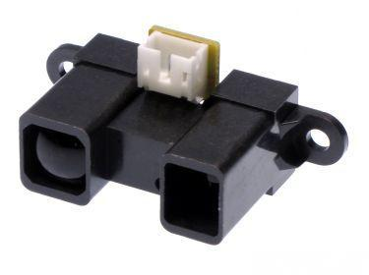
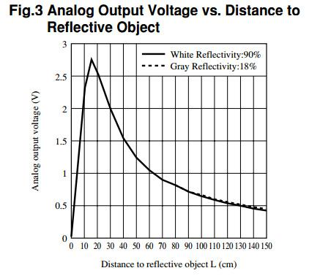
Infrared Sensors
Sharp GP2Y0A02YK0F
Effective Range: 20-150cm

Slide 8
FPGA Components
Cyclone IV FPGA
Processor
GPIO - IR Sensors
clock
Flash
DMA
UART - WiFi module
I2C - Compass module

Slide 9
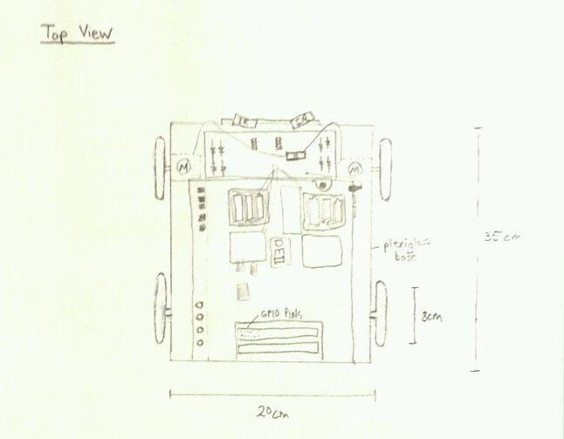
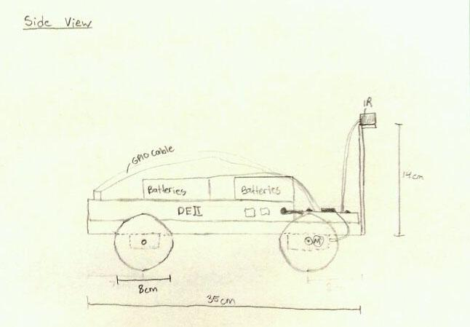
Diagram

Slide 10
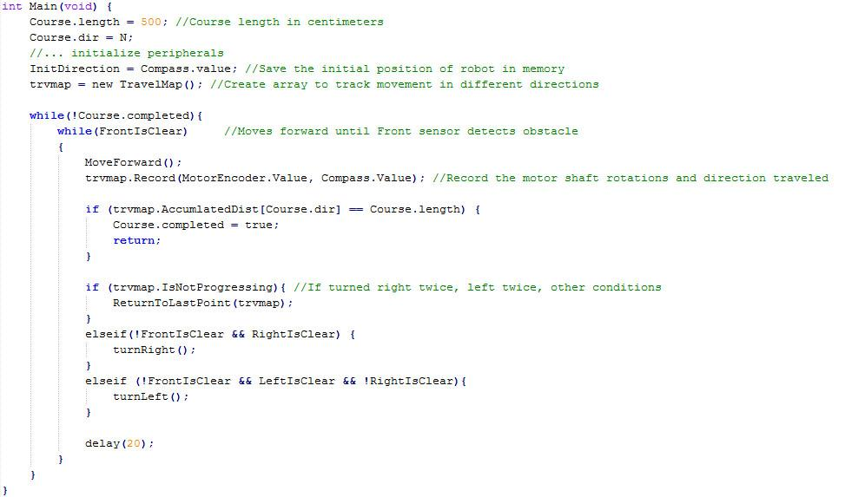
Operation Code

Slide 11
Test Plan
-Iterative testing of all peripherals individually
-Work up to integration in full system

Slide 12
Major Challenges & Optional Features
Versatile navigation
Path Memory Optimization

