Slide 1
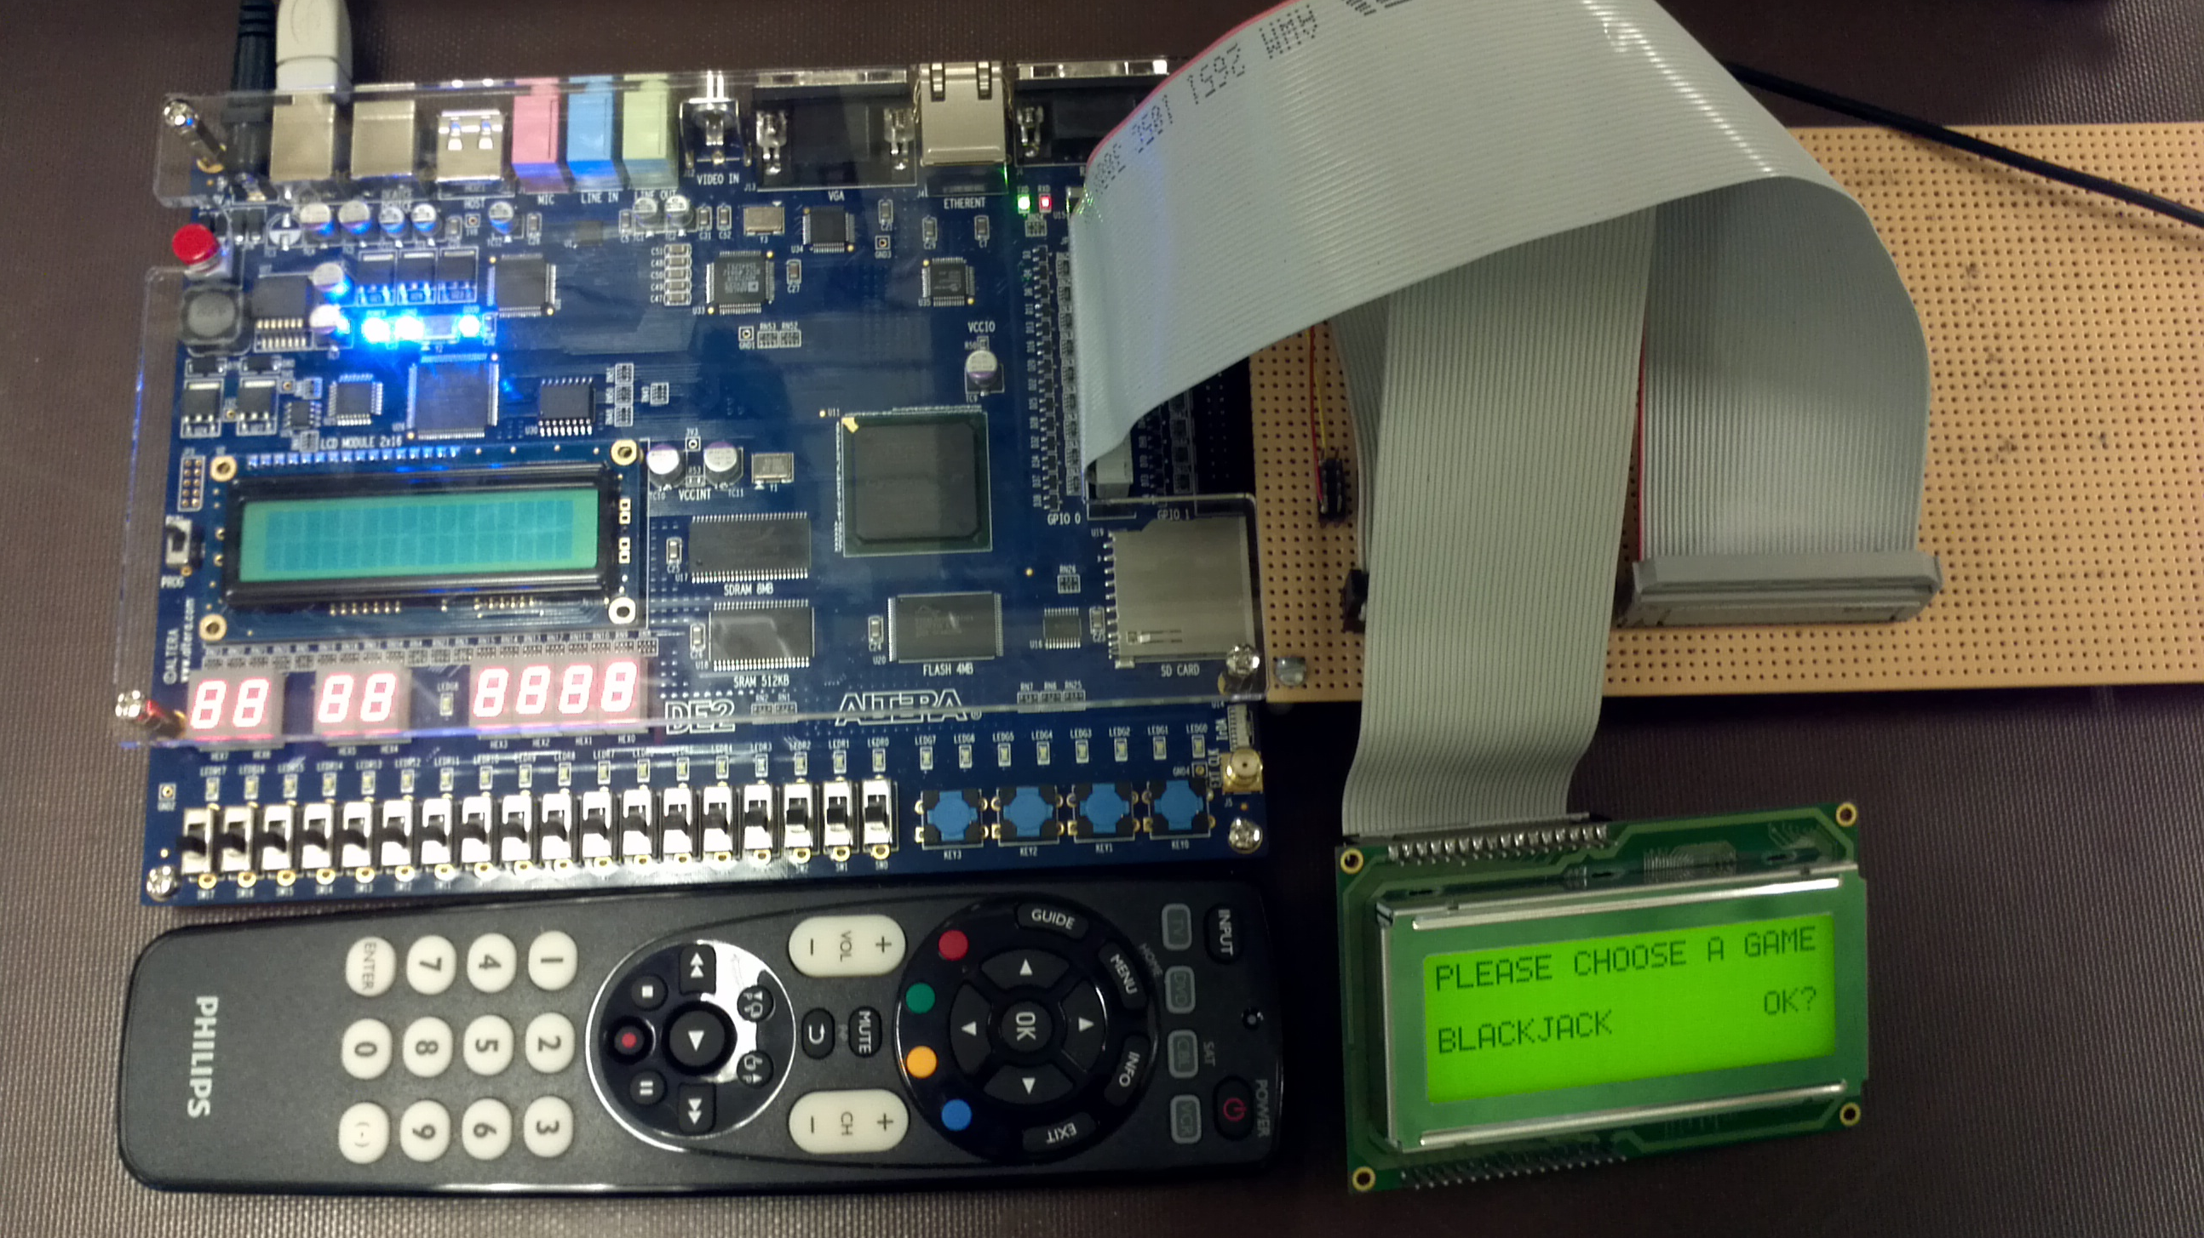
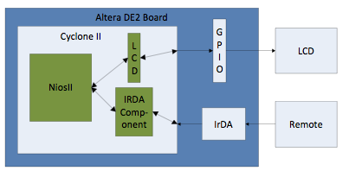
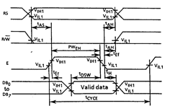
CMPE 450/490 Capstone Design Project
3-in-1 Game with Remote
Design Group Members | Year
Michael Shoniker and Timothy Bauman | 2012
Overview
Implement a 3-in-1 game using the Altera DE2 board that is displayed to an external LCD and receives user input from a remote. To accomplish this, custom components were created on an FPGA to decode IR signals and interface the LCD. Using the NIOSII processor in a µC OS-II environment the software is able to interact with the hardware components.
Fig. 2 Line art (or another vector format) is very effective for figures.
System Overview
Components
Altera DE2 board – Provides an on-board Cyclone II FPGA and 112 kHz IrDA receiver
Seiko L2034 LCD – 4x20 Character LCD with back light
Philips SRP4004 – 4-in-1 Universal Remote
Fig. 1 NEC Standard IR Protocol Signal
3-in-1 Game with Remote
Design
The IR signal from the remote conforms to the NEC standard protocol, as described in fig. 1. This protocol sends a message signal at 888 Hz with a carrier frequency of 38 kHz. This means each pulse in fig. 1 is actually made up of many smaller pulses.
A two-stage process is used to decode this IR signal. The first stage buffers the high frequency pulses to achieve the smooth message signal. The second stage interprets the serial signal and converts it to a 32-bit parallel output that can be read by the NIOSII system.
Software
We used µC OS-II to implement the functionality of our system. There are two main software components: the remote driver and the game driver.
The remote driver consists of a main task that polls the remote and sends the remote signals to the client. The remote module also catches special signals (exit and pause) and handles them with client-supplied functions.
The game driver consists of a main task that hosts the many game tasks. This driver prompts the user to choose a game and then starts the game task.
Operation
Games are selected from a menu that is displayed on the external LCD. The three available games are Blackjack, Skill Tester and Repeat After Me. The user has the ability to exit a game at anytime and return to the main menu.
The board receives and decodes every button push, if the button push is determined to be valid the appropriate action will be preformed.
Fig. 2 LCD Write Operation Timing
The external LCD is connected to the DE2 via GPIO pins. The NIOSII system is able to send 11-bit commands over these pins. These correspond to 3 control bits (RS, E and R/W) and 8 data bits (D0-D7). To ensure correct operation, strict timing requirements for these bits must be met. See fig. 2.
Department of Electrical & Computer Engineering

